Slide 1

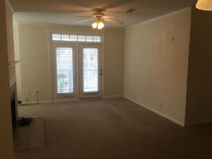
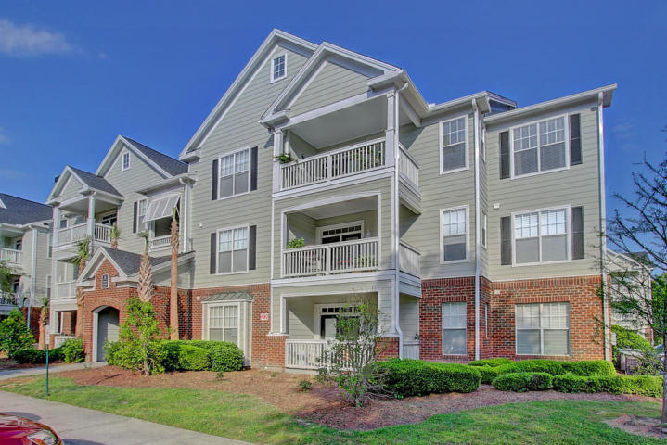
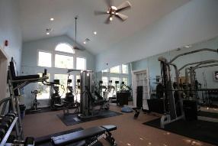
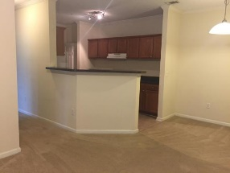
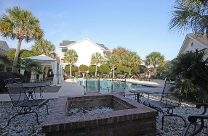
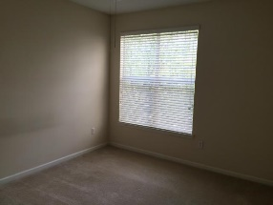
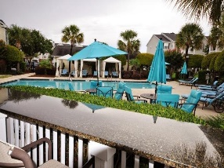
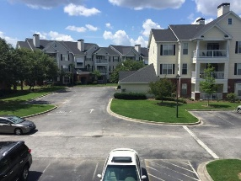
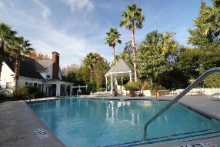
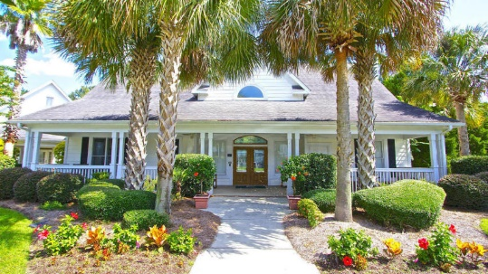
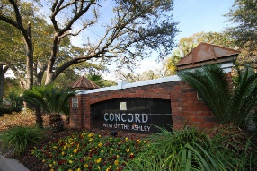
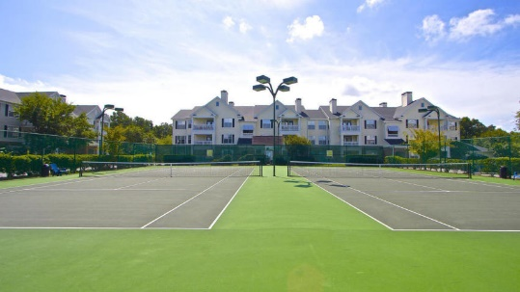

Concord West of The Ashley Under $180,000
45 Sycamore Avenue #527
Charleston, SC 29407 - MLS# 16009114 - $175,000
PRICE REDUCED!
Best priced 2BR/2BA condo at the Concord!
Convenient to downtown, the airport and beaches.
Gated community amenities include Fitness center, 2 pools, 2 tennis courts, hot tub, outdoor tv's, barbeque grills, picnic areas, office center.
Andrew Tackitt
843-437-8726 cell
andrew@radekopf.com
1205 Two Island Court, Suite 201 | Mount Pleasant, SC 29466
Phone: (843) 579.2217 | Fax: (843) 971-0281

