Slide 1
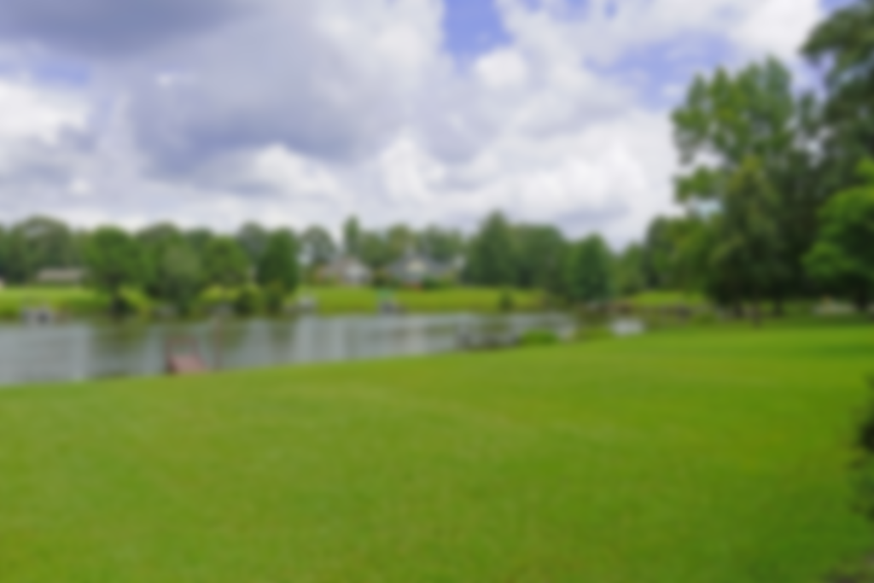
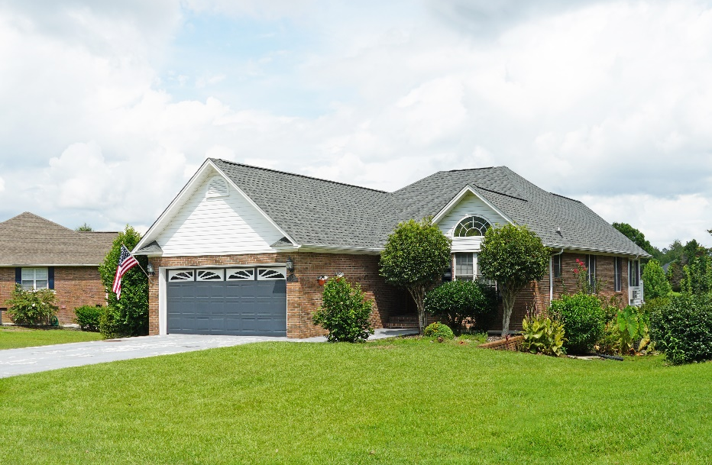
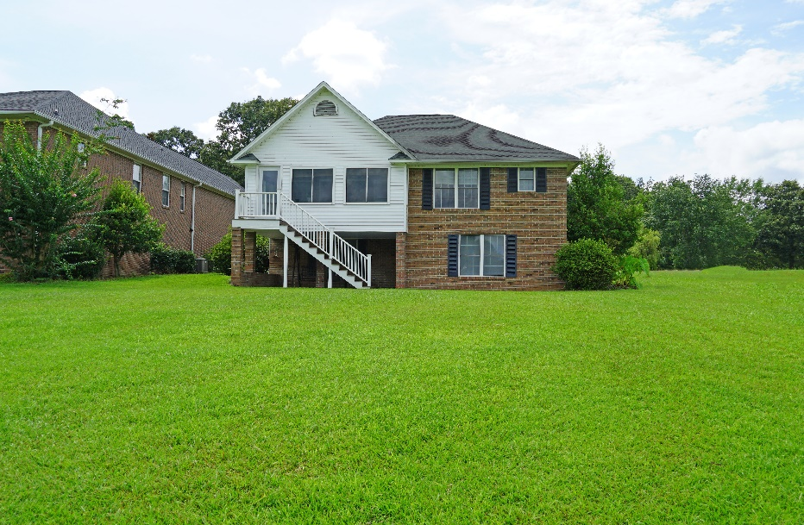
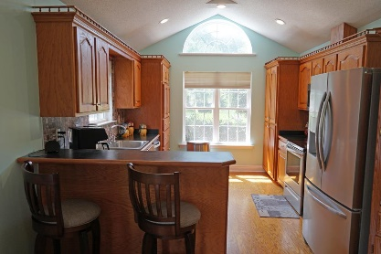
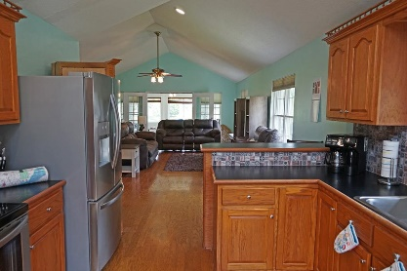
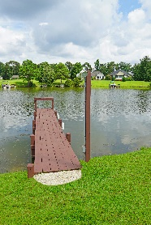
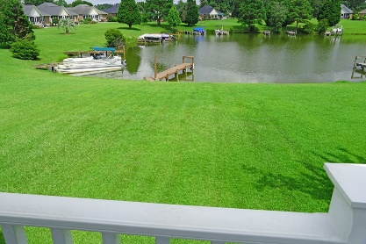
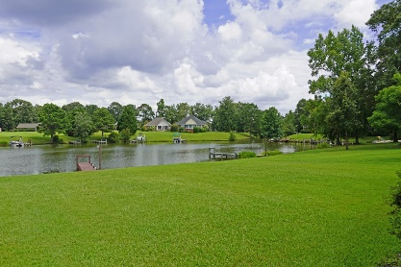

Just Listed On Lake Marion
45 N Lake Cir
Manning, SC 29102 ~ MLS# 148398 ~ $324,000
WATERFRONT inside Wyboo Plantation - 3 bedroom / 2 bath. Boating access to Lake Marion from shared dock. New mini split hvac on sun porch, hardwood floors, new master walk in custom shower, new master custom ordered vanity, new painted, heated/cooled walk out bonus room, new all appliances. Wyboo Plantation is a gated Lake Front Community on Lake Marion which is the gate way to Atlantic Ocean. Enjoy the relaxed Lake Life fishing, swimming, boating, golf cart riding and much more. 2 very nice golf courses just steps away (1 inside the gate and 1 across the road).
Make your dream of living on the Lake come true!
Lake Homes Realty, LLC
Elloree, SC 29047
www.SCLakeLife.com
Kristie Anderson
(803) 387-9459
kristie@sclakelife.com

