Slide 1
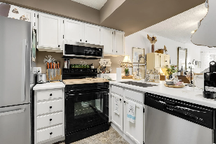
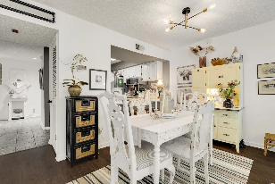
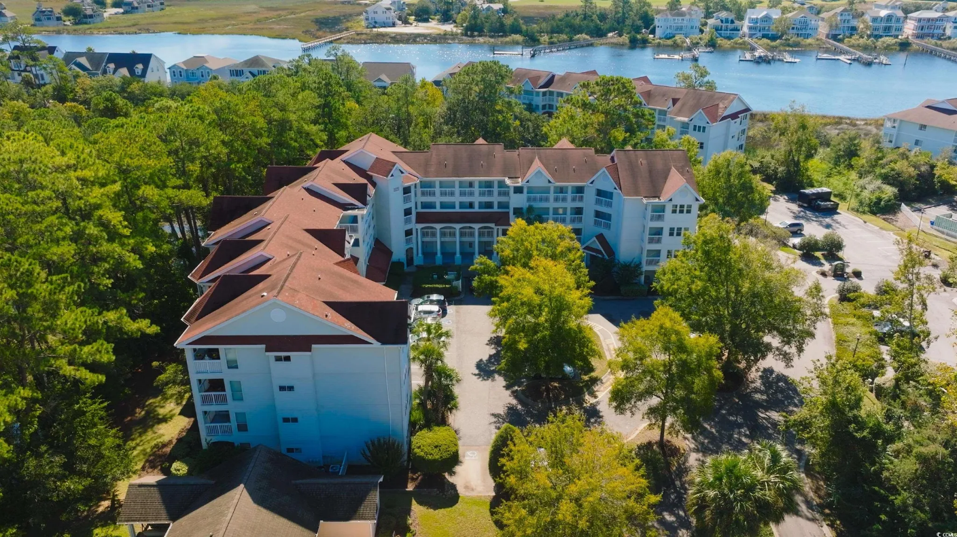
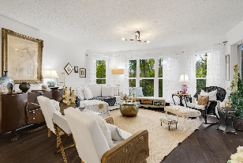
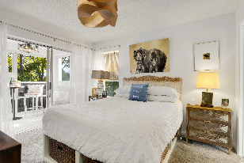
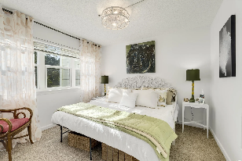
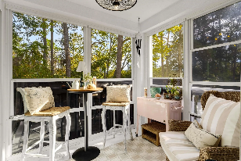
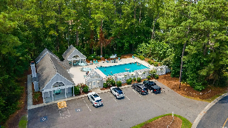

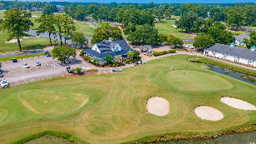



Elevator Building, Close To Parking, No Stairs To Climb And The Condo Enjoys A Beautiful, Safe & Comfortable Golf -Waterway Environment
4601 Greenbriar Dr #205A
Dupont at Eastport Golf Club | Little River, SC 29566 | MLS# 2427236 | $208,000
Popular Dupont at Eastport Golf Club has it all, stunning condo secluded in a highly sought-after golf-Intracoastal Waterway community with ease of access to everything the North Strand has to walk-in nestled peacefully in a private environmental sanctuary as a backyard, along with lovely wildlife and soothing songbirds. DuPont is small, manageable and very well maintained, along a natural swash. Its stucco building is attractive and functional. Residents have NO STAIRS TO CLIMB! This condo likewise has it all -- freshly painted newly renovated kitchen, painted cabinets, new stainless refrigerator, dishwasher and microwave. A new garbage disposal, deep stainless sink with pull down sprayer, and Corian countertops complete this unexpected extensive remodel. The kitchen is open to the dining/living area via the breakfast bar. Panoramic windows in the living room were custom and are not only stunning frames to the nature enclave but they also tip down for easy cleaning. New lightning fixtures and fans along with thousands in new windows bathe the home in light. Primary suite provides a relaxing atmosphere, with slider out to the private screened porch. Large year-round closet gives owner plenty of storage with a well appointed en suite. Enjoy the breezes year-round in that screened in porch overlooking the nature preserve which provides a quiet, serene atmosphere inside and out. New roof installed April 2024. HOA includes WIFI, cable and more. Baths newly modernized, including re-glazing of the master tub; new toilets, fixtures and doorknobs and a new sink in the guest bath. Master and Guest Rooms both accommodate a king bed. The master has a double-sink vanity. Much storage, internal and an exterior storage unit. And closets, lots and lots of closets, walk-in, linen, pantry and more! There are so many subtleties: the guest room and the porch both have eye-catching new ceiling light fixtures, but they are also cooling fans. And, last but not least, there is rich LVP in the main living area. Eastport, although long-standing, has grown more popular on the North Strand for its big value on a budget, central location on and near the ICW and in a golf-course community also near businesses, the Little River Waterfront district, restaurants, shopping, great schools and plentiful medical facilities. Plus, it has ease of access to many major roads and highways. See all this today and be at home in Dupont at Eastport soon!
VIDEO TOUR | VIRTUAL TOUR | LISTING INFO
Connie Ross-Karl
Realtor Broker SC/NC
702-306-2643
conniesross@aol.com
Ronnie Nichols
Realtor / BIC
RonnieNichols8@icloud.com
Helen Ashby
Realtor Agent
804-426-7758
hhashby@gmail.com
NEW WAY PROPERTIES MYRTLE BEACH

