Slide 1
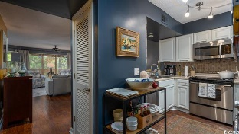
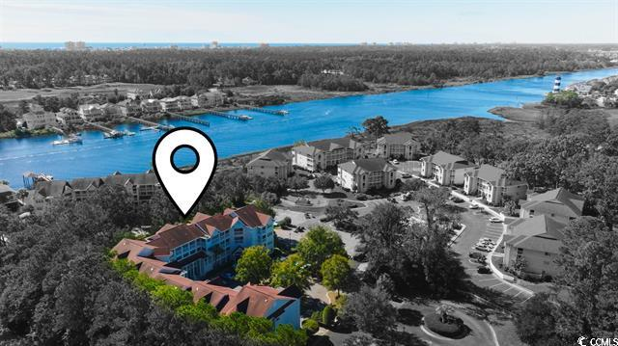
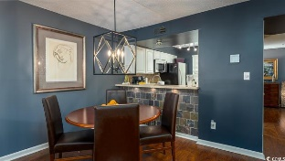
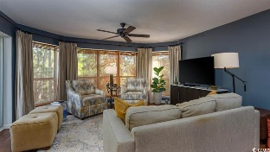
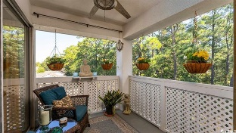
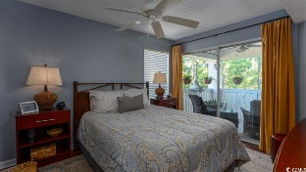
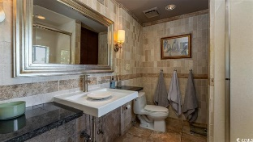
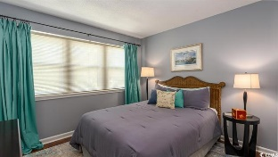
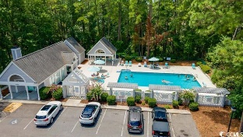
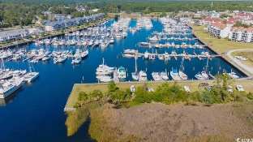




One of a kind, it is a penthouse, top-floor end-unit which is secluded yet lives with a charm and decor fully maximizing its also notable square footage.
4601 Greenbriar Dr #401-A
Dupont @ Eastport Golf Club | Little River SC 29566 | MLS# 2321467 | $239,900
Pure Pride of Ownership! These owners not only have extraordinary, upscale taste, they have enjoyed dedicating and enriching this luxury condominium to its current magnificent beauty and unexpected indoor/outdoor treasured space for nearly 20 years but ageless and timeless. One of a kind, it is a penthouse, top-floor end-unit which is secluded yet lives with a charm and decor fully maximizing its also notable square footage. In a sought-after elevator building, the condo may be easily accessed by an external-load nice-sized elevator or by nearby stairs. The front entry is setback and well lit with 2 perimeter windows for natural light, as well as a storm door. Applaud your first glimpse of the continuity of dark, luxury-plank vinyl that defines the flooring throughout the home, along with remarkable gold and navy walls -- stunning. This dedicated entry foyer is prized just as in the finest of homes. The guest bath is conveniently straight ahead, lovely and large, with sink, stately vanity and tub/shower combo with room for linens and relaxed enjoyment. You are then drawn to the left where the roomy guest bedroom opens up to more light from a wall of 3 windows and a perfect side porch for privacy and peaceful enjoyment. All windows with compromised seals have been replaced in the home. This guest room accommodates a queen bed and has an oversized closet along another wall -- a best example of a split-bedroom floor plan. Enjoy this spot for its quiet and seclusion, mirror-owing the tranquility of Eastport in general, off of the Intracoastal Waterway and of the Eastport Golf Club. Guests may never leave! Before moving to the heart of the house, though, open the enormous party-pantry in the hallway. Make it anything you want, but relish this bonus square-footage for any use. Cabinetry, likewise, has been upscaled. Check out the white cabinet by the side window in the kitchen; it mimics a tall-boy with raised buffet, glass inserts, and counter top for elegant serving. Magnificent trims, pretty laminate, marble, slate for walls for the breakfast bar, are all redone. Kitchen appliances stay, inclusive of the full-sized washer/dryers in the kitchen. The oven in the kitchen is a confection oven. They are top of he line, too; and there is ample storage space throughout. The dining area seats up to six, and is well accented by a large, contemporary chandelier, perfectly suited for this flex space. You will note there is also space for a large buffet. The living area adjoins the informal dining. Windows dominate the living room with much diffused light and style. They are almost oval in design to complement the casual seating in the living space, good for conversation and watching television. A large ceiling fan completes the ensemble. A larger, second porch extends from both the living room and the master bedroom. This spacious, 2 bd, 2ba condo with 2 porches, front and rear, and with a wonderful exterior private enclave, has no obstacles to the quiet enjoyment of its secluded location backing up to the natural swash. Mature trees; lots of wildlife, including songbirds; and no nearby buildings define the perimeter. Plus, NO FLOODING ever! So you can use the primary master/living room porch for a variety of activities. Southerns recommend sweet tea and a good book! The master bedroom accommodates a king bed, and the closet is completely redone for the elegance a master bedroom encourages, walk-in, of course with plenty of hanging space, shelving and drawers. The master bath has a linen closet, industrial-feel sink with huge walk-in shower with separate shower heads. This extraordinary condo favorably stands up to any for size, design, convenience and use as does the Dupont neighborhood of Eastport Golf Club. This safe, affordable residential/condo complex is located near many businesses and is in the Hamlet of Little River, SC, Horry County's second oldest town, which is renown for its proximity to the Atlantic Ocean via the ICW.
Video Tour | Virtual Tour
Connie Ross-Karl
702-306-2643
conniesross@aol.com
Ronnie Nichols
Realtor / BIC
ronnienichols8@aol.com
NEW WAY PROPERTIES MYRTLE BEACH

