Slide 1
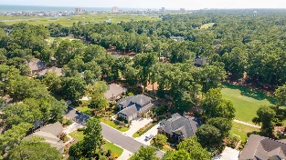
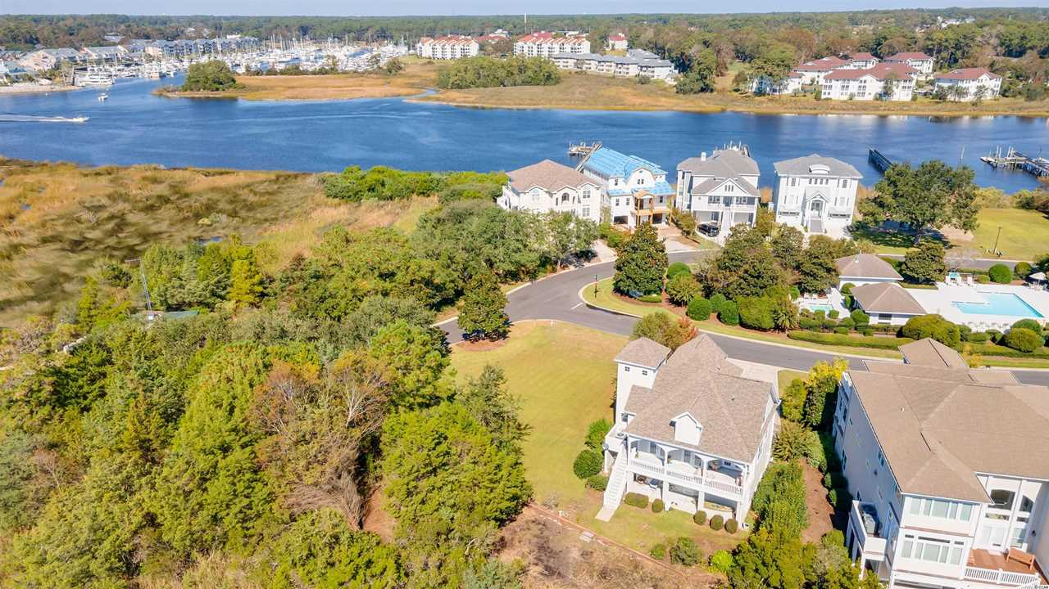
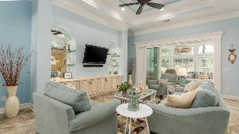
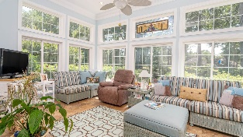
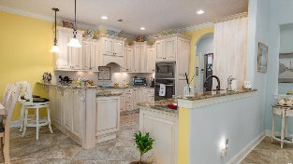
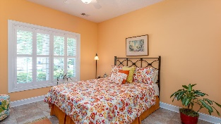
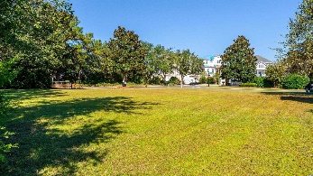
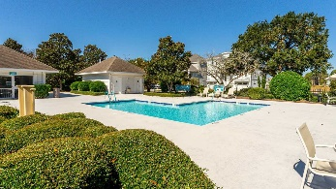
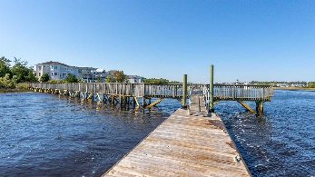
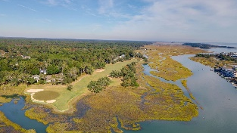
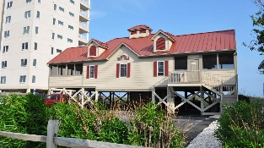



Vacant Lot On The Waterway Side Of The 8th Hole
4601 S Island Drive
Tidewater Plantation
North Myrtle Beach SC 29582
MLS# 2223181 | $169,000
Tidewater Golf Course was just named the best golf course in South Carolina! This lot is on the Waterway side of the eighth hole and boasts wonderful marsh views, teeming with wildlife. In addition to golf and being in an Intracoastal Waterway (ICW) community near the beach, Tidewater boasts many other rich, upscale amenities, including owners' beach cabana, pools & spas, clay & hard-surface tennis courts, pickle ball, bocce, horseshoes, amenities center, fitness center, driving range and putting green, 24-hour gated manned security, and clubhouse with bar & restaurants. There is even a complimentary gated storage yard for boats, campers, recreational vehicles and the like. The on-site, convenient HOA building has rooms for business and other meetings and events and a lending library. There are many clubs and activities year round. In Tidewater, you can do it all, or just relax in the luxurious Tidewater lifestyle. South Island of Tidewater is contiguous along the ICW. This lot, therefore, is highly sought after by the investor or primary or vacation home owner who desires to acquire an extraordinary golf/ICW/beach property at today's market price. Tidewater itself is on a tree-lined road to oceanfront Anne Tilghman Boyce Coastal Reserve, a nature conservancy, including Waties Island, with access for managed recreational use. Tidewater, a historic plantation, is on an elevated peninsula of live oaks and southern pines between the Intracoatal Waterway and the Cherry Grove Inlet to the Atlantic Ocean. The plantation also preserves the unique look of its own origins. It is close to the beach, shopping, entertainment, medical services, outstanding schools and parks and access to major highways. Be sure to check out the amazing South Island features herein. This rare, charming, livable and really fun lot location also enjoys a lovely, indigenous peaceful environment, along with the excellent reputation of the Tidewater Golf Course, the Pebble Beach of the East. Do not let this versatile, immaculate singular lot get away. Survey available to buyer. No time frame to build and AE Flood Zone but NO Flooding! Long-term rentals only are allowed in South Island. At this compelling price, and with low HOAs and taxes and enumerable amenities, this wonderful .24-acre, 10,454 sq. ft. lot is an investment as well as being desirable for building a vacation or permanent residence. As this is a corner lot, there are no neighbors to the rear or southwest to impede views of the coveted marsh or limiting privacy. Building up on the lot gives the opportunity for excellent ICW views as well. South Island is quickly building out. An available luxury lot is VERY rare. There is a remarkable, newly refurbished day dock on the Intracoastal Waterway to the left and across the street from this loop of South Island homes and exclusive to these residents and their guests. The South Island pool is for all the residents of South Island and is easily walk able directly across the street from this desirable lot. In fact, South Island owners also have access to the guest and owners' pools on the Plantation side, near the fitness and amenity centers and the tennis courts. Many of the communities' rich amenities are located nearby on the Plantation side. Ask about the clubhouse; pools; and fitness, tennis and amenities centers. The jewel in the crown, though, is the owners' oceanfront beach cabana located just a short drive away at 58th and N. Ocean Blvd. Its beautiful balcony overlooks the Cherry Grove Beach, named the 11th best in the nation. The cabana has two parking lots, a kitchen, elevator, large screened-in porch and restrooms and showers. Popular North Myrtle Beach is a Top-5 beach town and is safe as well as affordable. South Island of Tidewater Plantation Resort is one of the best of the best golf, beach and Intracoastal Waterway communities anywhere! Do not let this quarter-acre beauty slip away.
MAKE AN APPOINTMENT FOR A PERSONAL TOUR TODAY!
Video tour: https://youtu.be/ADX-B_OIWqk
Connie Ross-Karl
702-306-2643
conniesross@aol.com
Ronnie Nichols
Realtor / BIC
ronnienichols8@aol.com
NEW WAY PROPERTIES MYRTLE BEACH

