Slide 1
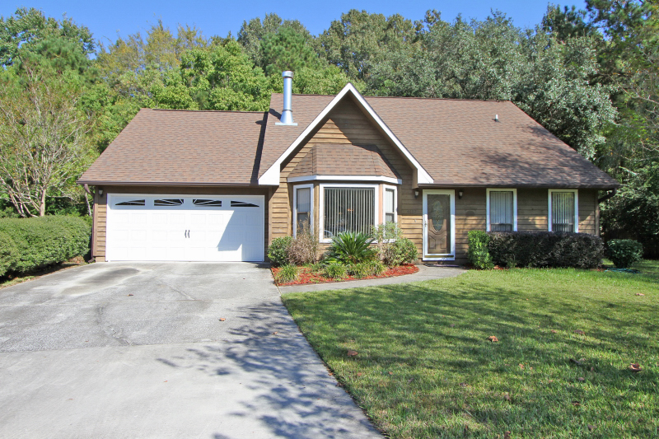
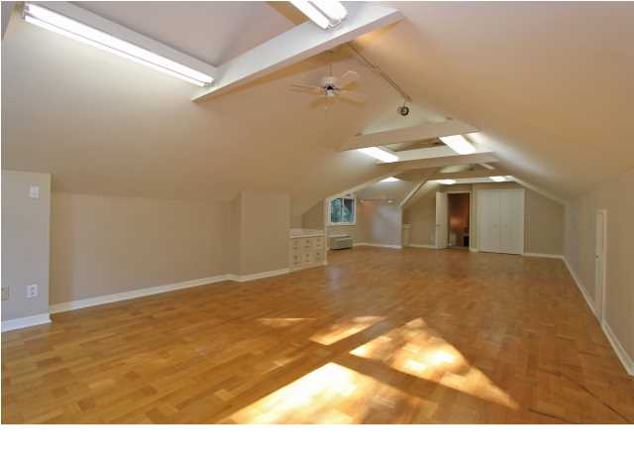
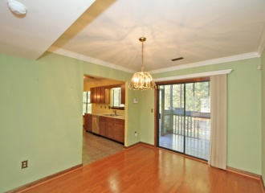
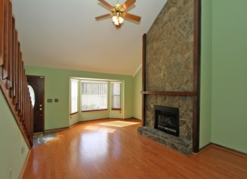
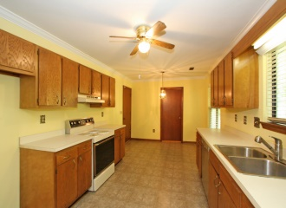
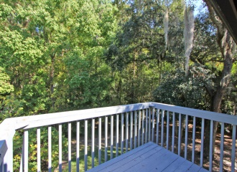
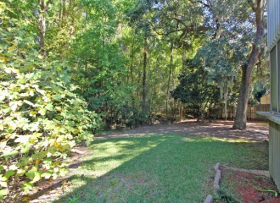


4607 River Run Court Appian Landing ~ Charleston, SC 29420 MLS# 14028273 ~ $179,000
Seller Motivated ~ Just Reduced
See more at www.2161shellring.com
Great house located on a private cul-de-sac in Appian Landing. Lovely open floor plan with vaulted ceilings and beautiful stone fireplace in the great room. Located downstairs are the two secondary bedrooms and full bath, large kitchen and dining room. The master suite is located upstairs with large closets and master bathroom. And lovely porch off the master to enjoy the private back yard.
Charla McDonald Office - (843) 884-1622
Cell - (843) 343-1456
Fax - (843) 746-4845
cmcdonald@carolinaone.com
charlamcdonaldproperties.com
Carolina One Real Estate
628 Long Point Rd
Mt Pleasant, SC 29464

