Slide 1
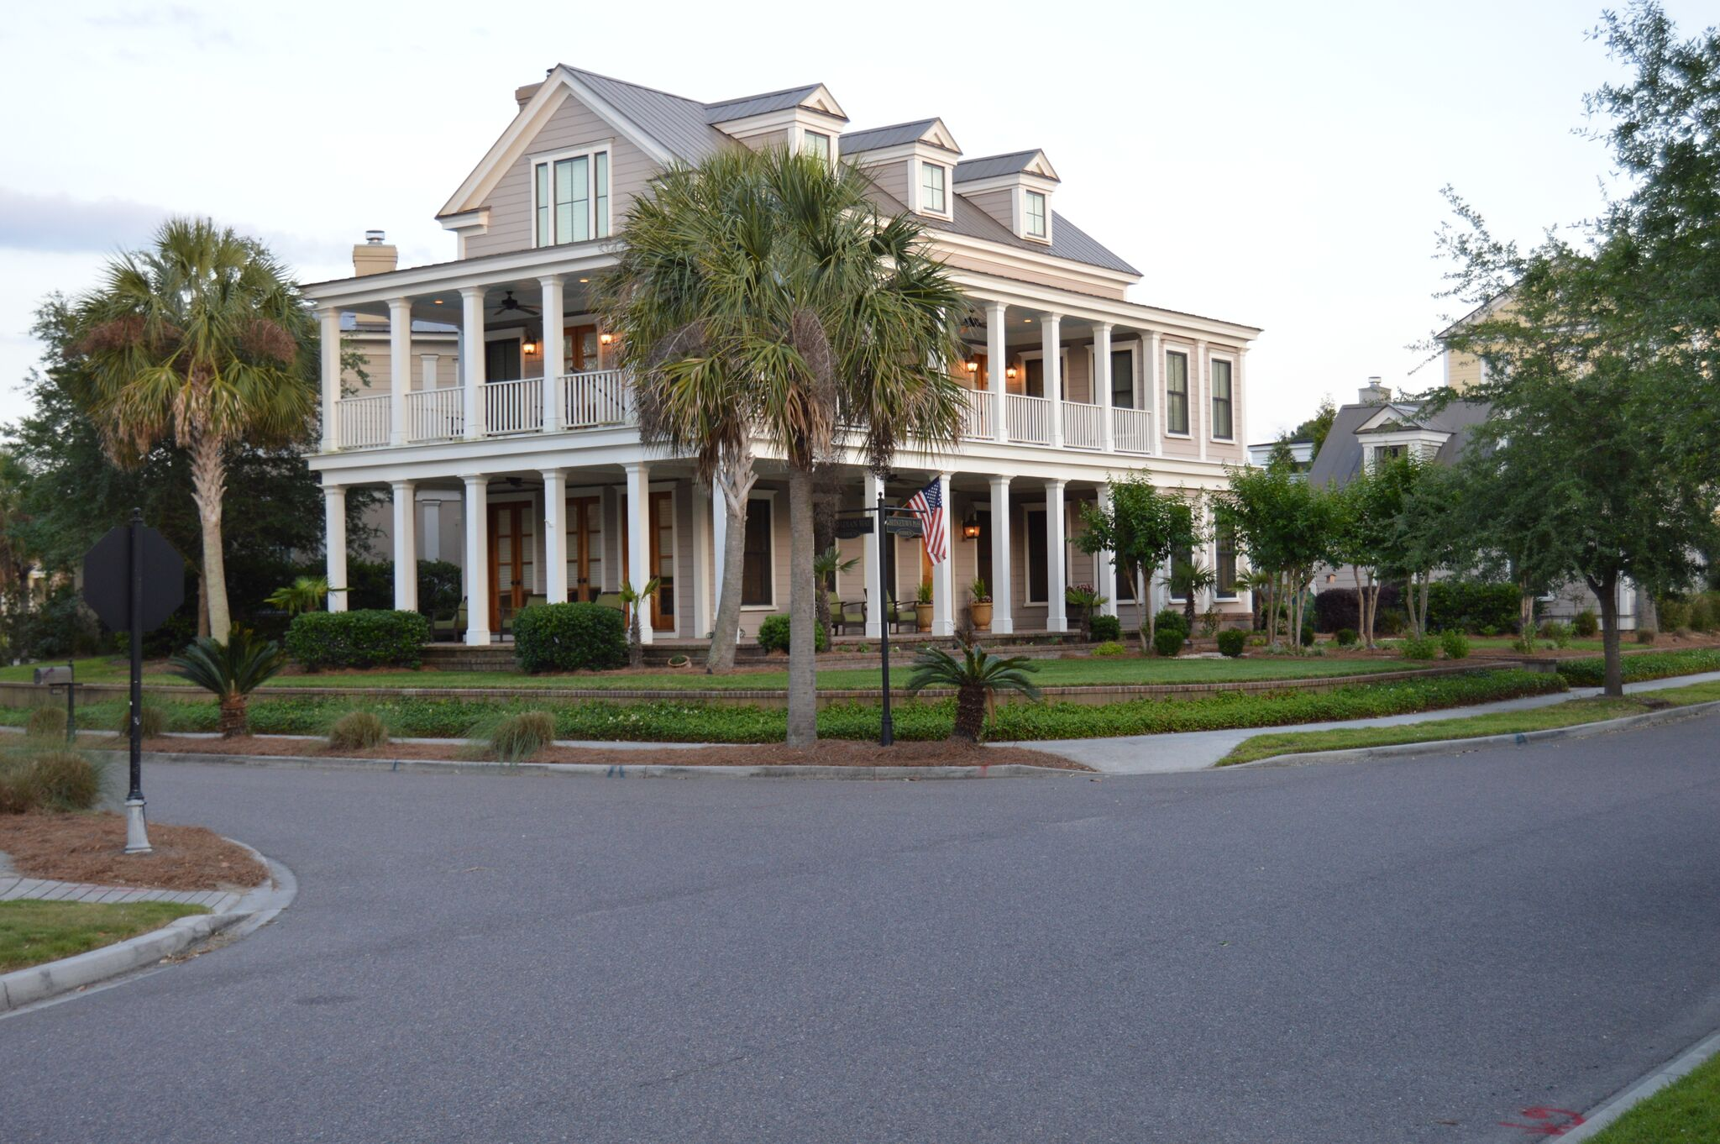
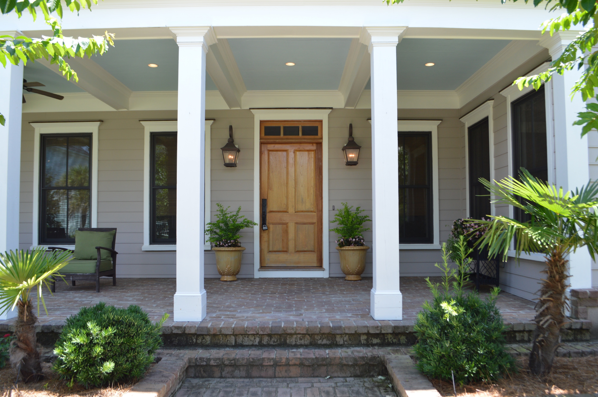
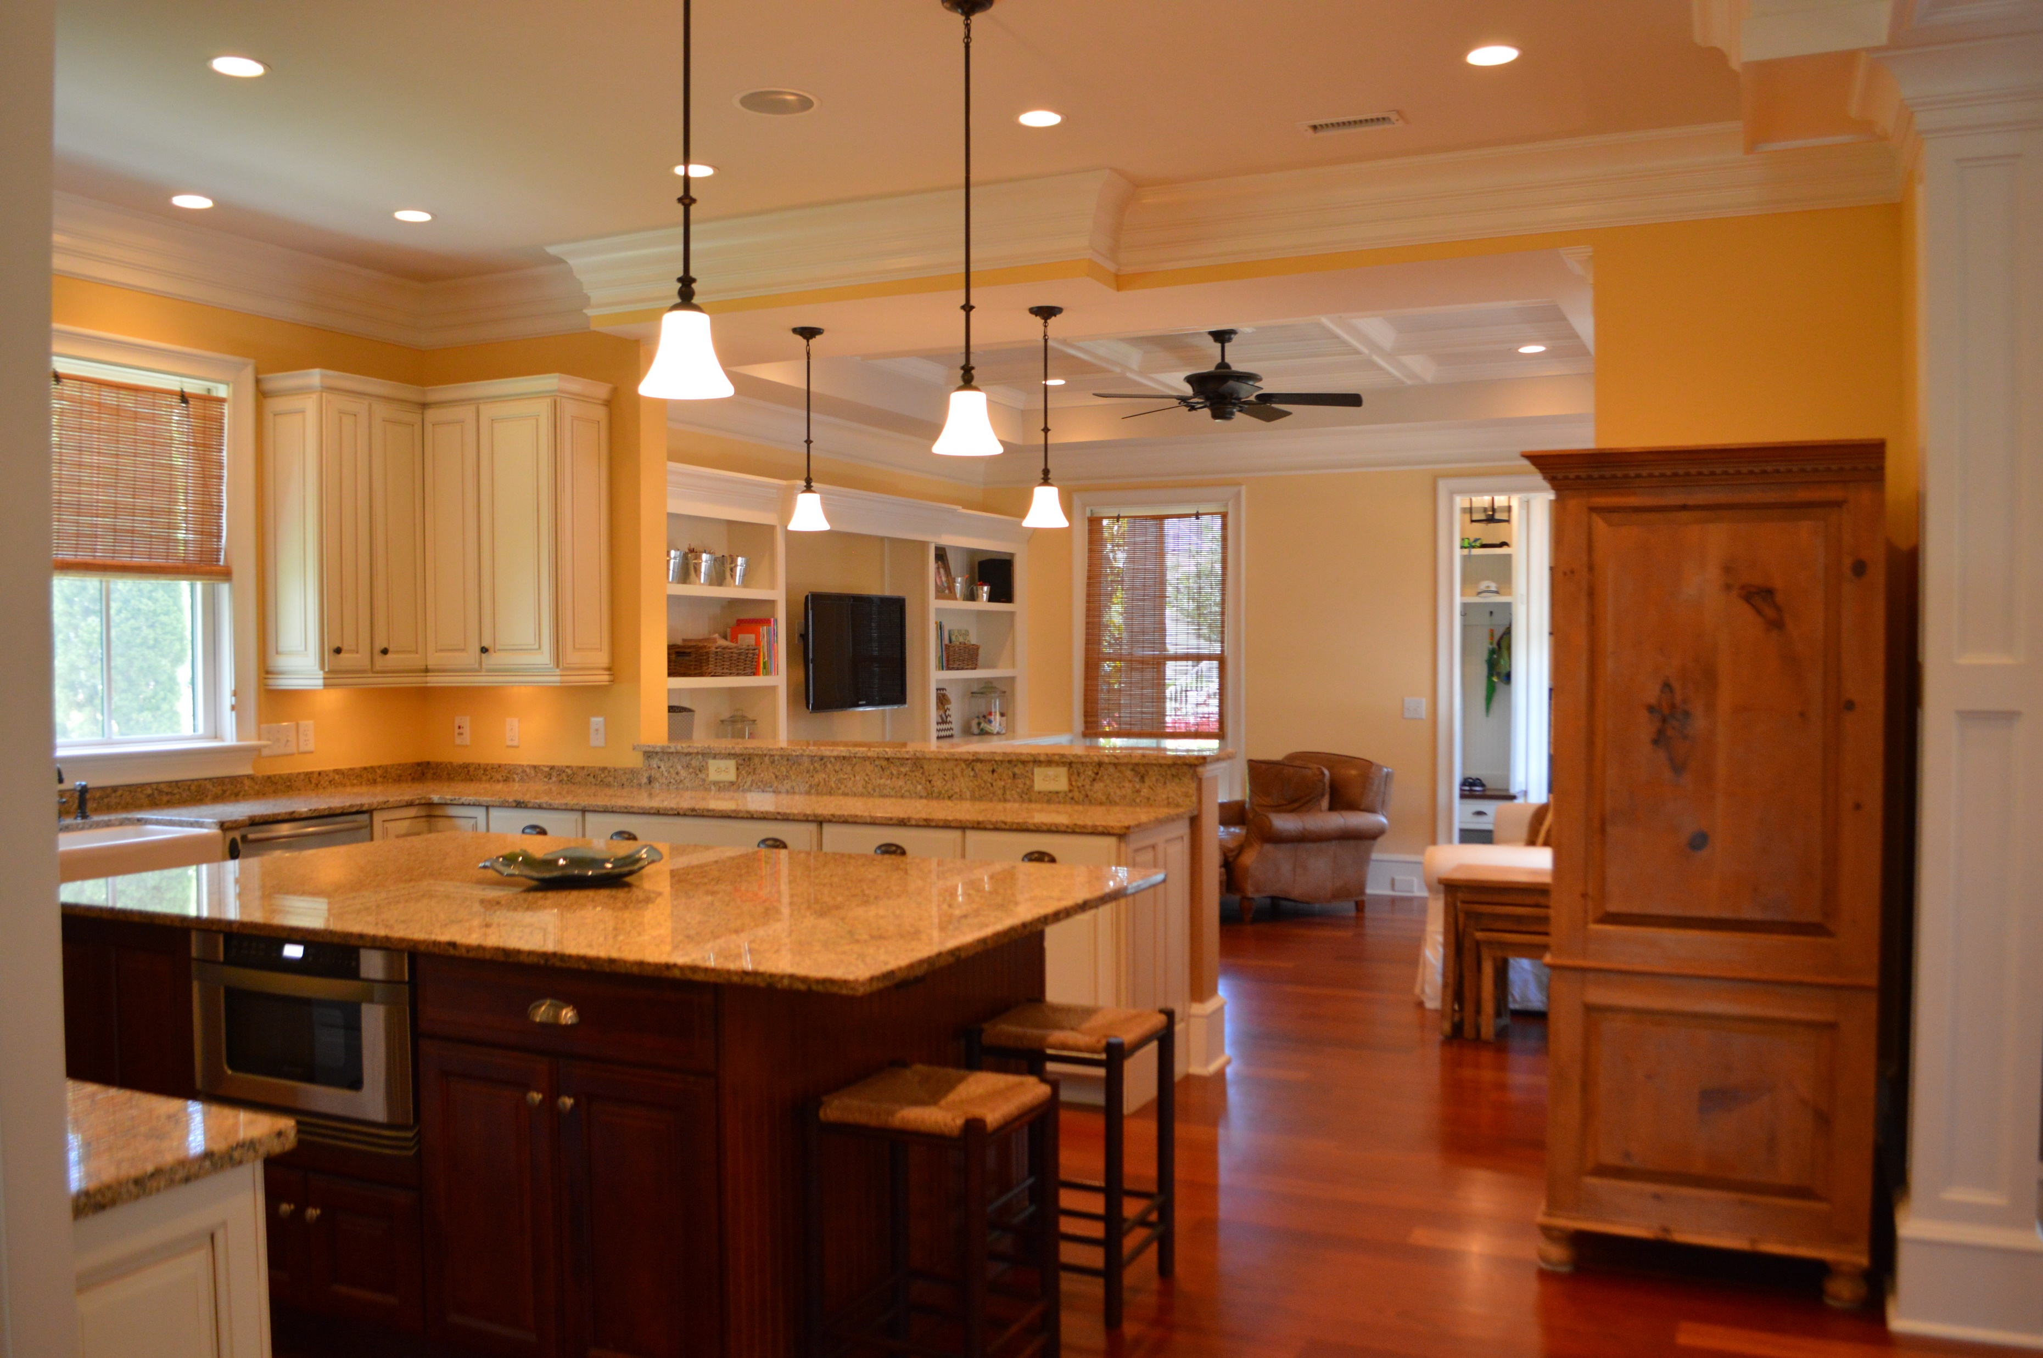
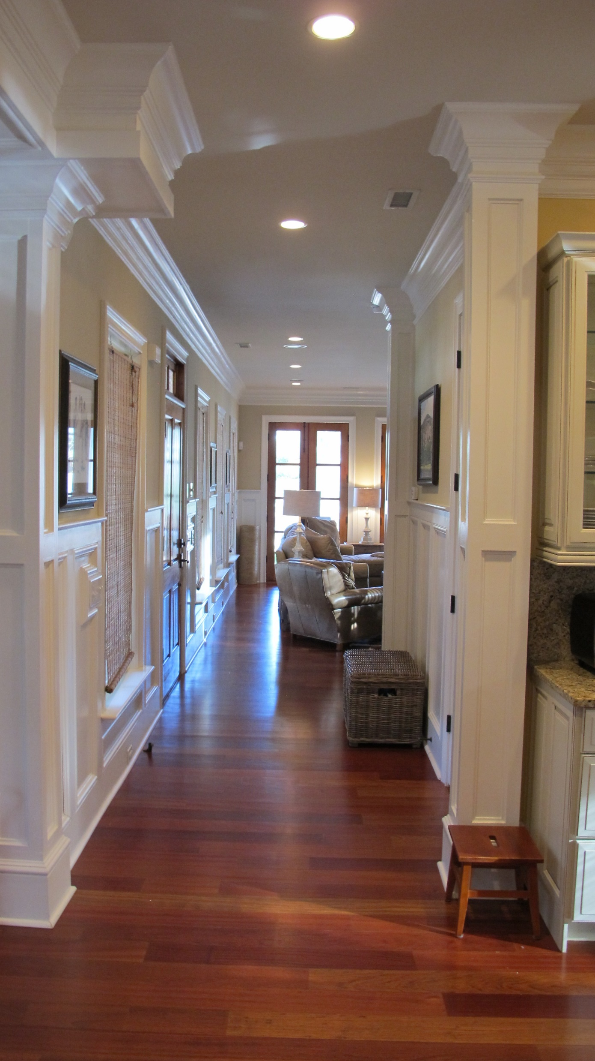
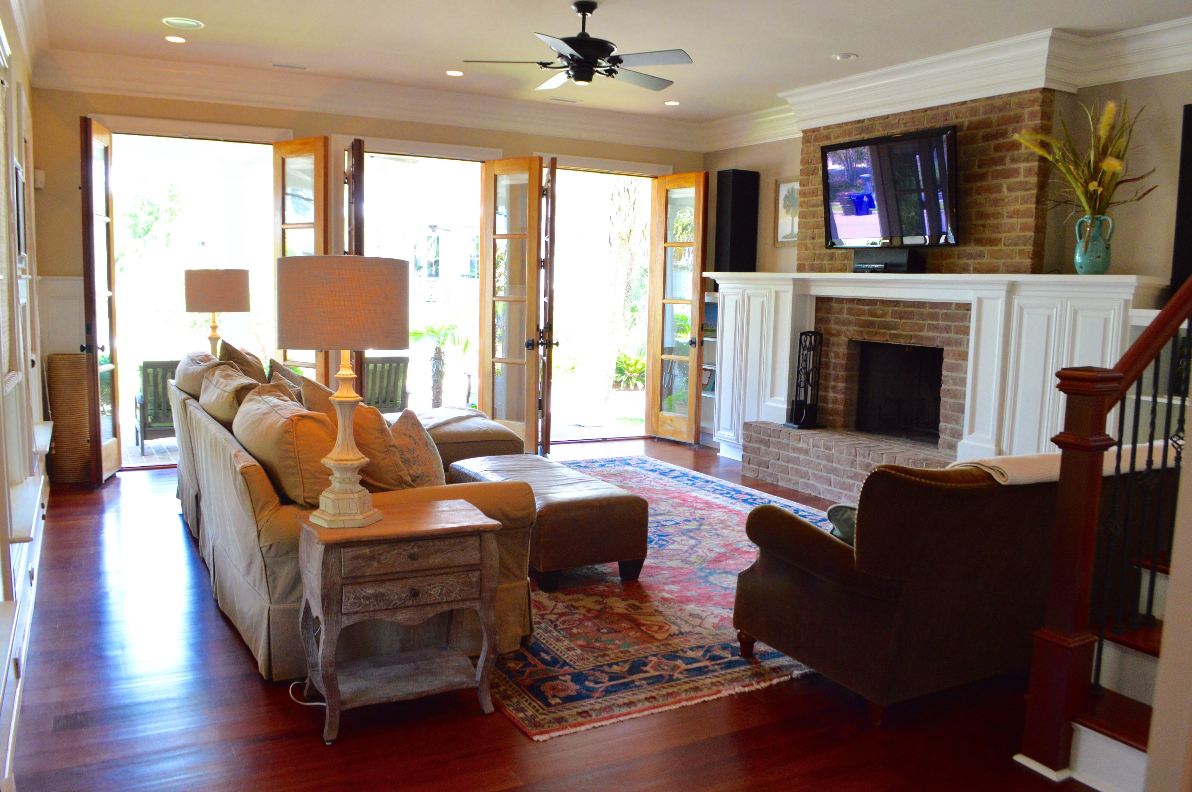
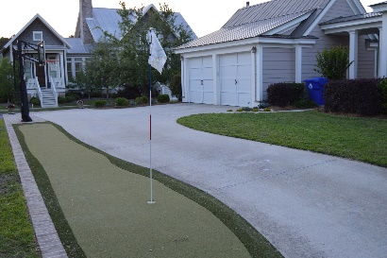

460 Barbadian Way
Belle Hall ~ Mount Pleasant ~ MLS# 16014183 ~ $994,900
Beautiful vast porches surround this custom built adaptation of the traditional Charleston single home. Constructed as one of Hibben's "Showcase of Homes" on a professionally landscaped corner lot, this property has stunning curb appeal and is adorned with great architectural detail. Inside, solid hardwood doors, extensive trim work and crown molding, Brazilian cherry floors, custom cabinetry, structured wiring, central vacuum, and granite and natural stone countertops are just a few of the elements that collectively create this exclusive Charleston residence. Relax in the living room beside the cozy fireplace, surrounded by custom built-in bookcases. Create culinary delights in the gourmet kitchen utilizing professional appliances from Viking and Sub Zero. Island is plumbed for sink.
Jonathan Vroon
(843) 514-3114
jvroon@southernlivingre.com
www.southernlivingre.com
Southern Living Real Estate 2249 Salt Wind Way, Mt. Pleasant, SC 29466

