Slide 1

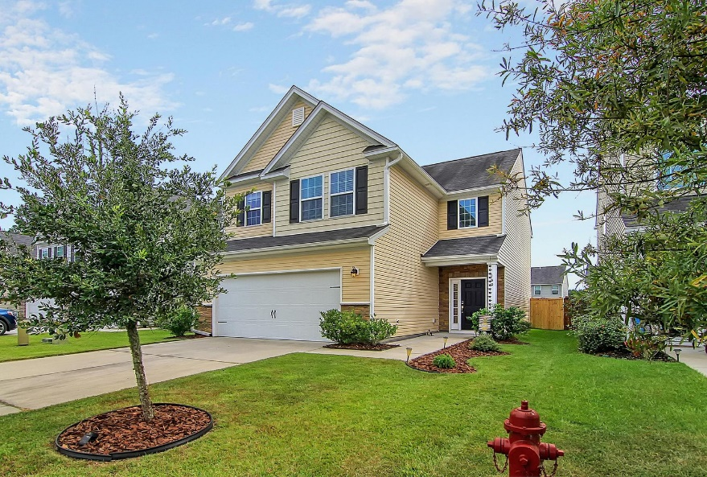
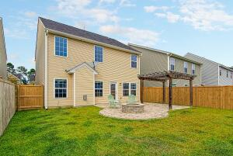
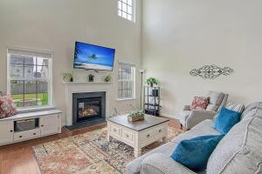
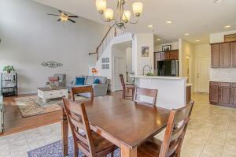
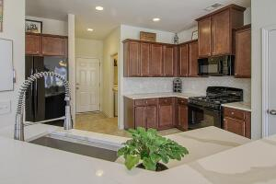
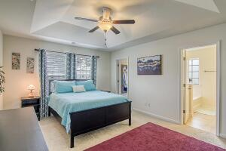
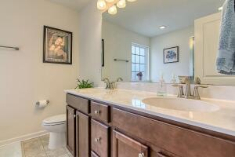

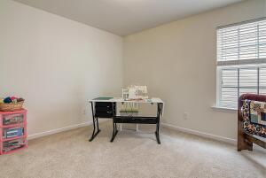
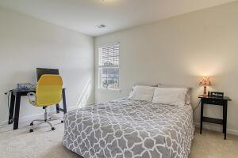

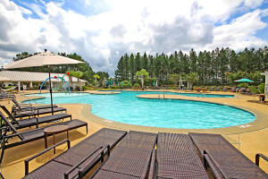
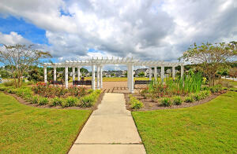
Open House Sunday
October 9th from 12-2
Debbie Cromer
ABR, RSPS, REALTOR, CRS
(843) 437-6342
debbie@debbiecromer.com
www.debbiecromer.com/
460 Whispering Breeze Lane
Cane Bay Plantation | Summerville, SC 29486 | MLS# 22025548 | $355,000
Gorgeous Hardwood Floors paired with two story entryway and family room offer that WOW factor you've always dreamed of. Kitchen has beautiful new quartz countertops and tile backsplash and features views of huge paver patio complete with pergola and fire pit. Perfect for entertaining! Master is spacious with his/her closets and large bath suite that includes separate tub and shower. Secondary bedrooms are spacious and the catwalk overlooks the family room! This home is located in the highly rated Lindera Preserve with excellent amenities. Just a short golf cart ride to shopping, dining and the YMCA. Convenient to I26 and major employers and a short trip to downtown Charleston and the beaches. No need to wait for new construction when this home is move in ready now!
Video Tour: https://vimeo.com/755200726
Century 21 Properties Plus | 1090 Park West Blvd; Ste 103 | Mount Pleasant, SC 29466

