Slide 1
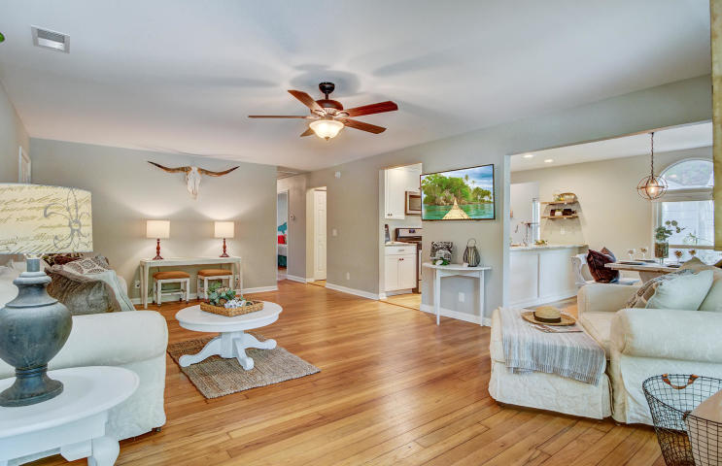
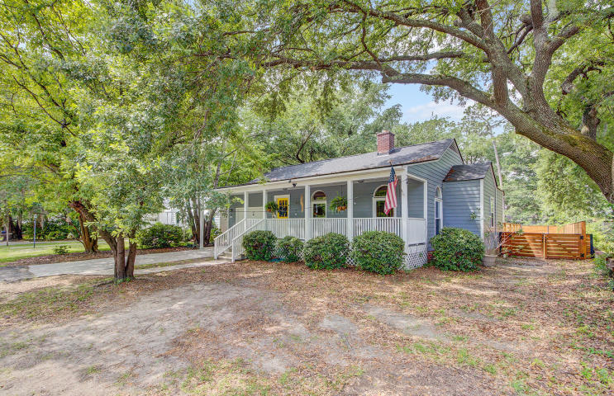
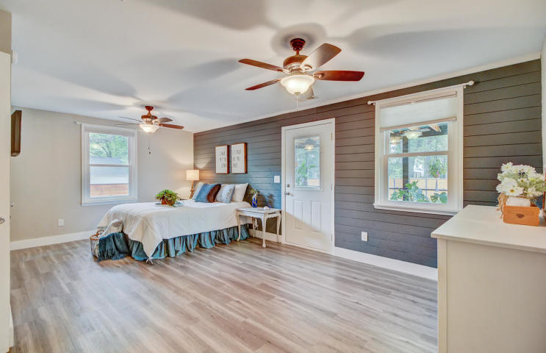
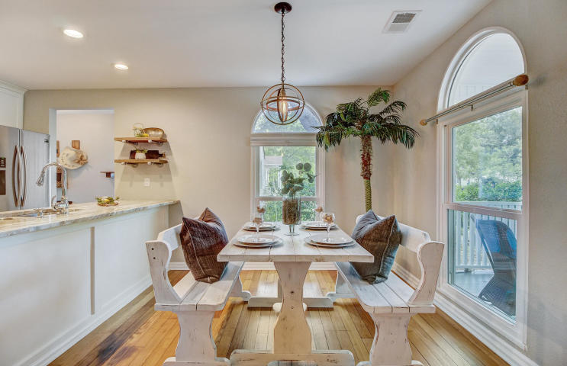
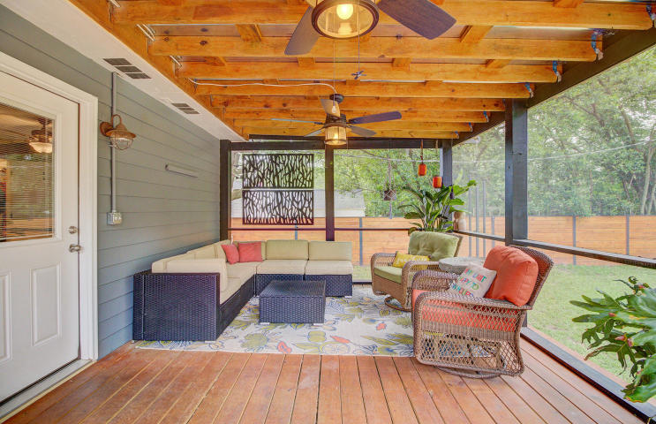
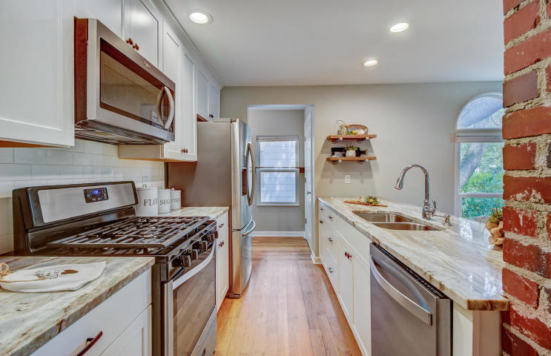
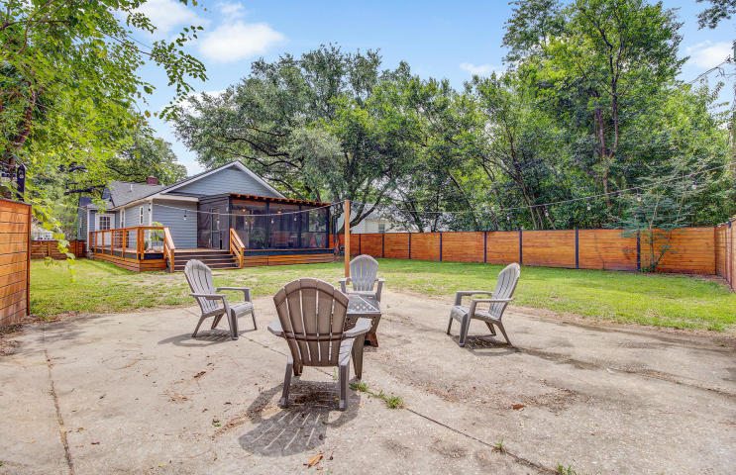


JUST LISTED! Perfect Park Circle Home
4617 Marlboro Place
Park Circle
North Charleston, SC 29405
MLS# 20015772 | $399,900
The search for the perfect Park Circle home is over. Fully renovated and ideal location make this single-story charmer a NO BRAINER! Upon entry, you will see and feel the fresh new vibe in this sought-after neighborhood home close to all the action. The main living area of this home is open and airy with the kitchen overlooking the dining area and a large family room perfect for gathering with friends and family. The finishes on this home are simply beautiful. The hardwood floors have been refinished and the kitchen has been updated with gorgeous granite, new cabinetry, and stainless steel appliances including a gas range that the chef in your household will definitely appreciate. This renovation, completed two short years ago, was significant and included a new roof, HVAC system, electrical, plumbing, tankless water heater, windows, hardiplank siding and more. Both bathrooms were renovated as well and the gorgeous finishes carry the theme throughout the house. The huge master bedroom is located on the rear of the home. His and her closets allow for excellent storage and the master bath with its oversized shower will create a spa like feel. You will simply love everything about the interior of this home which feels like new. If that was not enough, the outdoor living spaces are every bit as wonderful! The charming front porch is the perfect place to enjoy your morning cup of coffee or sit and watch the neighbors stroll by. Most recently, a large wrap around deck was built off the mudroom with plenty of space for grilling or even lounging in the sun. The deck connects to the new oversized screened porch on the rear of the home. You will find it hard to resist sitting out back in this "additional living space" with its trendy craftsman styling and metal roof overlooking the private back yard. The current owners spend many of their waking hours on this porch grateful that it can be enjoyed practically year-round here in Charleston. The very large back yard is fully fenced in and has a designated area for the fire pit for those fun nights with friends and family gathering by the fire. Park Circle is ideal for those who love to be in close proximity to all the action! Within walking distance to the park and popular restaurants and bars in Park Circle, it is a mere ten-minute ride to Downtown Charleston, so you could not ask for a better location. At the same time Marlboro Place is not a heavily traveled street so you feel as though you are nestled away within your community. Talk about the best of both worlds! It is a short ride to the beaches at Isle of Palms, Sullivans Island or even Folly Beach. Close to both Highway 26 and Highway 526, this is a great location for anyone who commutes. Luckiest are those who work from home because of what a SPECIAL home this is. Don't delay- come see for yourself today!
Check out the virtual tour here: https://my.matterport.com/show/?m=UzAvhFvo6TV
Ellen O'Neil
Broker/Owner, ABR, e-PRO, CNE
Charleston Realtor of Distinction
(843) 300-8530
www.EllenONeilProperties.com

