Slide 1
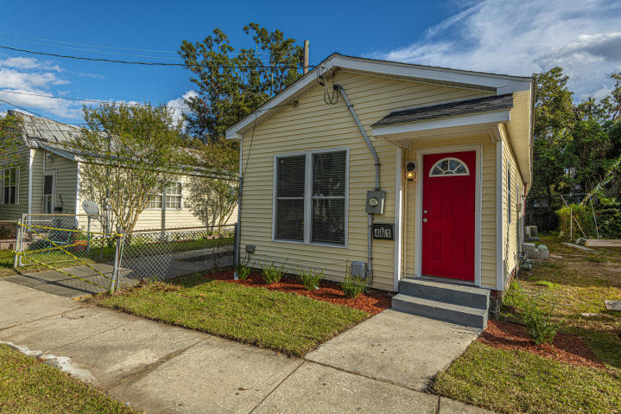
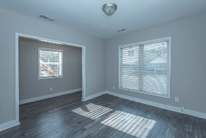
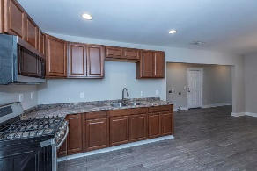
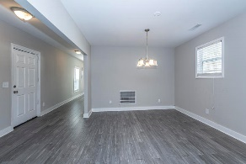
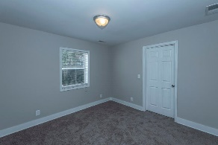
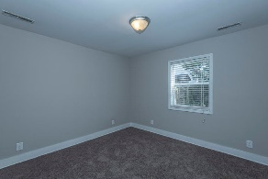
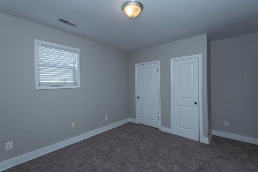
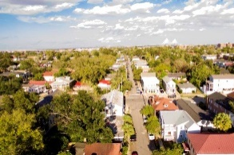
Just Reduced!
461 Race Street
Charleston, SC 29403
MLS# 19029196
$399,900
Charming 2 bed / 1 bath Charleston single located next to Historic Hampton Park and the Citadel. New bamboo floors. New carpet in the bedrooms. New paint on walls, New appliances. New sod and landscaping. Spacious kitchen. Close to MUSC, Brittlebank Park and The Joe. Welcome home!
David Hickman | (843) 505-0456 | davidisyouragent@gmail.com | www.davidhickmanrealestate.com
Carolina One Real Estate | 1530 Old Trolley Road | Summerville, SC 29485

