Slide 1
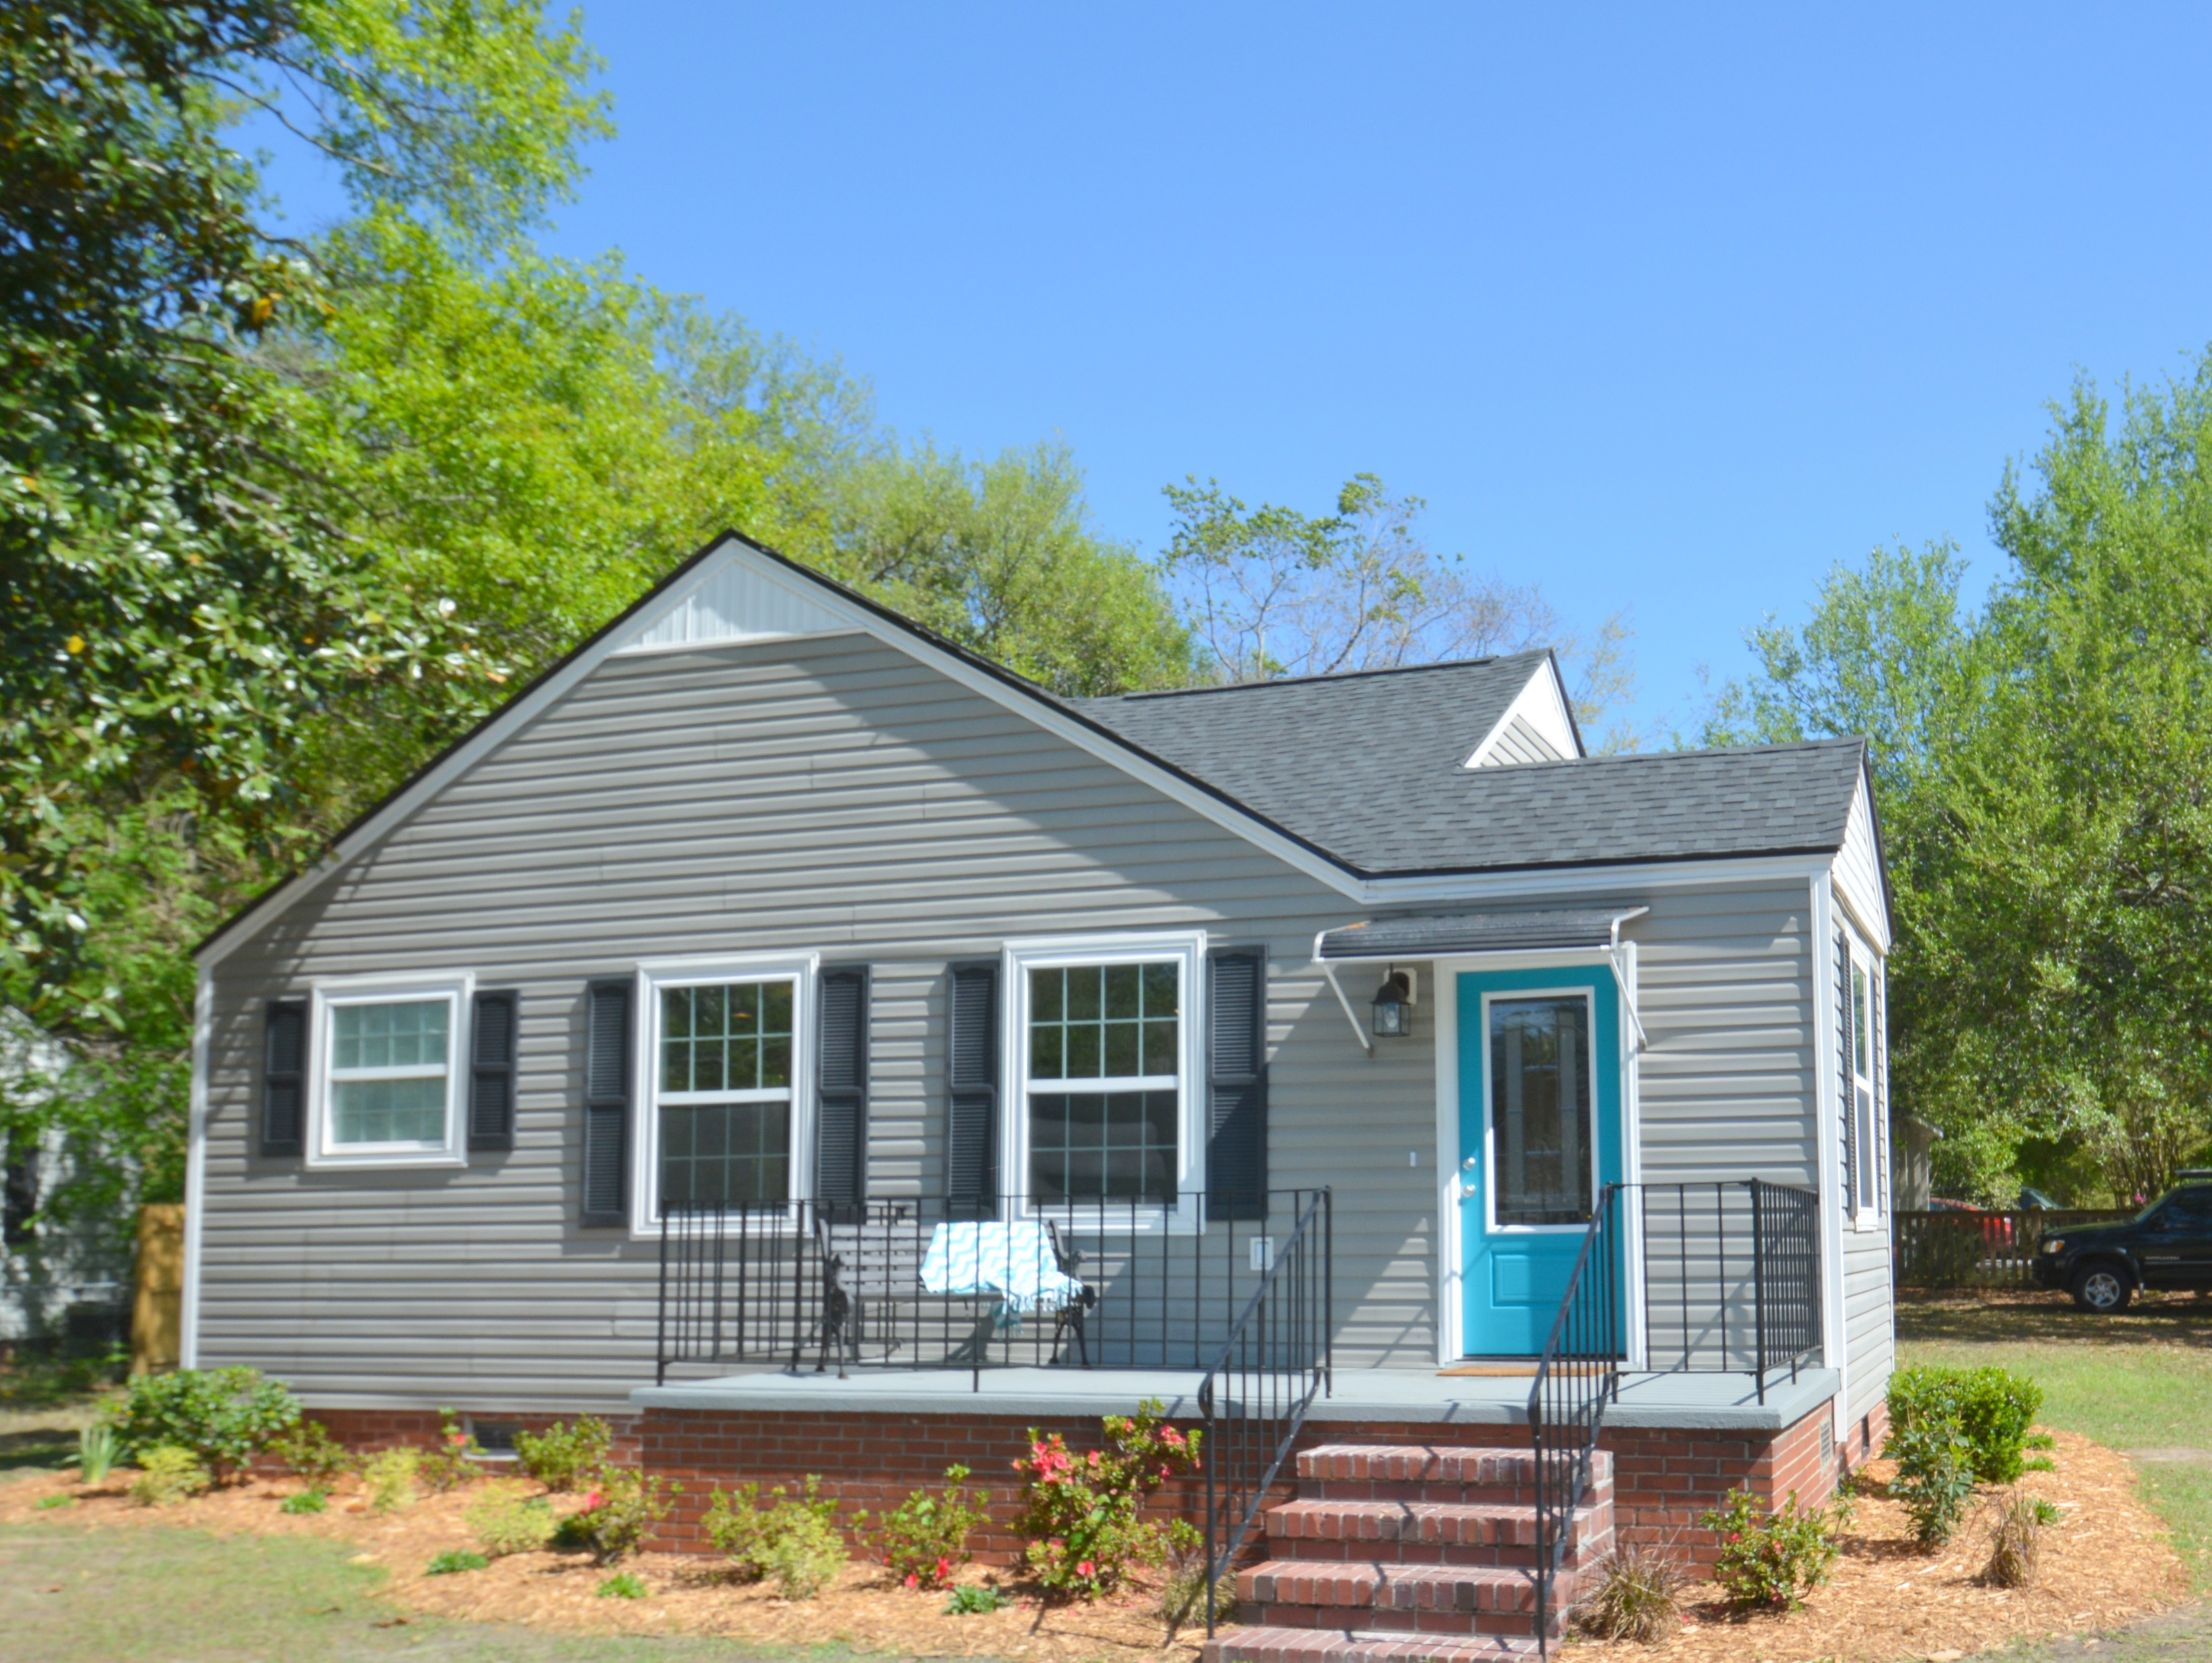
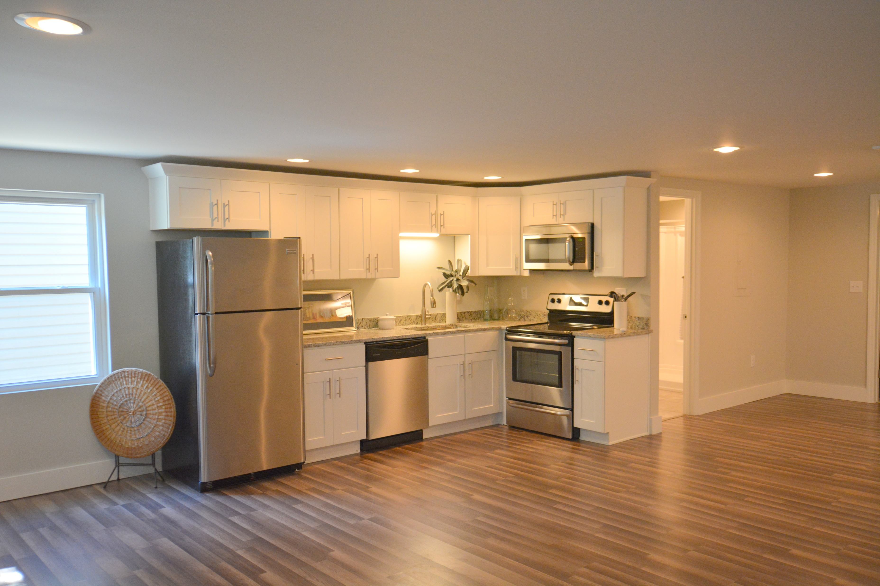
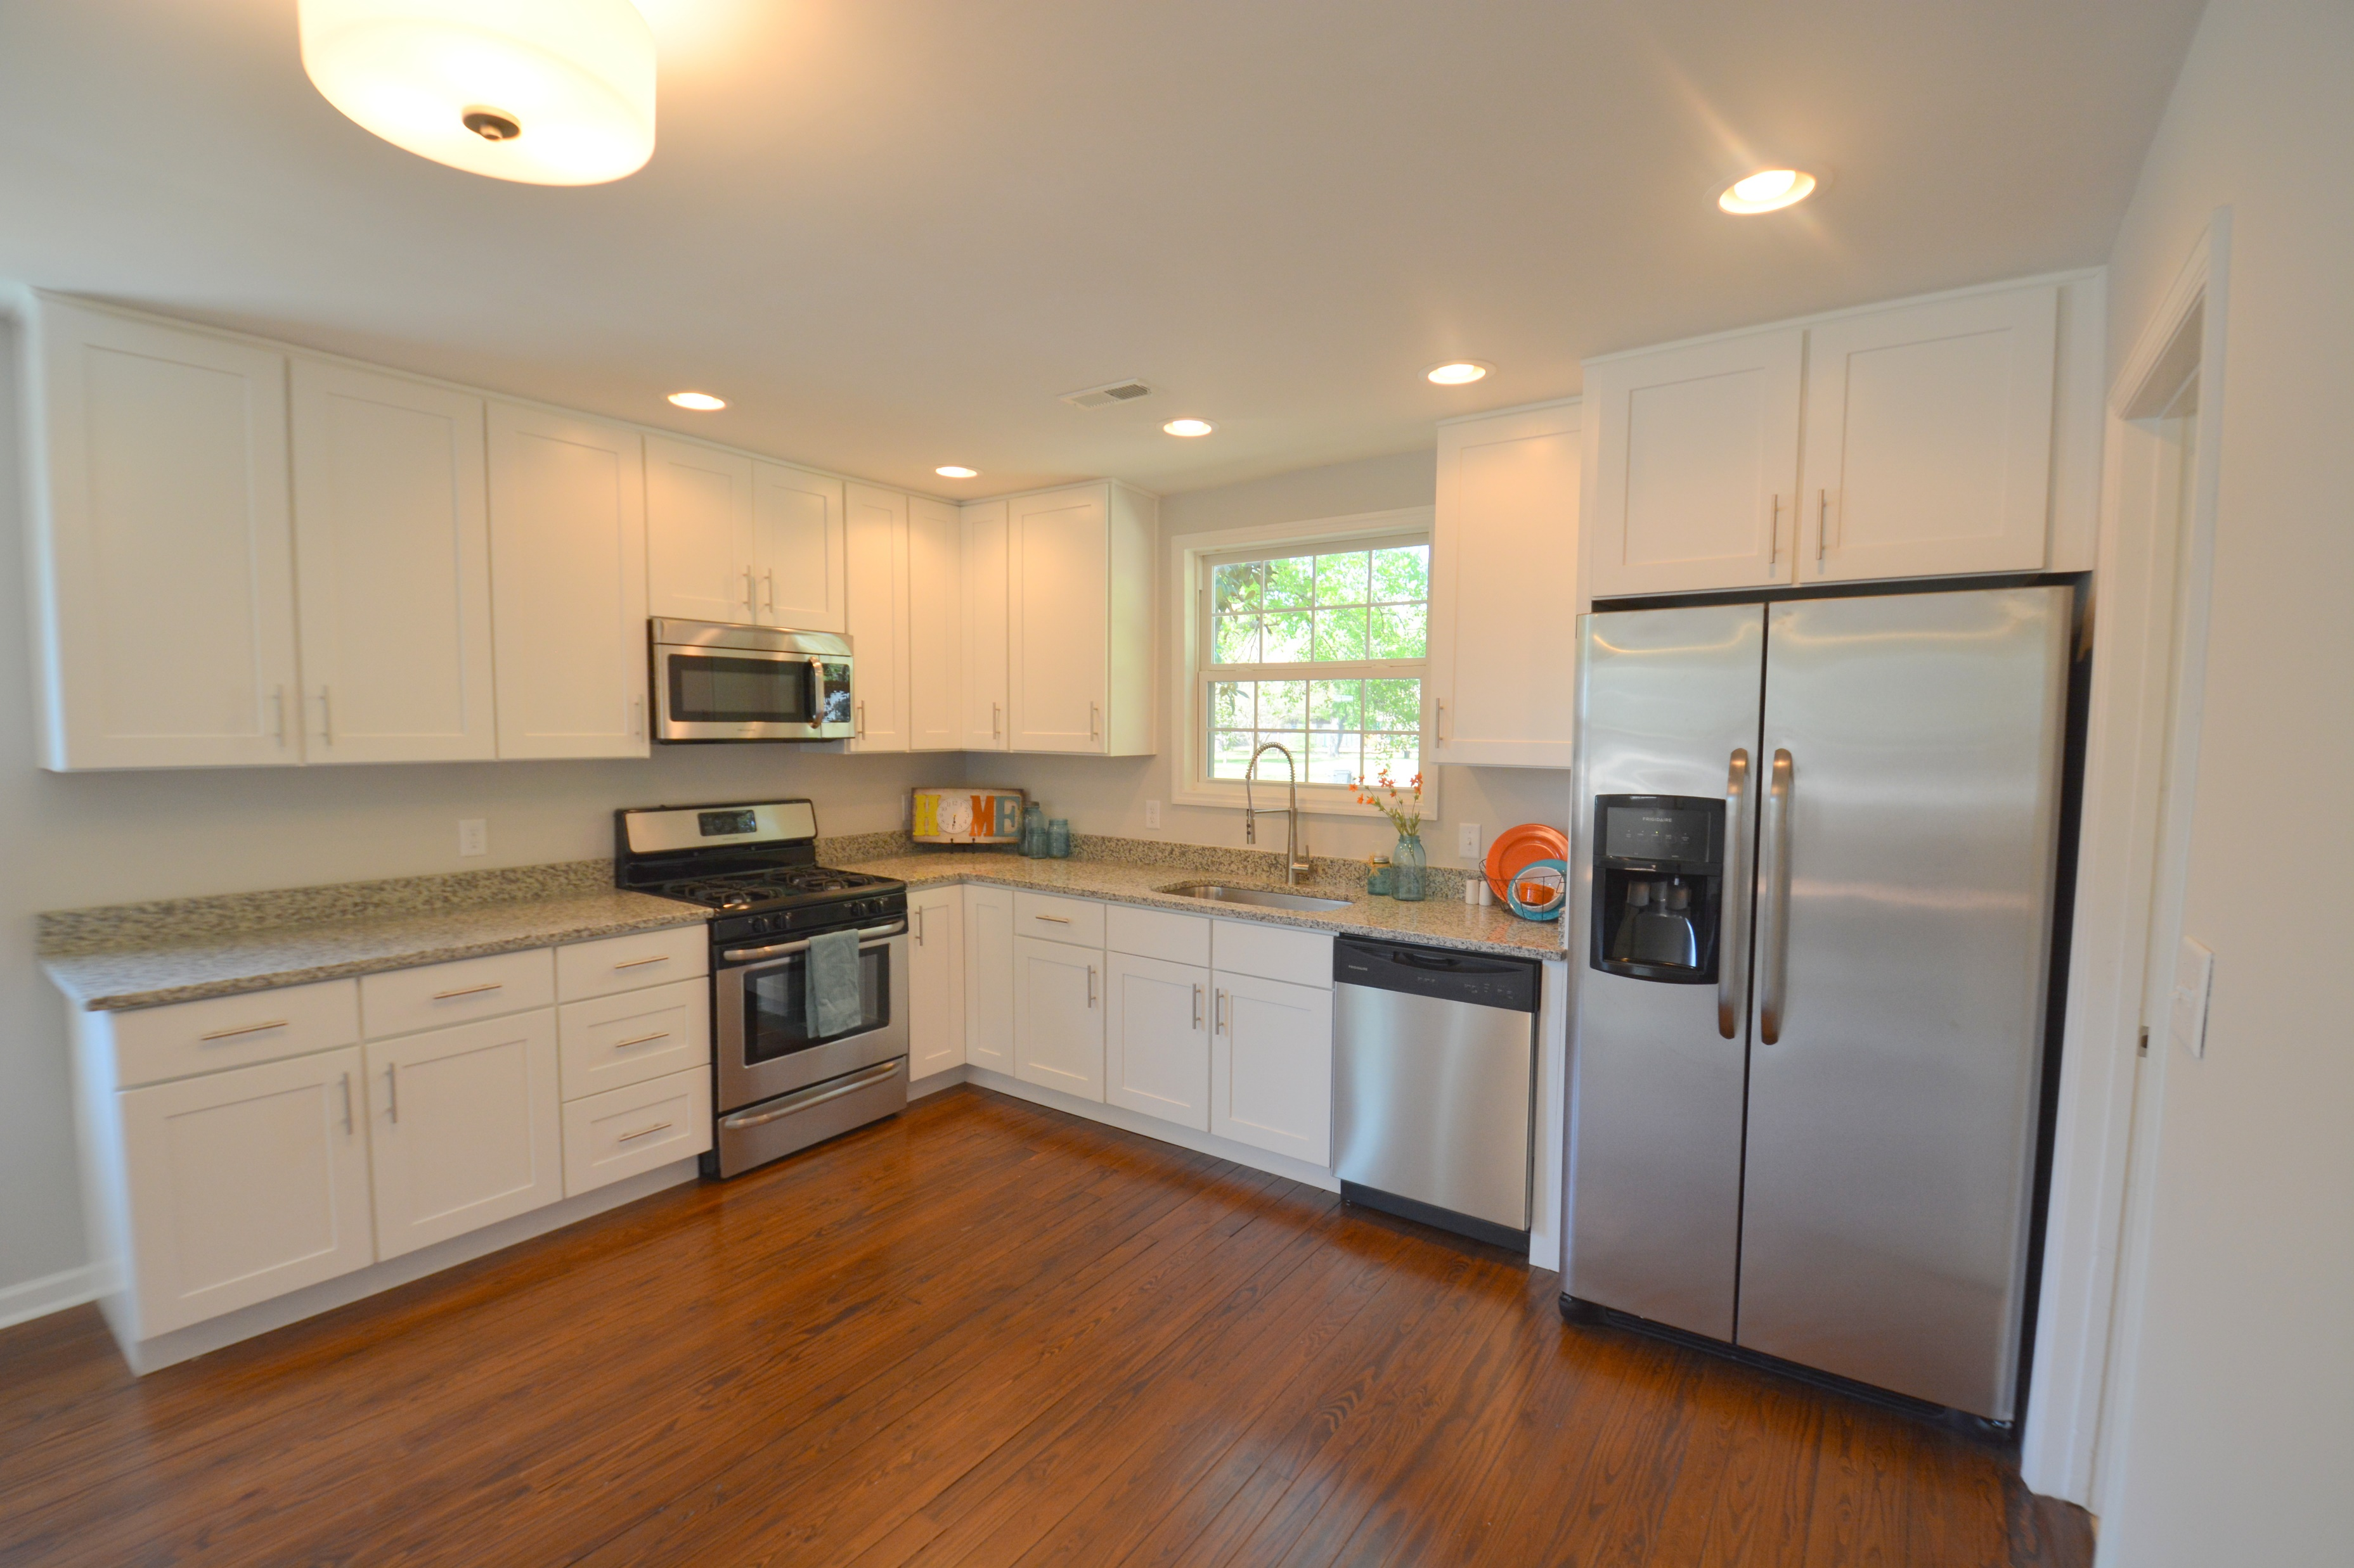
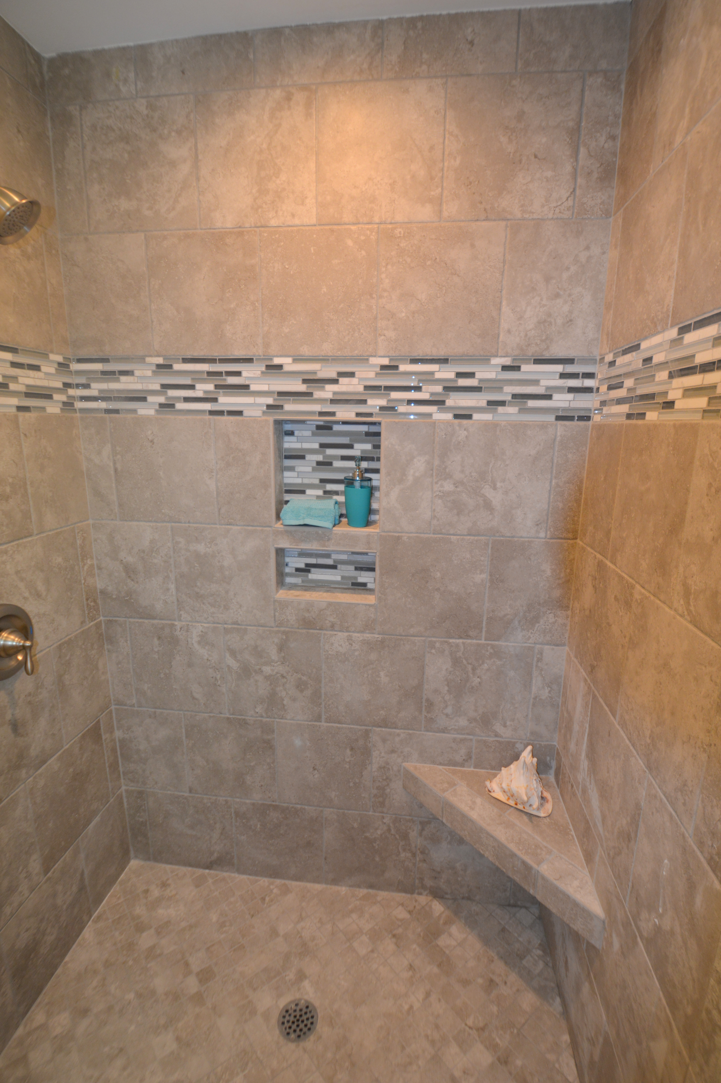
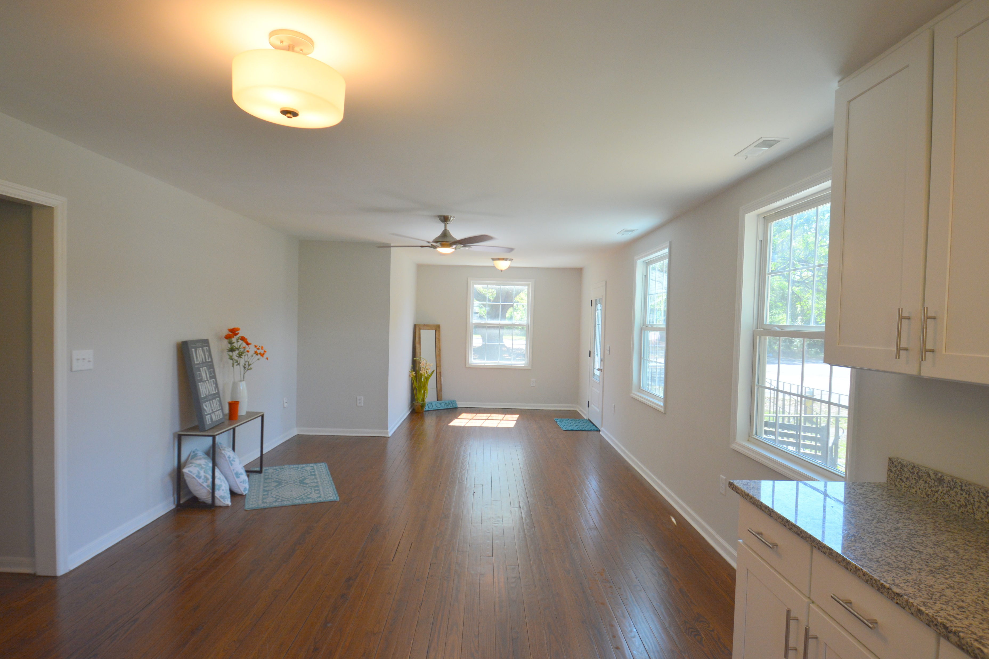
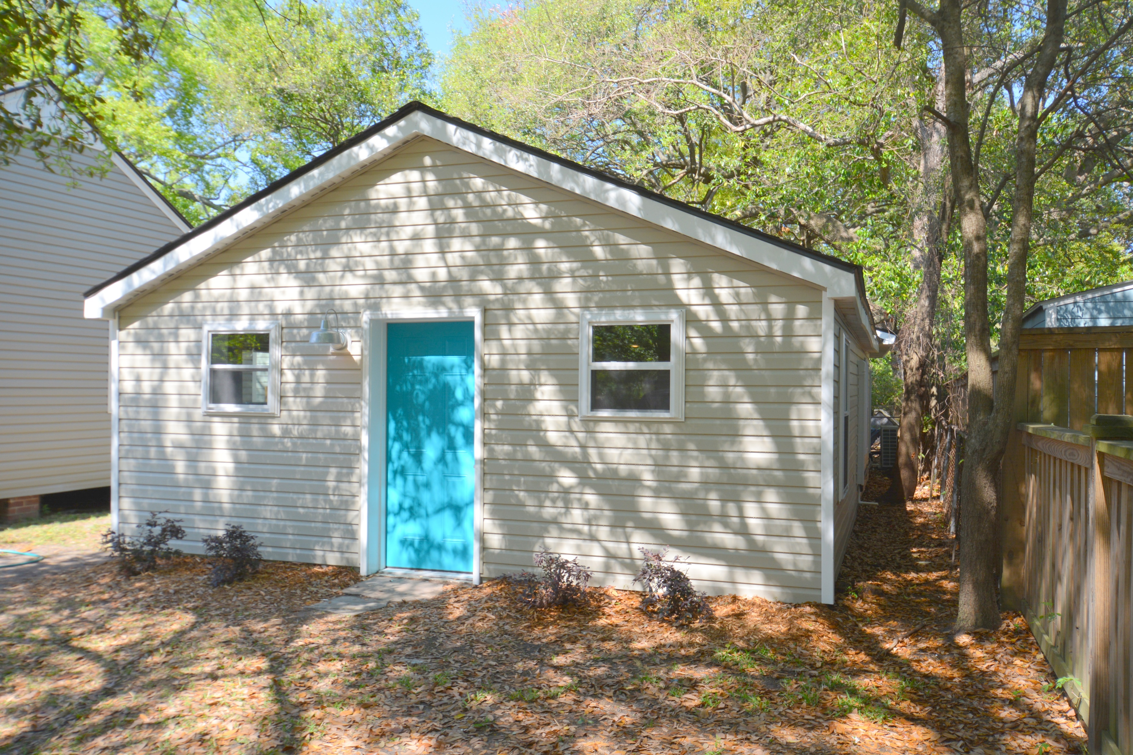
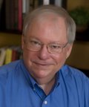

Broker Open House Wednesday 11:00-1:00
Buy.......Build.....Begin
4634 Holmes Avenue
Park Circle | North Charleston | MLS# 17009567 | $350,000
Welcome to 4634 Holmes Avenue in Park Circle. The measured size of this home is just over 2,000 SF. The Main House has three bedrooms, two full bathrooms, a laundry room, living room/dining room combo and a great front porch. The home sits on a corner lot across the street from a park. According to our Tax Information, this property is not in a flood zone. My client has added all new fixtures, a new roof, refinished the hardwood floors in the Main house, replaced both entry doors, smoothed the ceilings, created a custom tile walk in shower in the master bathroom, installed all new tile work in both bathrooms, installed new faucets and fixtures throughout, installed new vanities with cultured marble tops in the bathrooms, created a new kitchen with new cabinets and granite countertops, installed all new stainless steel appliances with natural gas range and added new landscaping all around the home. Now comes the real treat. The Guest House has a full kitchen, large living room dining room combo, full bathroom and nice bedroom. The utility closet also has room for a stack washer and dryer. My client added all new plumbing, all new electrical, new flooring, new fixtures, new bathroom vanity and mirror, all new kitchen with stainless steel appliances, new doors, new windows, new vinyl siding and a new split Samsung HVAC system. You could use the Guest House as a mother in law suite, a rental unit, an office, a great man cave or whatever you wish. All this within walking distance of Montague.
Bob Ramella, Broker
CRS, CDPE, RCC, e-Pro
(843) 330-8300
bob@bobramella.com | www.bobramella.com
Keller Williams Realty Charleston | 496 Bramson Ct Ste 200 | Mt. Pleasant, SC 29464

