Slide 1
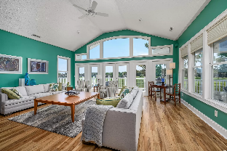
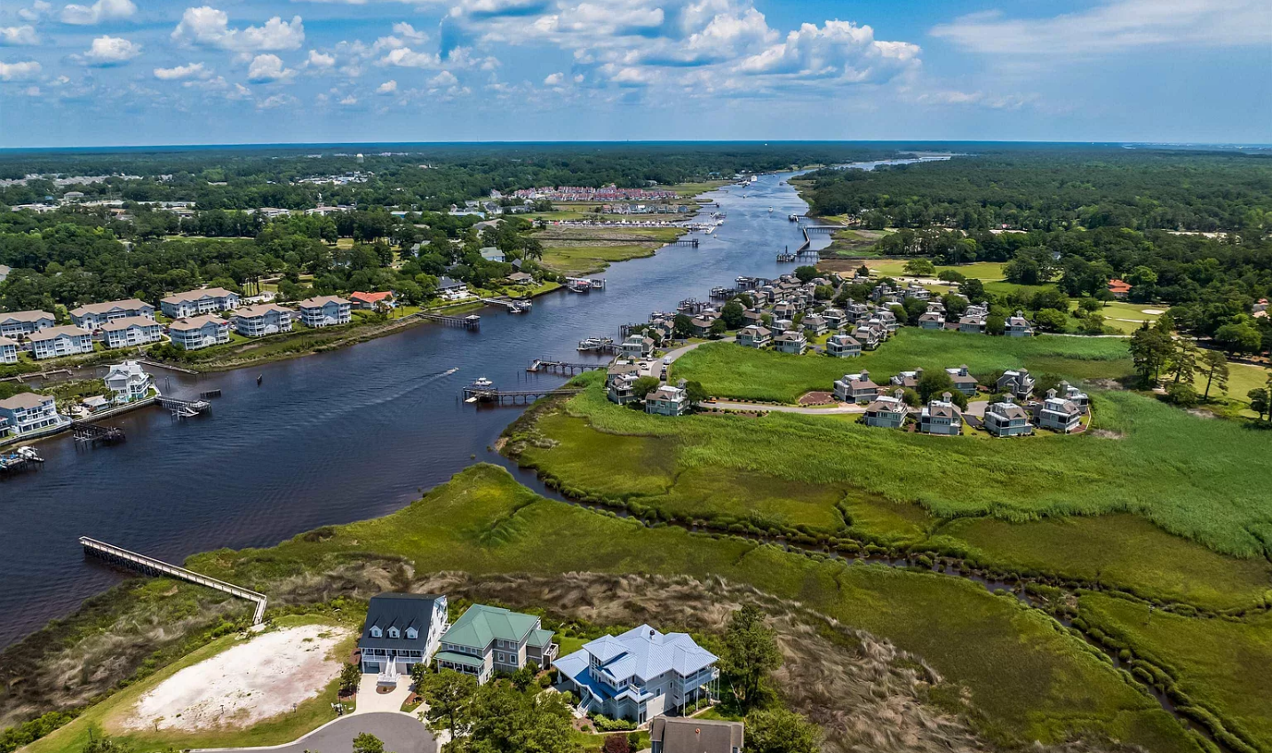
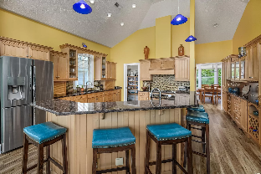
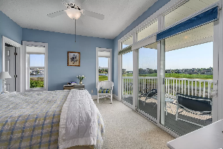
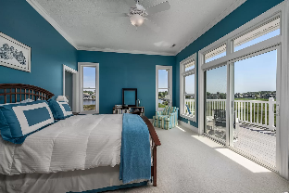
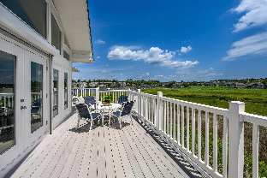
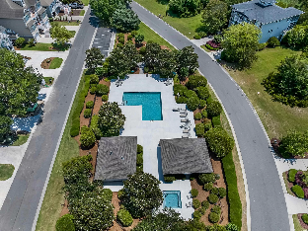
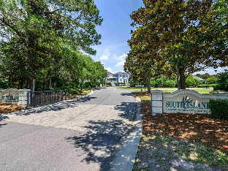
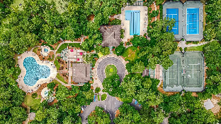
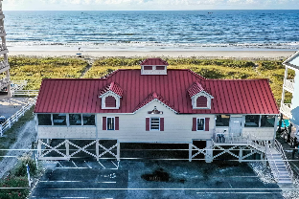
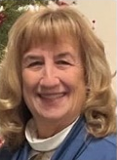

Coastal Living Along the Intracoastal
4636 South Island Dr
South Island | North Myrtle Beach, SC 29582 | MLS# 2405995 | $1,390,000
WATERWAY, GOLF COURSE and MARSH VIEWS welcome you to the gated Tidewater Community in the prestigious neighborhood of South Island. As a resident of South Island you will enjoy a neighborhood pool/hot tub and a neighborhood dock; both located just minutes from your front door. As an owner in Tidewater you will enjoy beach house access from Tidewater's Beach Cabana featuring bathrooms, showers, dining space and plenty of parking located in Cherry Grove. Other Tidewater amenities for your enjoyment include two additional pools, fitness center, amenity center, tennis courts, pickle ball court and bocce courts. Enjoy all of this from a stunning contemporary custom designed home that features 6 decks, and outdoor shower/cabana and sauna. This is a reverse house with a great room (living and kitchen) , dining and master bedroom suite on the top floor where every room has a waterway, golf course and marsh views. Master suite features a large walk in closet, access to decks, glass shower and jacuzzi tub. You will find peace and quiet in the intimately designed crows nest located an additional 1/2 level above the upper floor with panoramic views of the intercoastal waterway. There are five guest bedrooms/offices/dens on the mid level. The entire first level is a 3 car garage with plenty of storage space. Their is an elevator to make all this convenient for everyone. Entertain your guests from the one of the many decks or from the great room with plenty of seating that is open to the kitchen and is equipped with all stainless steel appliances, prep sink, walk in 6' by 6' pantry, and a 14' built in hutch/wine rack. This home features a metal roof, hardy plank siding, all vinyl railings and composite decking, all of which leads to a low maintenance home giving you plenty of time to enjoy all of amenities Tidewater has to offer. 2 hot water tanks replaced 9-23 2 heat pumps replaced 2017 Refrigerator replaced 12-20.
Enjoy a Virtual Tour
Helen Ashby
804-426-7758
hhashby@gmail.com
NEW WAY PROPERTIES MYRTLE BEACH

