Slide 1
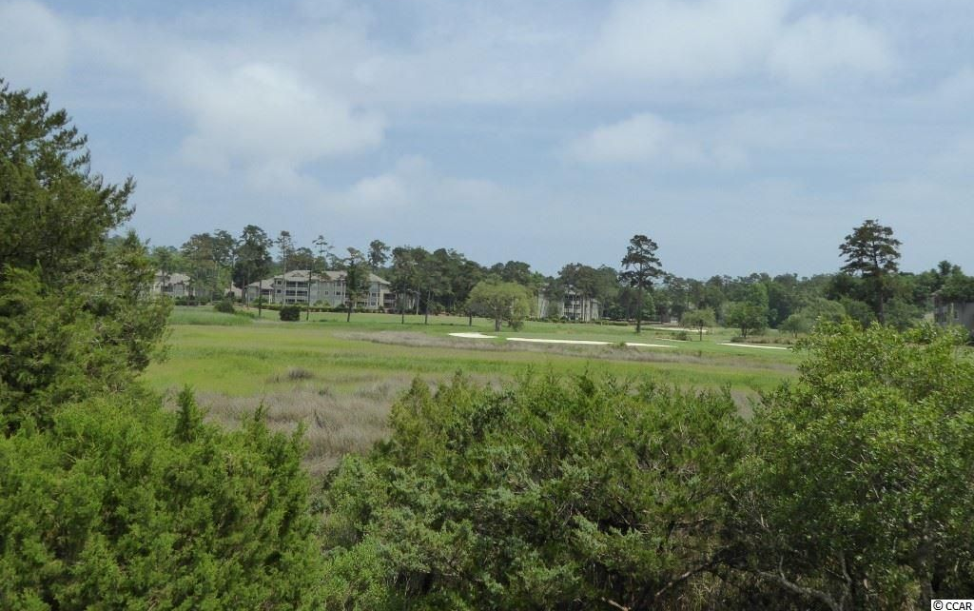
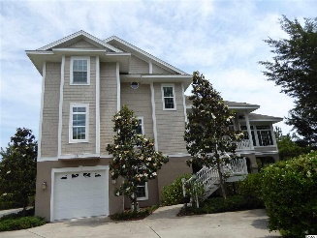
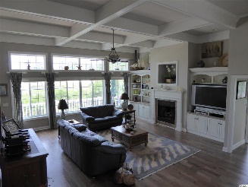
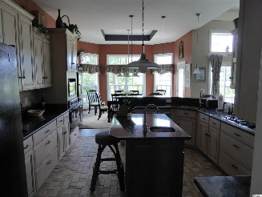
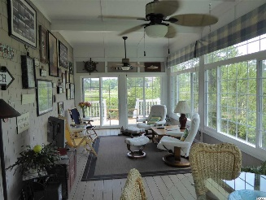
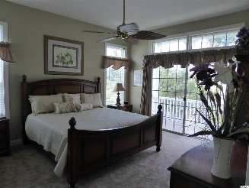
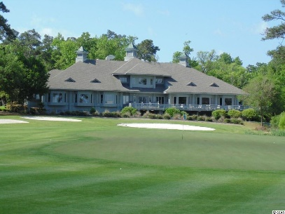
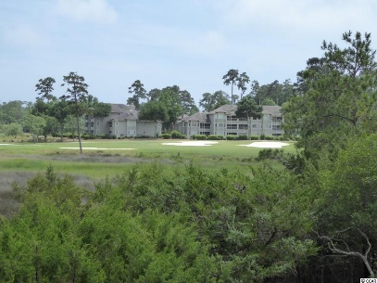
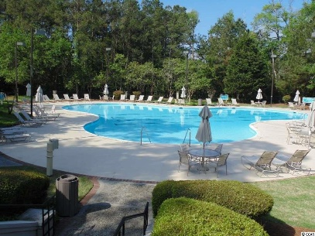
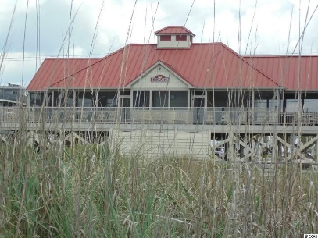


Panoramic view of the Tidewater Plantation
Golf Course and Intracoastal Waterway
4637 South Island Drive
Tidewater Plantation
North Myrtle Beach, SC 29582
MLS# 1510597
$688,900
Prestigious home in Tidewater Golf Plantation. This 3 bed 2 1/2 bath home is a must see to take in all the beauty. Home features, gourmet kitchen, with gas cooktop, convection oven. The great room/living room features coffered ceiling, built-ins and crown moldings. The beautiful finishes in this home makes it ready to move in. It features a first floor master suite. The home has a total of 3500 heated sq. ft. There is a craft/exercise room with great natural light. The garage is large enough to park cars and boat. Beautiful views from all windows of the marsh and the golf course. Marsh and golf course views from anywhere in the great room, Carolina room or deck. There are gorgeous Intra Coastal Waterway views from the Carolina room and front porch. Private waterfront community in this prestigious area of Tidewater, featuring private community pool and private community dock. Association Amenities include community dock. You will have access to all the amenities including pools, exercise facilities, restaurant, golf and clubhouse. Owners have access to private ocean front beach cabana. Gated community with 24/7 security. Most of the furniture is negotiable.
Donna Fortney
703-624-3517
dofortney@aol.com
NEW WAY PROPERTIES MYRTLE BEACH

