Slide 1
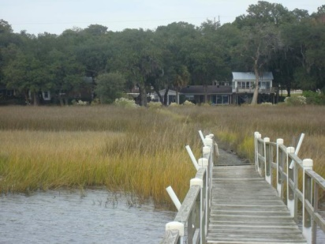
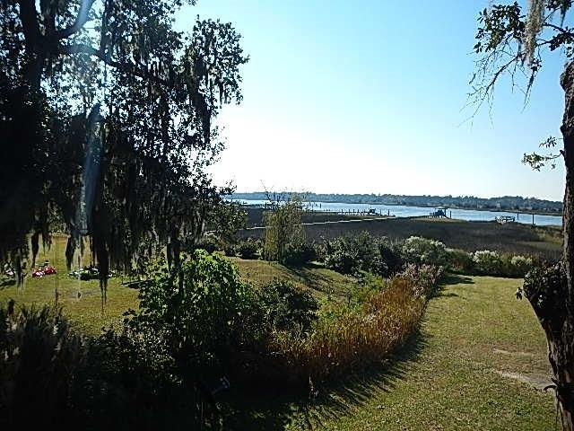
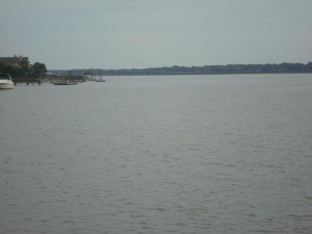
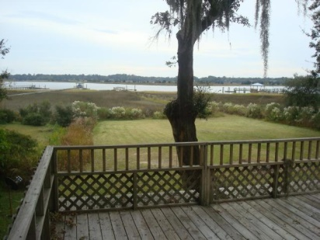
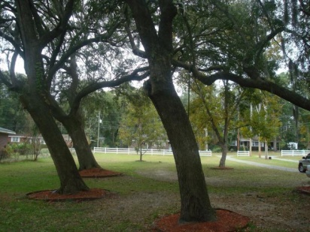
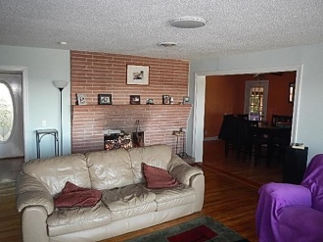
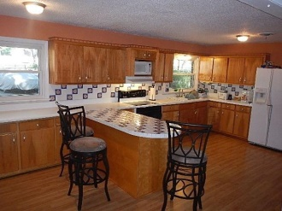
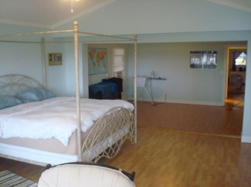
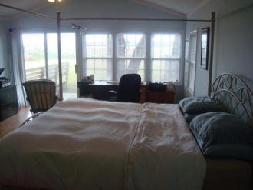
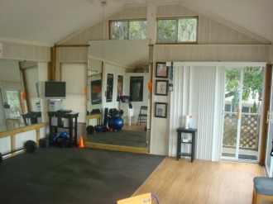
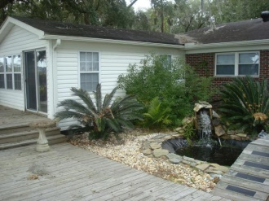
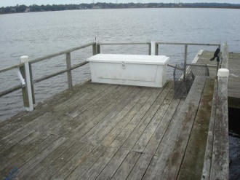
DEEP WATER 2+ACRES $479,000
~ 4641 Apple St ~ Wando Woods ~ North Charleston ~
239 Cypress Gardens Rd – Now a Par 3 Golf Course
Deep water with dock directly on the Ashley River...Only 5 minutes to the I-526...10 minutes to Boeing...15 minutes to downtown Charleston...And less than 30 minutes to the beach! This is a one of a kind property that can't be found anywhere in the Charleston area for this price! Over 1 acre of high land with mature oaks on a dead end street that has the utmost in quiet and privacy and yet close to everything. Wando woods is a hidden gem...It's a well maintained older community with no covenants and restrictions and no HOA fees. This property could have one or 2 lots subdivided from it and resold or you could build 1 or 2 additional homes on the property for your kids or parents or simply to rent out and bring additional income. Don't let the age of the home scare you away...It has been updated and upgraded...The home has an open floorplan that lives larger than it's square footage. The living room, master bedroom, media room all have spectacular views of the rear yard, marsh, and the Ashley River. Where else can you crab, fish, boat, and jet ski from you own 1 acre lot with mature oaks, and only 5 minutes to the I-526 for this price?...Nowhere!!! Also available for lease/purchase for $2000/month...Owner will not lease without a purchase contract...A deferred closing date is ok...
MLS# 14029659 - $479,000 - Purchase MLS# 14029977 - $2,000 - Lease/Purchase
Rick Willis
843-327-3017
rwillisteam@gmail.com
The Group, LLC

