Slide 1
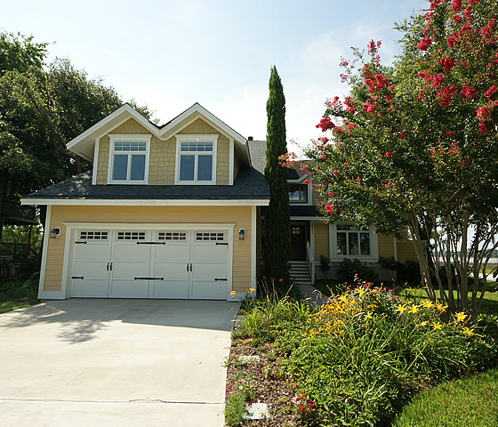
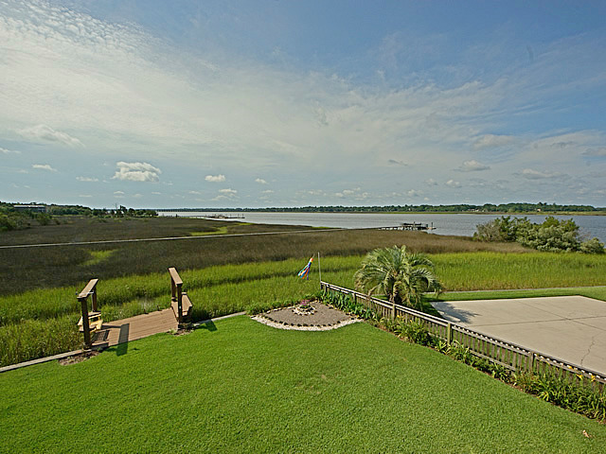
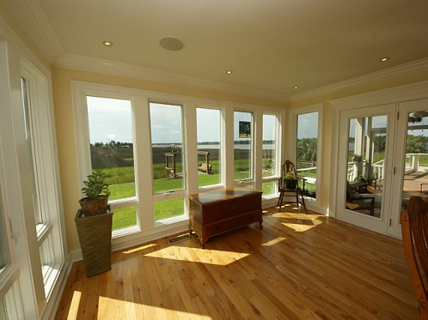
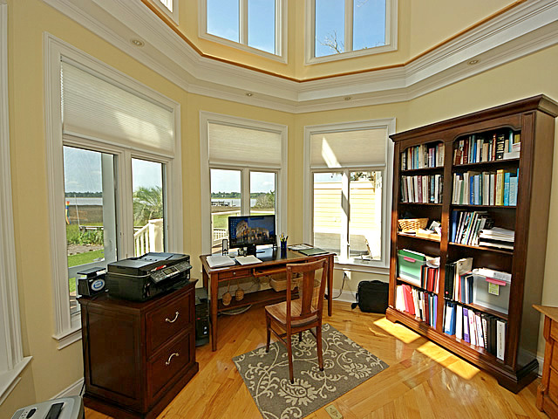
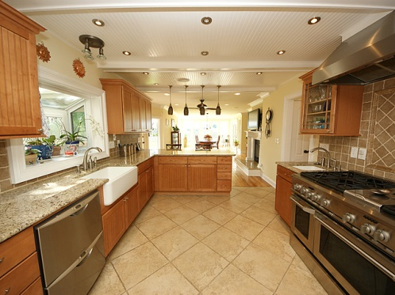
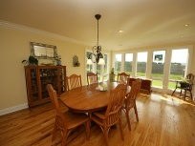
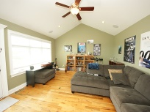
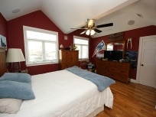

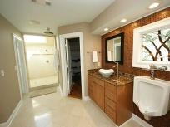
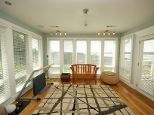
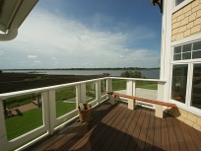
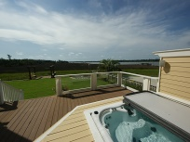

Waterfront with Dock on Tidal Creek Reduced by $52,000!
4641 Ashley View Ln ~ Ashley Point ~ North Charleston, SC
MLS# 1419102 ~ $498,000
Waterfront home with incredible views of the Ashley River from almost every room in the house. Dock in place on tidal creek which puts you in the Ashley River within about 200 feet. Great central location just minutes from I-526 and Boeing. Don't miss this one! Home was remodeled in 2008. Home features beautiful hardwood floors in every room except two of the bathrooms, kitchen and laundry room. The kitchen is a chefs dream with a GE Monogram 6 gas burner stove with hood, large deep sink and granite counter tops. The rest of the appliances are high end stainless steel. There is plenty of detail in the kitchen with beams and bead board on the ceiling, custom tile back splash and wood cabinets with bead board faces. Lots of recessed lighting and a deep window for your plants makes the kitchen light and bright. The master bedroom is huge with high ceilings, a sitting area and plenty of windows with views of the water. The master bath is well appointed with granite counter tops, decorative back splash and huge custom tiled shower with sky light. There are four large outdoor spaces to relax and enjoy the water views. There is a screened porch, large open deck with hot tub, side deck with fantastic outdoor kitchen and a deck off of the master bedroom. Going up the stairs you will notice the wrought iron spindles and at the top of the stairs is a large game room with lots of water views. On the back of the house over looking the water is a unique tower which has an office area/study in the bottom and a extra room up top which is being utilized currently as an art studio. The tower is wrapped in windows which allow tons of natural light. All the rooms in the house are very large and functional. Some of the other great features include custom stained glass windows, tank less water heater and surround sound in every room. There is also a private boat ramp in neighborhood. This is a fabulous property with tons of details, dock on the tidal creek and water views everywhere! Schedule your showing today.
Rob Sturm
M 843-478-2404
rsturm@century21properties.com
Bud Poston
M 843-697-3786
bposton@century21properties.com
Century 21 Properties Plus | 3301 Salterbeck St Suite 100 | Mt. Pleasant, SC 29466

