Slide 1
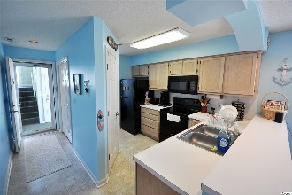
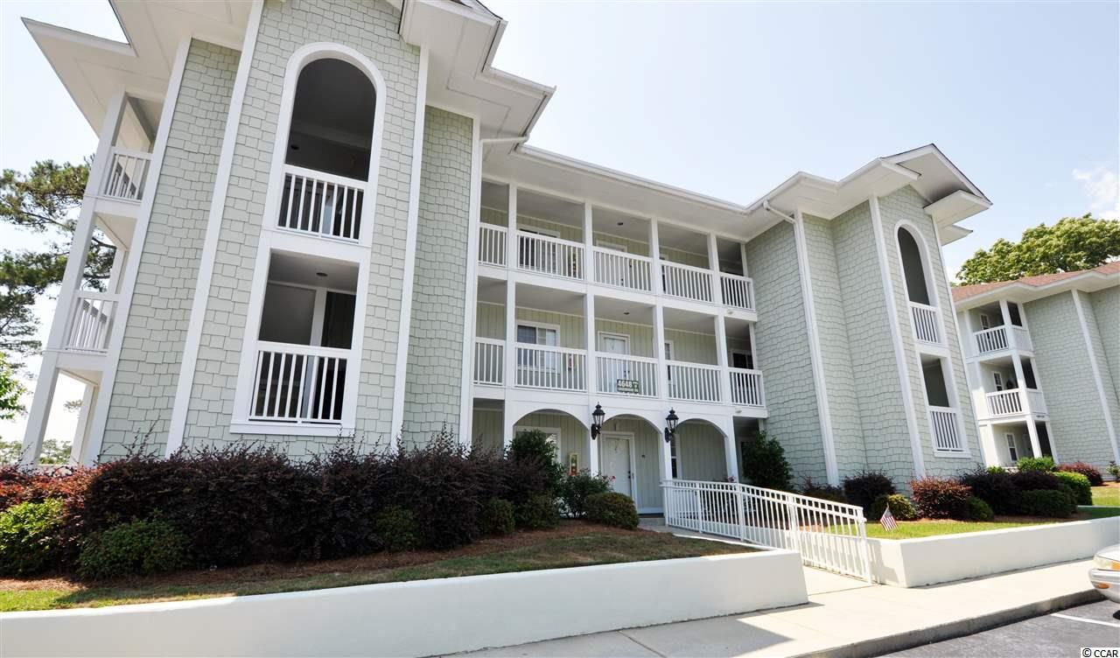
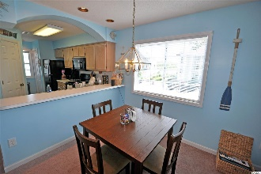
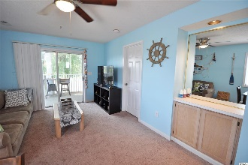
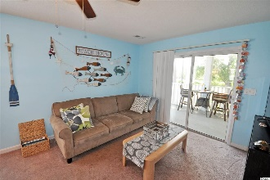
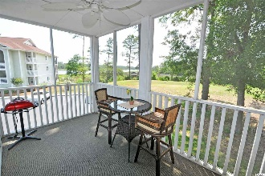
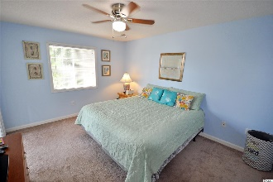
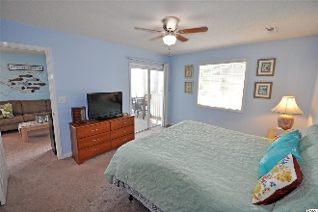
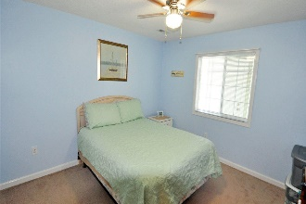
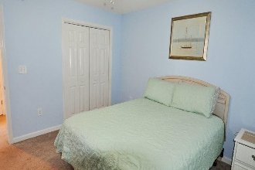
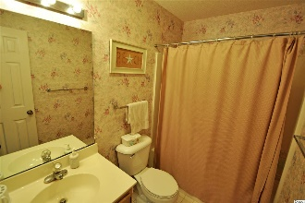


4648 Greenbriar Dr. #D4
Spinnaker Bay E
Little River, SC 29566
MLS# 1911564
$118,500
Views! Views! Views!
This charming beach and golf condo is also preferred by boaters, too, as it is located in the historic Hamlet of Little River, Horry County's second oldest town, which is renown for its proximity to the Intracoastal Waterway, rich nautical history including being a popular pirate port, and easy access by boat to the Atlantic Ocean. See the ICW, the marsh and the Valley at Eastport Golf Course from several windows and the spacious rear screened porch from this light and airy second-floor end-unit gem. You can even see the iconic Little River Lighthouse. Little River is now home to South Carolina's only offshore gaming vessels. The area boasts signature golf courses, wonderful restaurants, antique and thrift trails, recreation, shopping, access to major highways and medical services and everything that the North Strand has to offer. It adjoins North Myrtle Beach, which was recently named one of the safest cities in the nation and with one of the best beaches in the U.S., the nearby Cherry Grove Beach. The school district is North Myrtle Beach as well; however, the taxes are levied at the low Horry County rates. Being sold furnished and with all new appliances and paint, this comfortable and cozy condo is the perfect choice for a home, vacation home or investment property. Short- and long-term rentals are allowed. A big plus is the top-of-the-line Old Republic Ultimate Home Warranty with HVAC coverage included with a full 12 months of coverage. The second-floor front porch area has an owners' closet, nice views and breezes, and condo entry through a welcoming foyer with wide hallway. The kitchen is to the left, is very workable and has appliances only months old, along with a stackable washer /dryer in a pantry-style closet. The perfect floorplan provides that infinity view from entry, kitchen, and living/dining areas. The kitchen has a breakfast bar and spacious cabinet and counter space. The gathering-sized dining room has a big, bright window looking out on the ICW and is great for a family or a foursome! The living space is has a dry bar, is roomy and walks out to the large screened porch with those VIEWS! VIEWS! VIEWS! ICW, golf course (6th hole tee box), marsh and lighthouse; so linger there to just relax, reflect or savor morning coffee or an evening glass of wine. The porch is accessible from the master bedroom, ...so the big master bedroom has two remarkable views from the porch-entry door and another BIG window. There are a closet and en suite with vanity and tub-shower combo. The second large bedroom is in the favored split-bedroom layout and has a Jack & Jill bath that functions as a second lock-out master en suite or a guest bath with convenient entry from the living space. And there is a linen closet. Living and bedroom areas have new ceiling fans. This Eastport remarkable find enjoys 2 pools, golf and a golf clubhouse with snack-bar, and lovely streets and neighborhoods to walk and bike ride. Really, this condo home does have it all and at an amazingly affordable price. See it today; those singular VIEWS ,VIEWS, VIEWS await!
Deborah Collins
843-424-9013
dctidewater@yahoo.com
Connie Ross-Karl
702-306-2643
conniesross@aol.com
NEW WAY PROPERTIES MYRTLE BEACH

