Slide 1
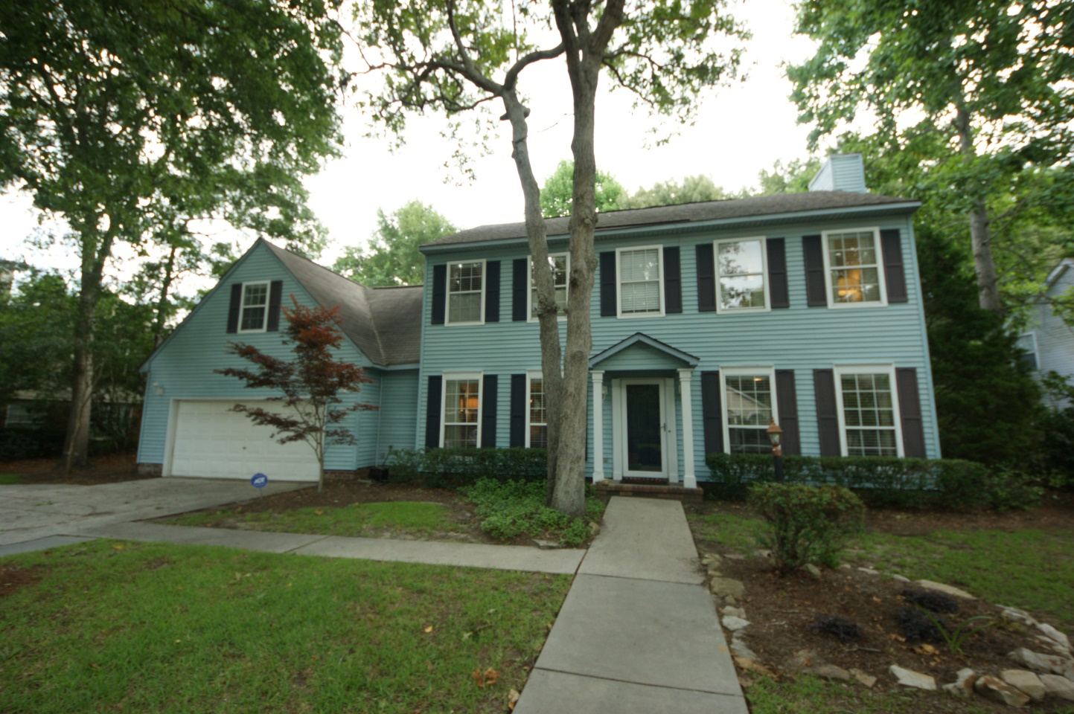
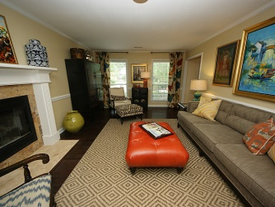
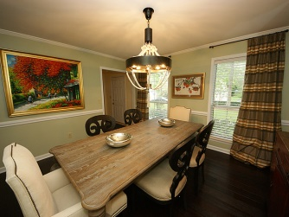
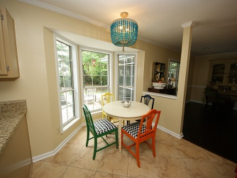
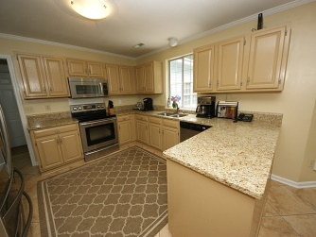
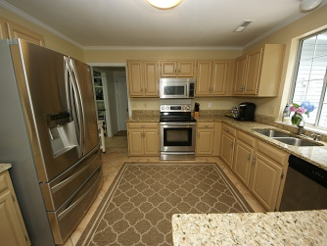
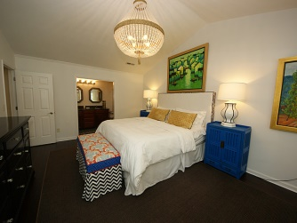
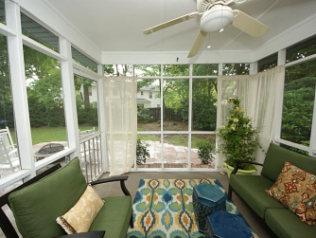

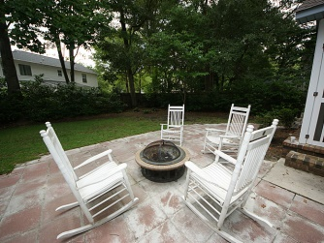
Open House :: Friday 6/27 :: 11-2
464 Springfield Rd
Longpoint
Mount Pleasant
MLS# 1417185 // $479,900
Fantastic home located in desirable Mt Pleasant neighborhood!
In close proximity to shopping, Mt Pleasant Schools and Palmetto Islands County Park. Neighborhood amenities include tennis courts, neighborhood large pool, green space, and clubhouse. Home has 5 bedrooms, 4.5 baths serving a multitude functions. Boasting 2 large mother in law suites that could be used for multi purposes. Many upgrades to include: hand scraped stranded bamboo flooring throughout downstairs and upstairs; added Berber carpet to the living room in upstairs mother in law suite; new fireplace mantel, gas logs and travertine hearth; new faux wood blinds in 20 windows; custom walls in both guest bedrooms; all trim and first floor ceilings have a fresh coat of paint; new mirrors in master bathroom; in addition to the mature landscaping, owner has added 2 new tea olive trees, boxwoods, a ligustrum tree, and hydrangeas.
Other notables: stainless steel appliances, granite counter tops, tile flooring found in kitchen. Screened porch overlooking large slated patio and a private fenced in backyard; loads of parking from the 2 car garage, driveway and circle driveway in front of home.
This home is not to be missed and will not last long due to its price, versatility, quality and condition!
Karla Leahy
Realtor CRP, ASP, QSR
karlaleahy@gmail.com | (M) 843-452-6670
www.yourlowcountryproperties.com
Harbor City Real Estate Advisors | 510 Live Oak Drive | Mt Pleasant SC 29464

