Slide 1
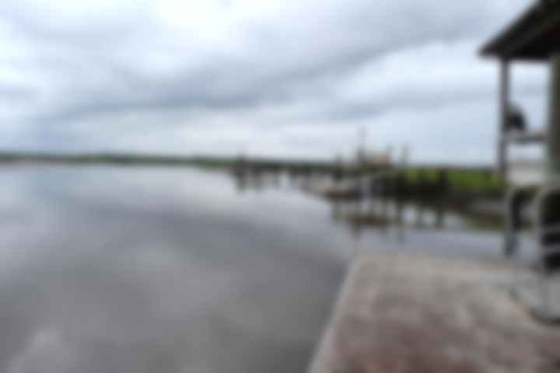
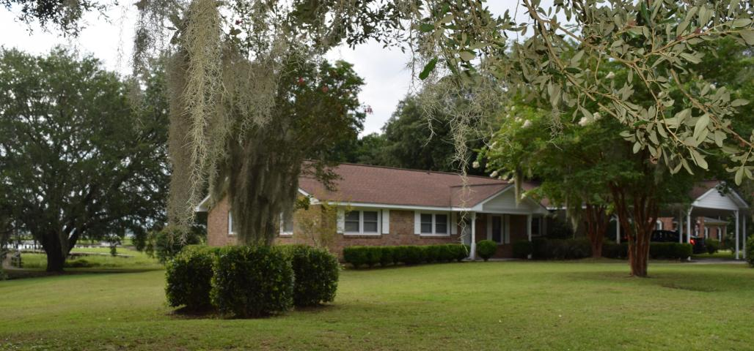
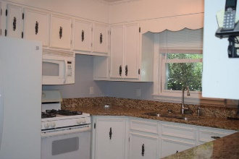
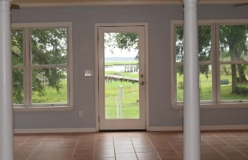
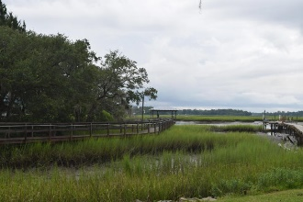
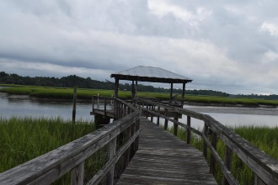
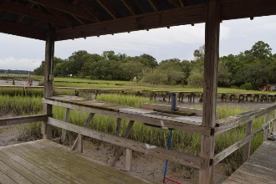


Waterfront Home With Dock ~ Beautiful Views Of ICW
4651 Shark Hole Road
Meggett, SC 29449 • MLS# 18020331 • $599,000
Price just reduced by $36,000 Just Under $600,000 for Deepwater and dock home.
True lowcountry living on deep water! Private covered dock. 7-8 feet at low tide. Dock has floating dock, running water and electricity. This one level home is on 1.12 acres surrounded by beautiful mature oak trees. Enjoy the sunroom as you gaze out at the views of the Intra Coastal Waterway or launch your boat and be on ICW in less than 5 minutes. Catch fresh fish, crab, and shrimp in your own backyard. Home has brick wood burning fireplace in great room, kitchen has granite countertops with tile backsplash and gas range. The spacious converted garage with full bath would make a fun Game or Man Cave. The information herein is furnished to the best of the Listing Agent's knowledge, but is subject to verification by the purchaser and their agent. Listing Agents assume no responsibility for correctness thereof, nor warrant the accuracy of the information or the condition of the property. Buyer to verify schools, cost of insurance and square footage.
Christina Garvin
(843) 270-7667 | cgarvin63@gmail.com
Elaine Brabham and Associates, LLC • 1890 Sam Rittenberg Boulevard, Suite 217 • Charleston, SC 29407

