Slide 1
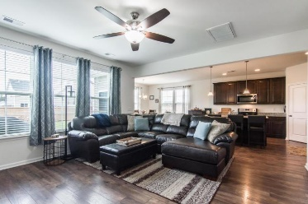
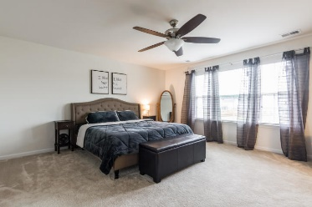
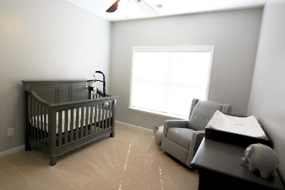
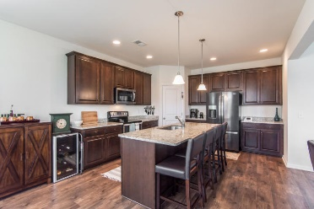
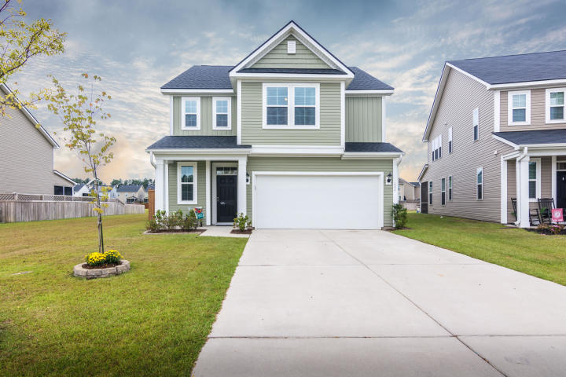
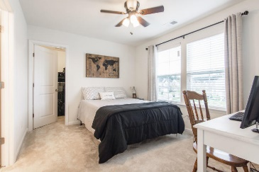
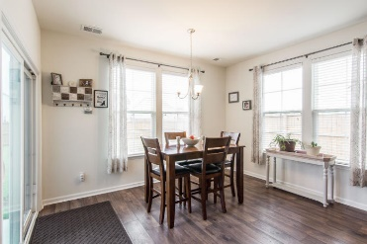
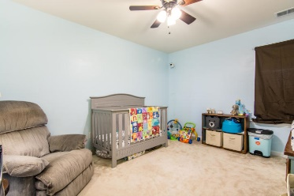
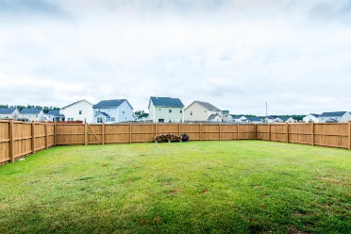
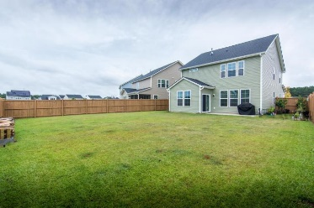



466 Spectrum Road Cane Bay Plantation Summerville, SC 29486 MLS# 20025086 | $289,000
Cane Bay
Move-In Ready
OPEN HOUSE
Sun 12-3
$50 Gift Card Drawing
Just listed in Cane Bay Plantation, one of the most popular communities in the country! With interest rates so low, now is the time to take advantage of homes that are ready to close right away. This awesome Merlot floor plan by Dan Ryan Builders is like new, built in 2018 and immaculate! The first floor includes gorgeous scratch resistant 8'' plank laminate wood flooring, a tray ceiling in the foyer, huge open spaces, gourmet kitchen with granite counters, enormous island, pendant lighting, recessed lighting, wood cabinets with hardware, smooth-top range, walk-in pantry and more. There are three bedrooms upstairs. The secondary bedrooms share a large Jack and Jill bathroom with a separate shower area. The granite counter tops are beautiful in there too! The master suite is enormous and takes advantage of the lovely pond views. The master bath includes a 5' walk-in shower, linen closet, raised double vanity with granite counters, a water closet and huge walk-in closet! There is also a functional loft area at the top of the steps perfect for a home office, school area or a space for your workout equipment! The owners upgraded the roof when they built it to an architectural roof. They also upgraded to a tankless water heater! The owners fenced in the yard with a 6' wooden privacy fence that has been stained to preserve it. There is a back gate which allows easy access to the ponds and easement which provides the owners of this home the feeling of more space and separation from the home next door as well as those behind it! Cane Bay has top rated schools and is self contained with its own restaurants, services, grocery store, gas station, YMCA and more!
Beth Moore
M (843) 532-4892
bmoore@carolinaone.com
Meg H. Kandik
M (843) 814-5137 | O (843) 603-4659
Meg@HolyCityRE.com | www.holycityre.com
Bennett Construction & Realty | 792 Folly Rd | Charleston, SC 29412

