Slide 1
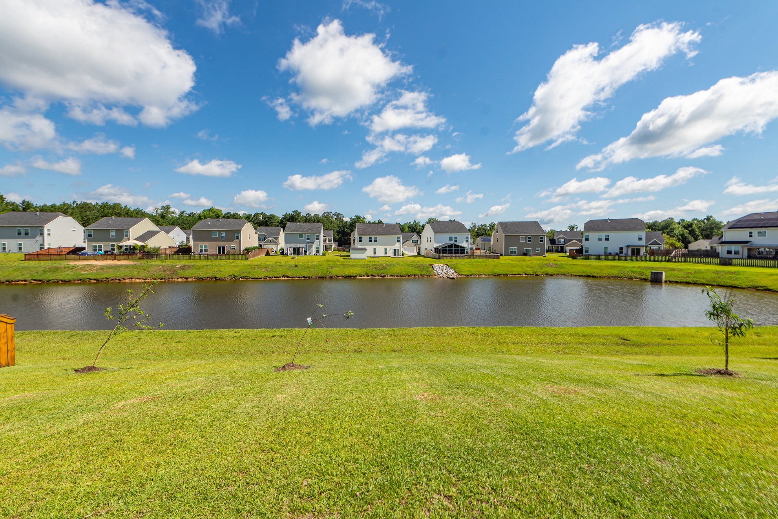
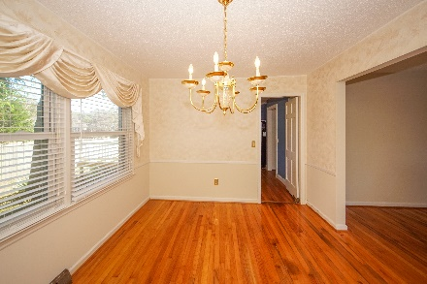
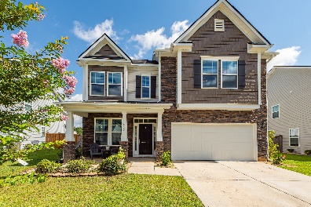
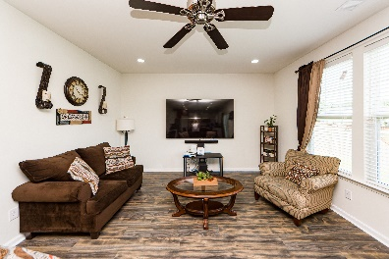
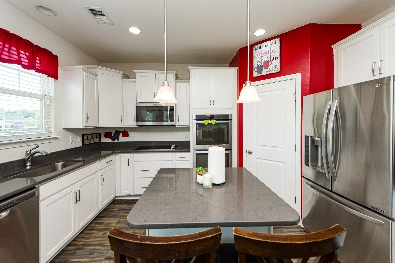
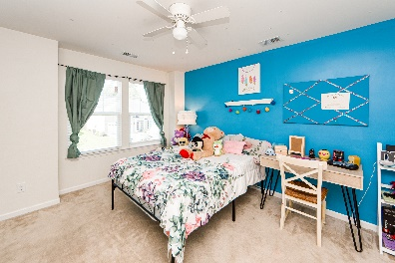
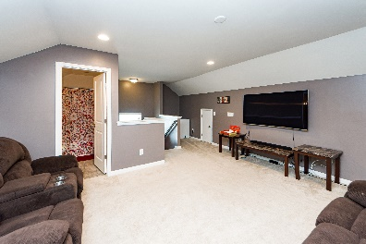


467 Gianna Lane
Sophia Landing | Goose Creek, SC 29445
MLS# 22019411 | $420,000
Otranto Beauty
$318,000
Open House Sunday 12:30-3:30
Stunning…
Move In Ready!
Opportunity to own a 3 Story Home. First floor is open with formal living, den and Gourmet kitchen with double ovens, stagger white cabinets, pantry and island. Second floor has over sized master bedroom with separate tub/shower and 3 nice sized additional bedrooms. Third floor has a spacious rec room/living room with full bedroom and full bath perfect for mother in law suite, visiting family. Sellers selected top of the line upgrades inside the house but also upgraded the front elevation and this over 3000 square foot home stands tall on a premium lot backing up to a pond. All 3 floors have separate thermostats/ac units and are serviced every 6 months. New owner will take advantage of a well maintained home! This home is a must see and must own!
Come take a virtual tour: https://charlestonvirtualhomes.com/2220293
Connie White, Broker
843-532-3356
connie@chrepros.com · conniewhiterealestate.com
Charleston Homes · 597 Old Mt. Holly Road · Suite 301 · Goose Creek, SC 29445

