Slide 1
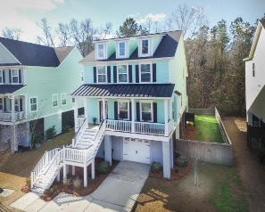
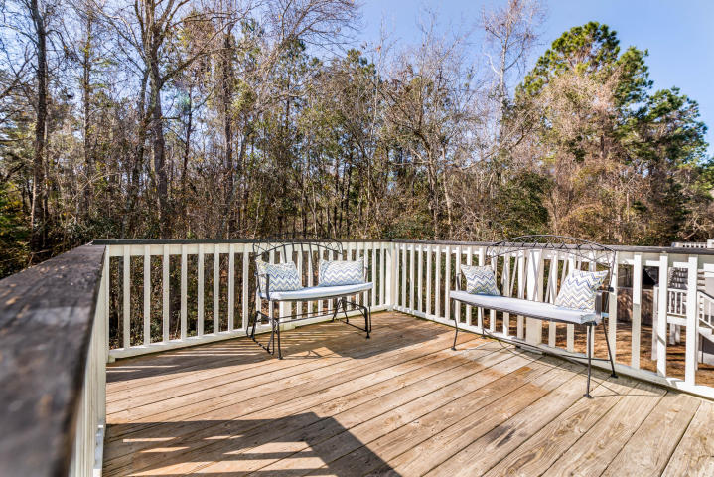
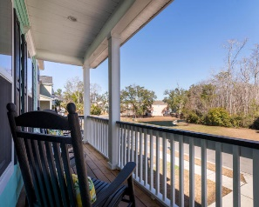
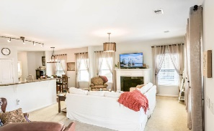
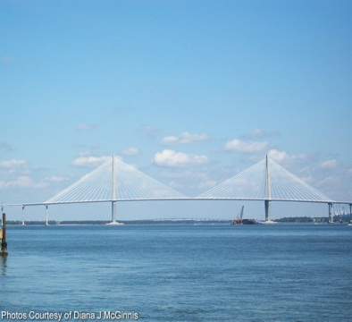
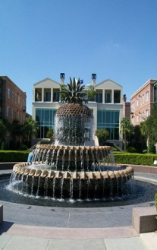
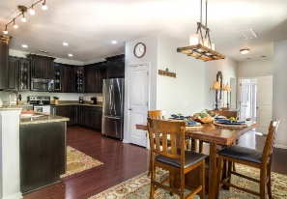
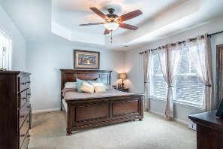
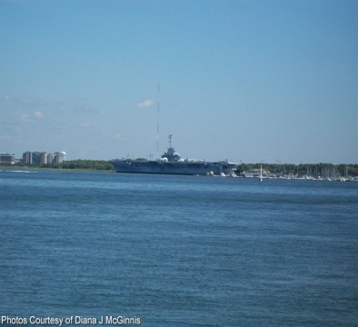
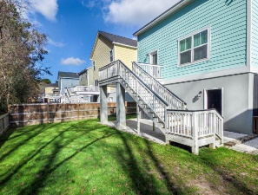


OPEN HOUSE
Sunday April 15th
1:00 - 4:00
$450,000
$450,000
469 Sanders Farm Lane
Retreat at Beresford · Charleston, SC 29492 · MLS# 18002664 · $439,900
Rodney Hancock
(843) 437-1347
rodneyhancock08@gmail.com mortgageprofessionalsonline.com
Southern Living at its finest! This spacious Charleston Single home is conveniently located on a quiet street within the Retreat at Beresford and within minutes to everything Charleston. When you enter the property, you will notice the open floorpan that is perfect for entertaining. From the foyer, your eye is drawn to the main living area with fireplace and tons of windows with natural light. The open kitchen has tons of cabinet space, stainless Steel Appliances & Granite Countertops which are ideal for your guest. The master suite is downstairs and has great size closet and his and her sinks and Jacuzzi tub with a separate shower. The half bath has been upgraded to tile and shiplap. The laundry room has been upgraded with cabinets as well. The 2nd story has three additional bedrooms. Two are being used as guest rooms and one is currently being used as an office. There is another room that could be a huge closet or another small bedroom or office. The 2nd full bathroom has been updated as well with a tile shower. The garage is huge and the seller added an oyster shell concrete pad in the backyard that is perfect for grilling and entertaining!
AgentOwned Charleston Group
902 Savannah Hwy
Charleston, SC 29407
Real Estate ● Mortgage Insurance ● Business Brokerage

