Slide 1
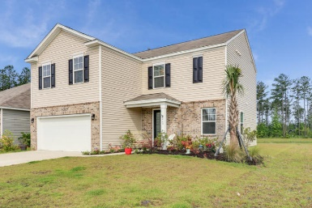
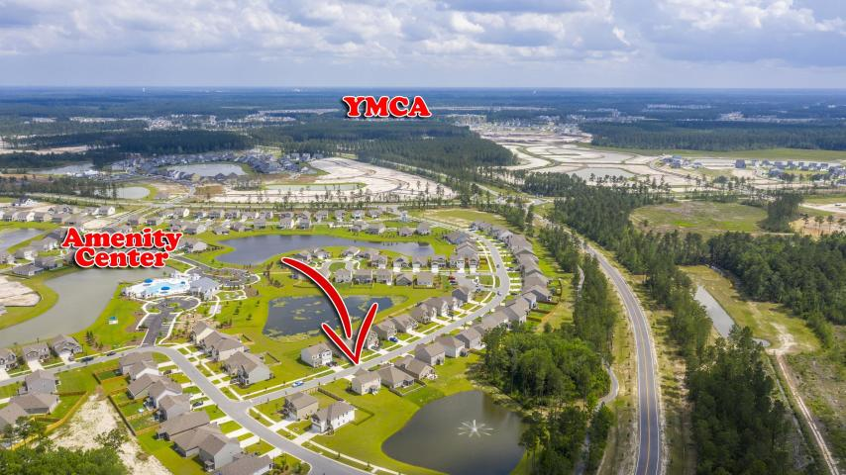
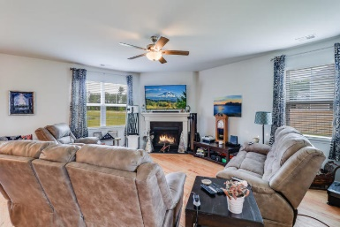
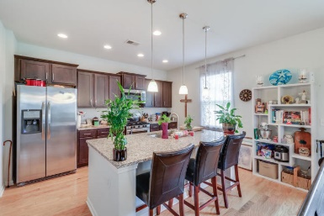
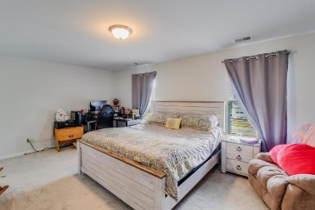
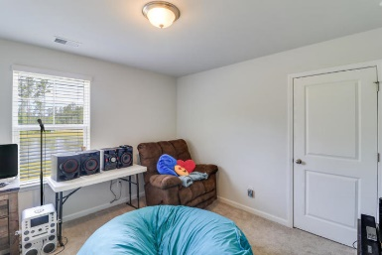
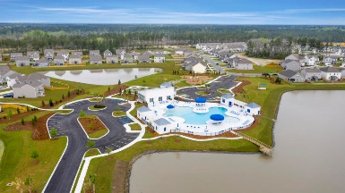
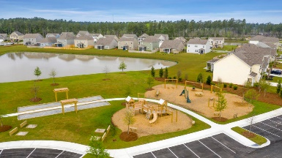

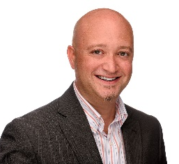
469 Zenith Boulevard Cane Bay Plantation | Summerville, SC 29486 MLS# 20014090 | $299,900
Agent Open House! Oct 15th 11-1
$2,500
Agent
Bonus!
The Sunset Views over the Water, Fountain, and Pine Trees in the rear yard of this 2,239 Sq Ft Calhoun Plan 4 BR home sets in apart from all others in the Meridian at The Lakes of Cane Bay. Built by D.R. Horton in 2018, this Home features $24,500 in Option Upgrades and a $10,000 Lot Premium. Purchased with a 10 Year Construction Warranty and Mfg. Warranties on all Appliances. Relax on the screened rear patio, open the double rear patio doors, or open any 1st or 2nd Floor windows, and enjoy the sight and sound of the water and fountain surrounded by a beautiful wooded buffer of tall pine trees. Not only is the home centered on this water-front lot, it is within a block of the community amenities, to include a large playground & pool also surrounded by water, and uniquely backs to the newly-opened rear access road to the development, facilitating daily commutes.
The 1st Floor offers an open concept living area, with Foyer, Family, Dining, & Kitchen facing the water. The Family Room features cathedral ceiling and gas fireplace, with the kitchen affording stainless steel appliances, granite counter tops, and an abundance of cabinet and storage space. The central dining area is centered on the double patio doors facing the water.
The 2nd Floor segregates the Master BR retreat from the 3 BRs facing the water to the rear of the home, and sharing a large BA. The Master BA affords double sinks and walk-in glass door shower.
Don't miss the opportunity to own this unique home in the sought-after Cane Bay Plantation community! Can Bay Plantation offers all residents miles of walking / biking / golf cart trails, an abundance of retail shopping, and elementary, middle, and high schools, all within the development.
Virtual Tour: https://my.matterport.com/show/?m=WgNiEa5WQVH
Brandon Ray
(843) 499-1928
brandon.ray@carolinaone.com
www.therightrayhome.com
Carolina One Real Estate
900 N Main St
Summerville, SC 29483

