Slide 1
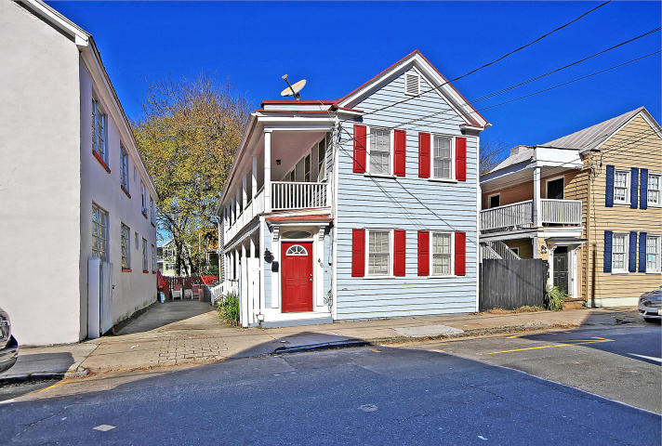
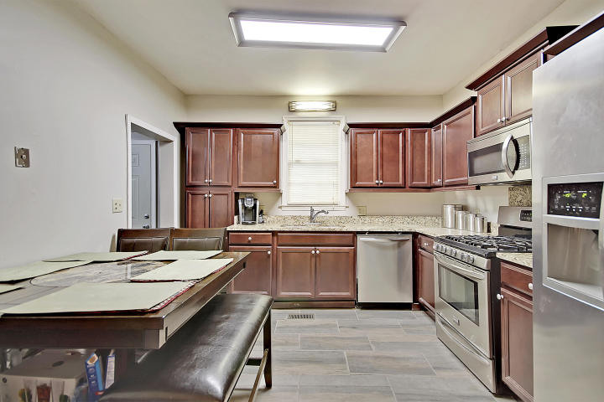
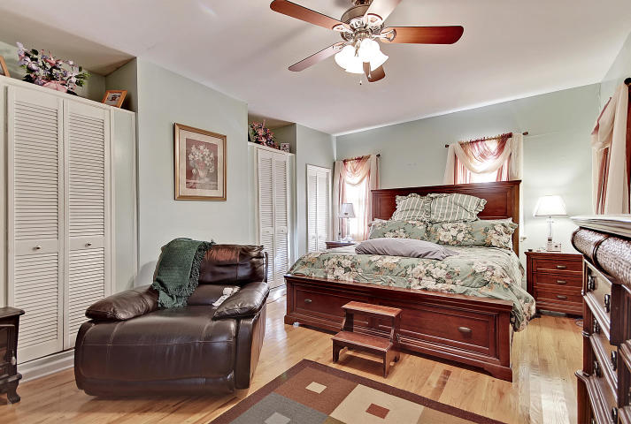
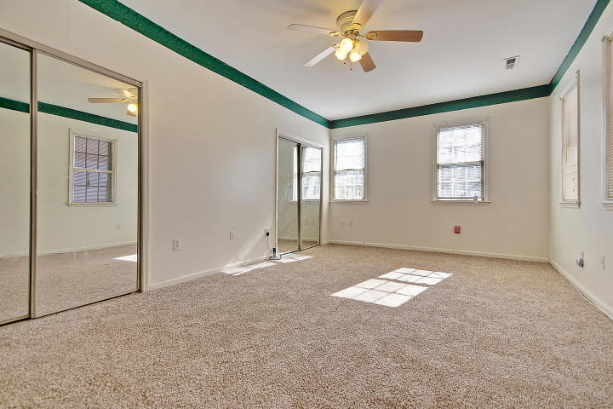
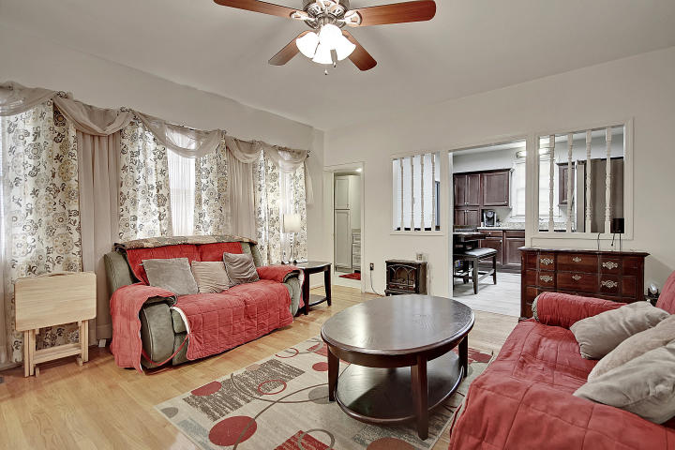
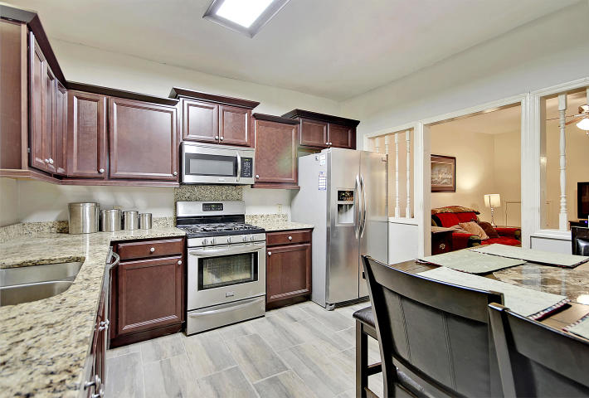
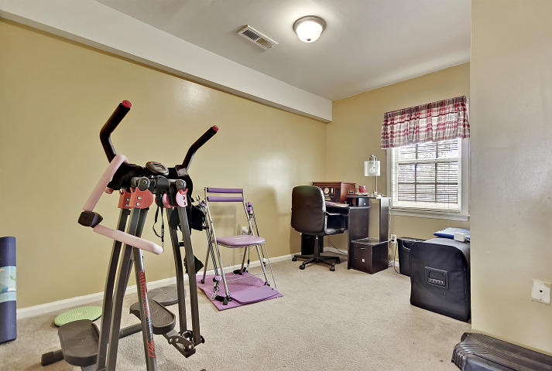
Charleston Single with Duplex Option
Price Reduced!
46 South Street
Charleston, SC 29403 ~ MLS# 18032250 ~ $545,000
Located in the heart of downtown Charleston, this Charleston single style home features the traditional double, side porches & a gated entry to great off street parking. The kitchen has been beautifully renovated as well as the full bath on the first floor. The home is currently set up for a first floor master bedroom situation but could easily be used as a 2nd living room. The upstairs boasts 3 bedrooms, a sitting room, full bath & access to the balcony. The spaciousness of the outdoor living spaces offers amazing options to entertain & enjoy the outdoors. The backyard area is well maintained & has a shed for storage. Walk out the front door, turn left & you can see the Ravenel Bridge! With tons of historic charm & convenient location that is hard to beat, this home is a must see!
Additional features include:
Kitchen has granite counters, stainless steel appliances, staggered cabinets and hardwood tile flooring
Hardwood floors
New carpet upstairs and in master bedroom
Separate new laundry room
Book your showing today!
Susanna Lee susanna@mattoneillteam.com 843-870-9960

