Slide 1
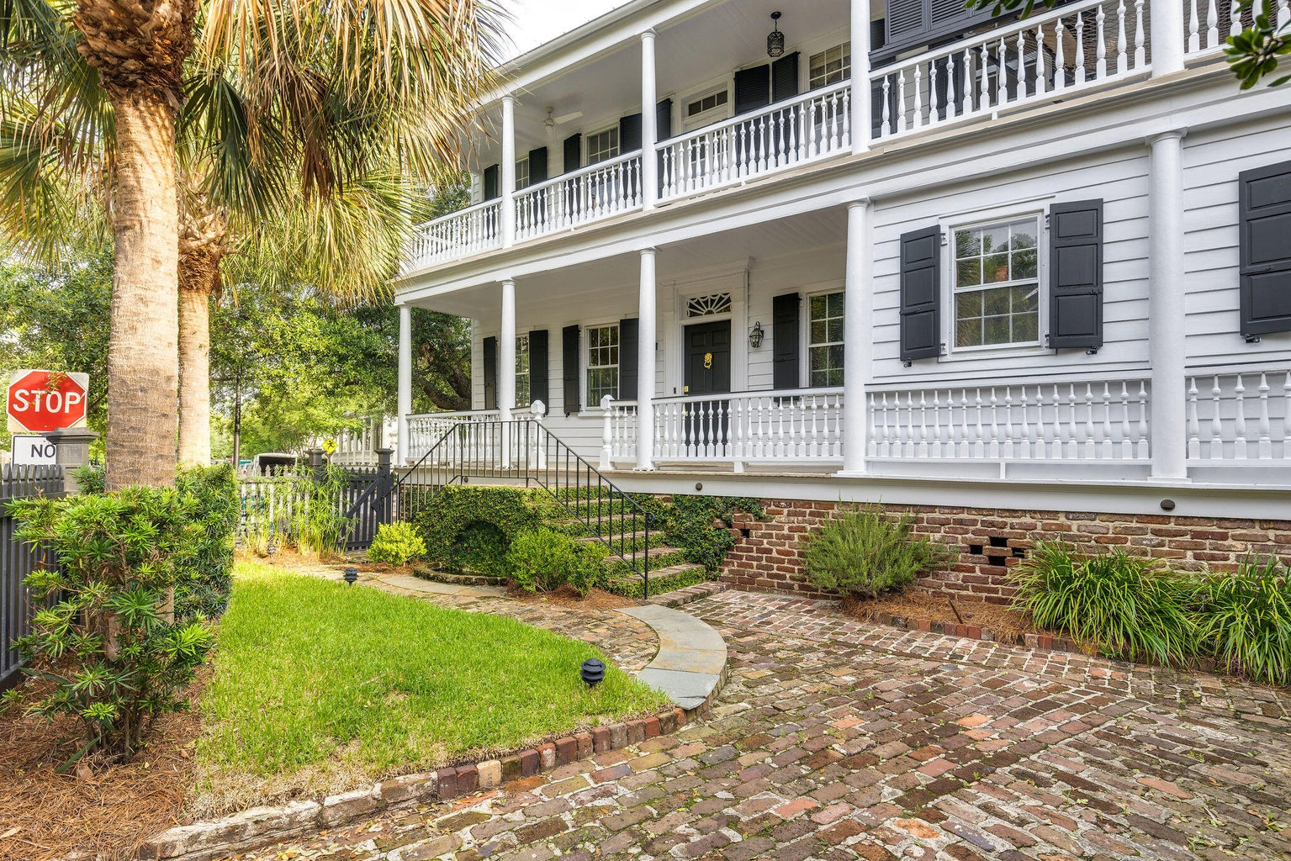
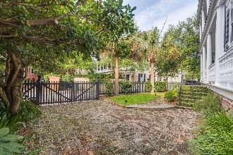
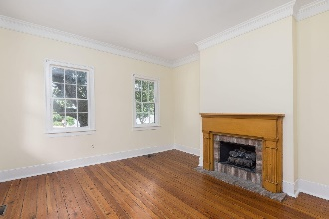
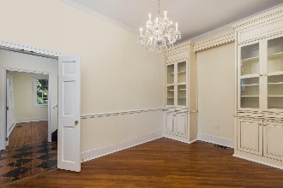
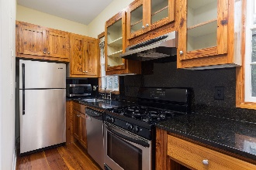
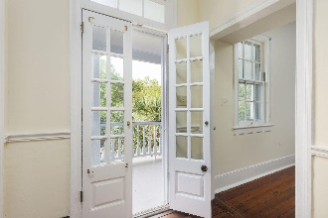
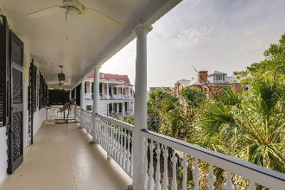
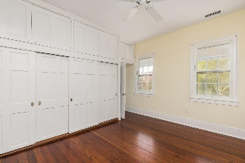
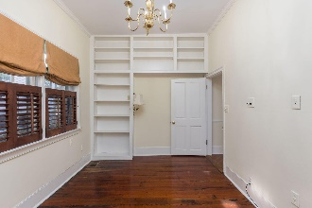

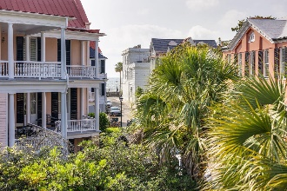

46 Church Street
South of Broad | Charleston, SC 29401
MLS# 23010708 | $2,220,000
Wild Dunes Swim & Social
Membership w/ Acceptable Offer
Charming South of Broad Home
Great Price Adjustment
Charming c.1800 home located in Historic South of Broad, one of the most desirable neighborhoods in downtown Charleston. Just steps from the Battery overlooking the Charleston Harbor.
This home has all the character and charm of historic Charleston, Including original heart of pine flooring, beautiful crown molding along with high ceilings. The perfect pied-a-terre which has recently been updated, freshly painted, both interior and exterior.
Private off-street parking in bricked gated driveway with lush landscaping along with a charming garden fountain that provides soothing sounds of rippling water.
Linda Laird
REALTOR
M (843) 209-7571 | O (843) 886-8110
linda.laird@carolinaoneplus.com | www.lindalaird.com
Leading Real Estate Companies of the World
Carolina One Real Estate
1503 Palm Blvd
Isle of Palms, SC 29451-2280

