Slide 1
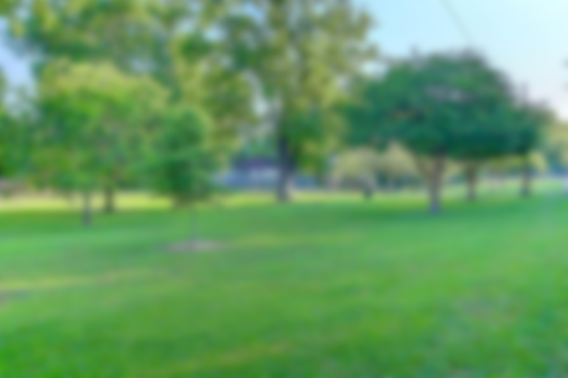
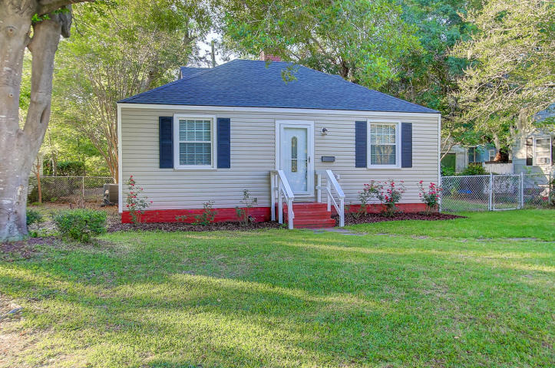
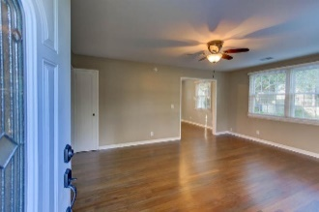
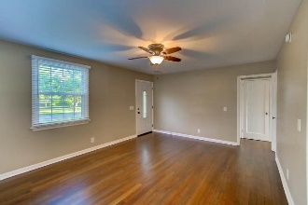
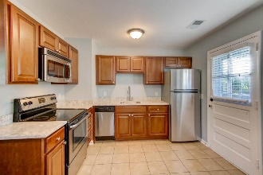
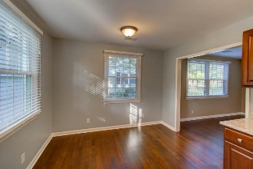

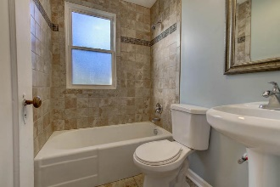
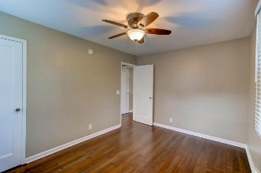
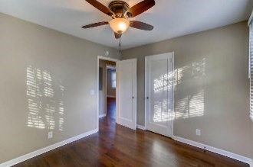
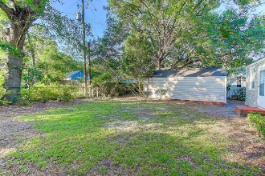
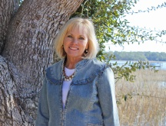

4710 Brookside Drive
Only 4 Blocks From Park Circle
North Charleston ~ MLS# 17013781 ~ $219,000
Remodeled Bungalow with great curb appeal 4 blocks from Park Circle and across the street from beautiful green space & play Park! Totally remodeled down to the studs in 2015. Refinished original wood floors, new sheetrock, new windows, tankless H2O heater, upgraded electric & plumbing, striking quartz counter tops, modern porcelain tile bath/shower surround, stainless smooth top range AND stainless refrigerator, built in microwave AND you get a washer/dryer included! HVAC, kitchen cabinets & roof shingles only 2 yrs old! Separate garage provides plenty of extra storage. Fenced back yard*Gorgeous trees in yard! As a bonus, home is currently under termite bond! Move in READY now!
Sheila Romanosky
(843) 224-0242
sromanosky@carolinaone.com

