Slide 1
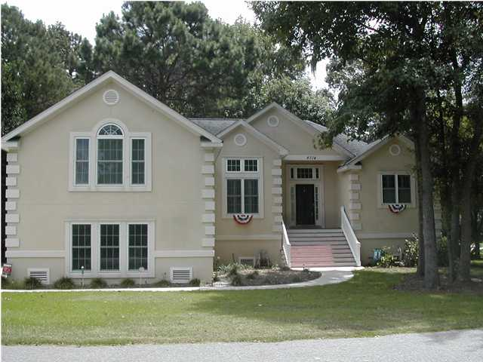
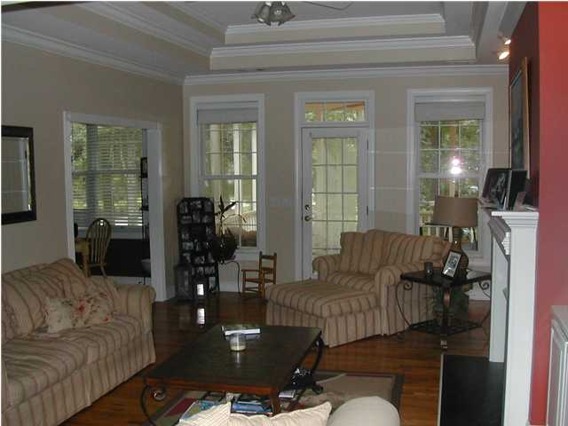
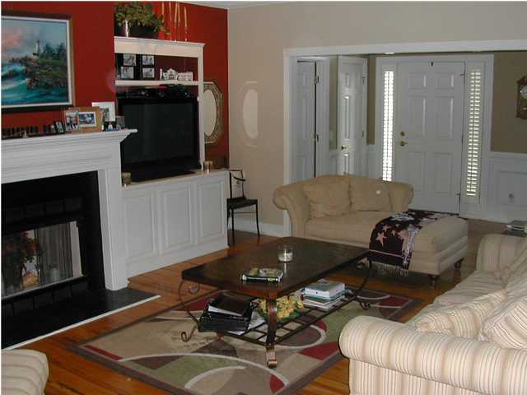
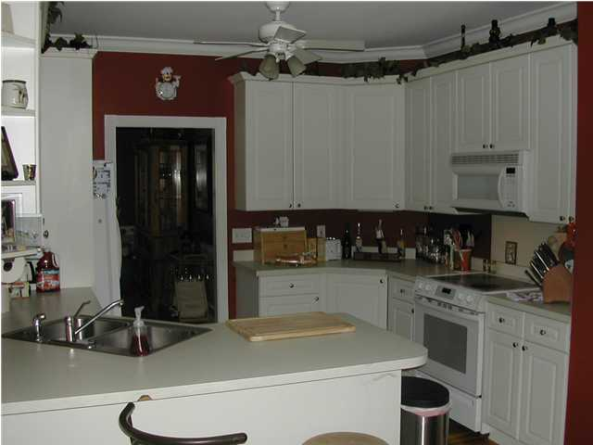
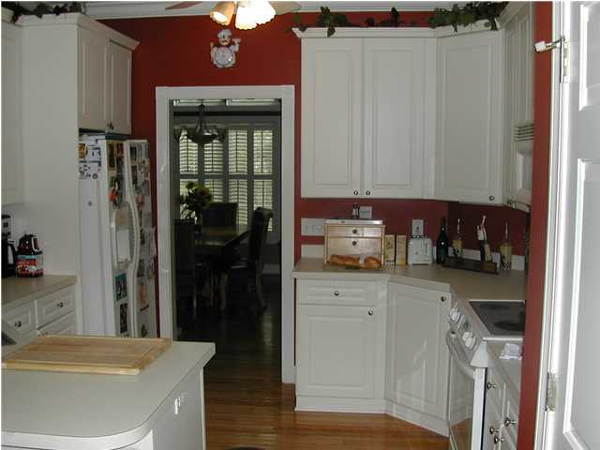
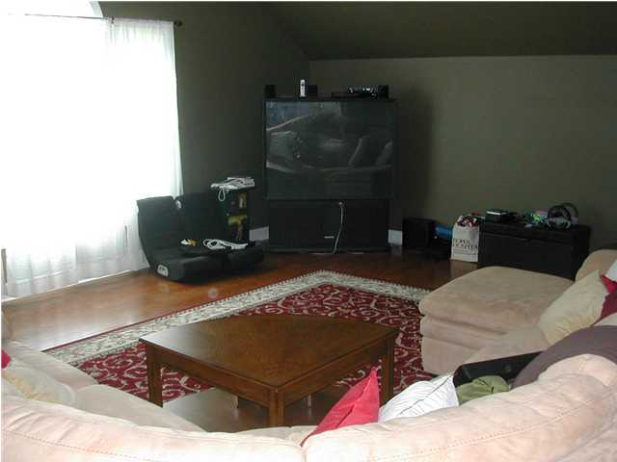
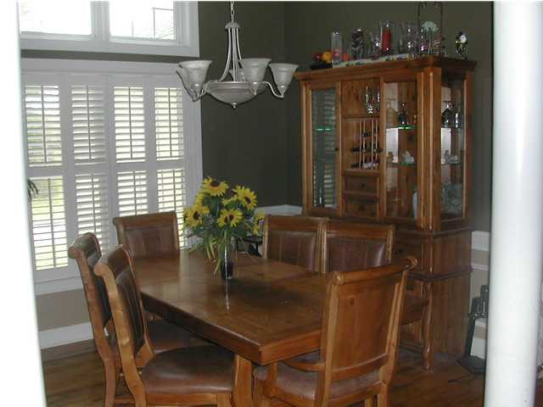
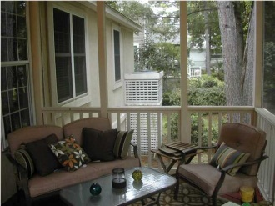

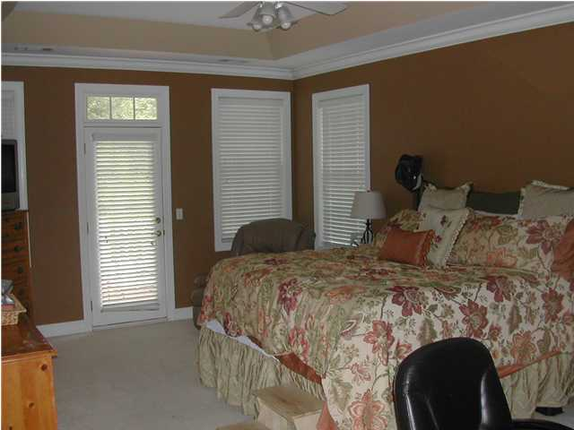
Short Sale! Bring Offers!
4714 Hard Scuffle Ln
Stono Ferry ~ Hollywood
MLS# 1216754~ $325,000
Stucco one story home in desirable Plantation At Stono Ferry, a gated golf and equestrian neighborhood.
3BR/3BA with some 9 foot ceilings, eat-in kitchen, formal dining room, fireplace in great room with built ins.
Screen porch and an open deck on back.
This is a short sale subject to 3rd party approval.
Rob Sturm
Mobile 843-478-2404
rsturm@eratidesrealty.com
Bud Poston
Mobile 843-697-3786
bposton@eratidesrealty.com
843-763-1817 x2

