Slide 1
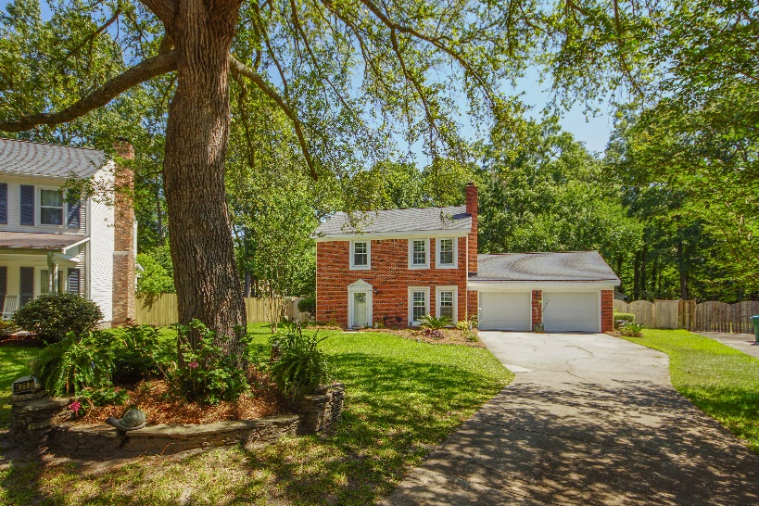
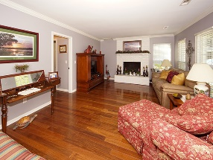
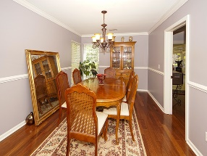
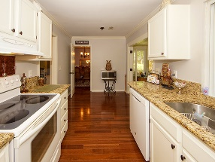
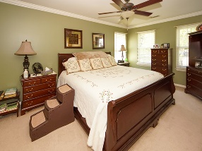
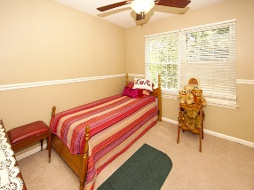
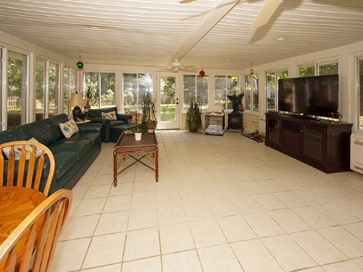
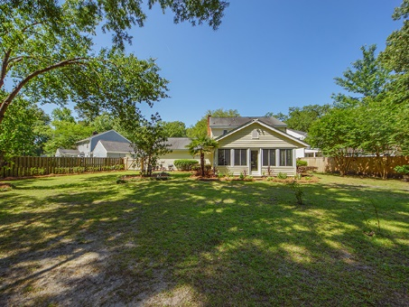
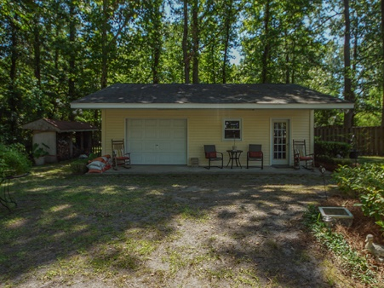


4717 Blakeford Court Woodington Charleston, SC 29420 MLS# 19014461 | $277,500 2,276 Sq Ft - 3 Bedroom – 2½ Bath
NEW PRICE! LARGE SUNROOM + DETACHED WORKSHOP
This is absolutely a one of a kind home that has been upgraded and well maintained over the years. The kitchen, family and dinning room downstairs consist of fairly new wood flooring , smooth ceilings and crown molding. In the cozy kitchen you will find granite countertops, a brand new dish washer that has not been used and a very spacious walk in pantry to store all your dry goods. Near the kitchen there is a half bath for your convenience. Through the double French doors awaits your hidden oasis. The additional 24x23 spacious Florida Room with a panoramic view of your private fenced yard comes equipped with 2 ceiling fans and is own heat and air unit and windows that slide open on days you want to enjoy the fresh air. The back yard is a gardeners dream with ample shade to relax.
Further in the back yard is a detached garage with a porch that can be used as a man cave/workshop or finished for a mother-in-law suit whatever your needs may be. As you travel upstairs you will see a lift that will be removed and carpet replaced before closing. There is carpet in all 3 bedrooms upstairs and remote ceiling fans for your pleasure. You will enjoy the roomy master bedroom with his and her closets and Jacuzzi tub with new wall tile.
Brand Name Real Estate
4 Carriage Lane Suite 106
Charleston, SC 29407
Barbara Limehouse
843-870-8291
bllimehouse@gmail.com

