Slide 1
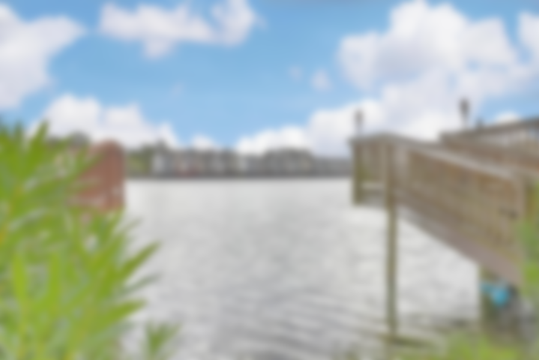
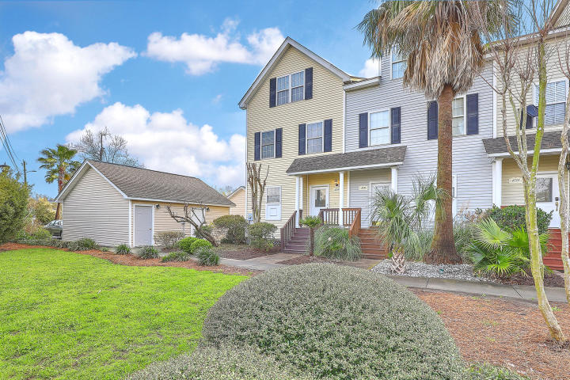
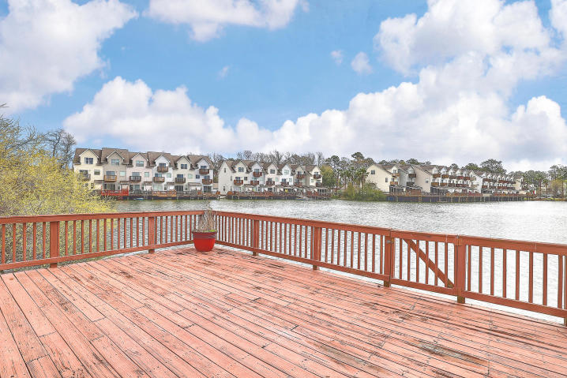
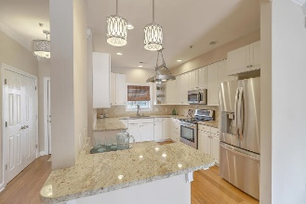
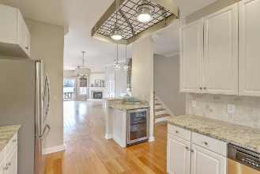
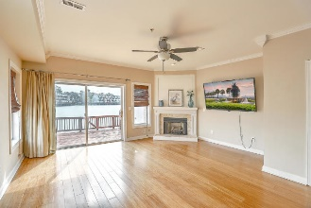
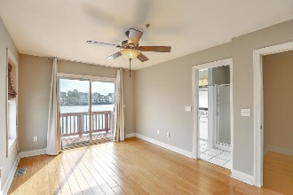
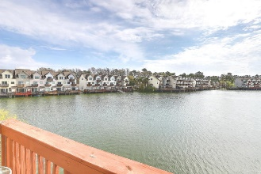
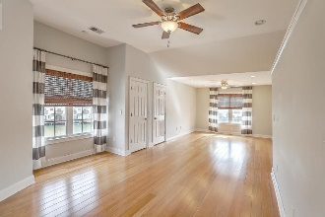
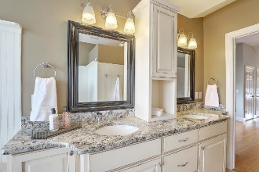
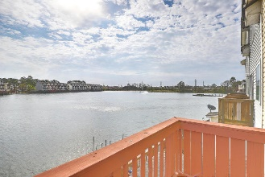
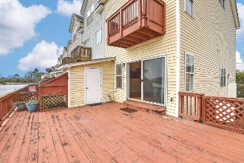
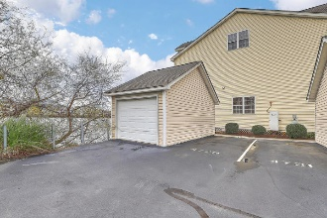


Spacious Lakefront Townhome With Oversized Deck Open House Saturday from 12-2
4729 Arco Lane
Lake Palmetto | North Charleston, SC 29418 | MLS# 20006360 | $243,975
Well maintained, spacious 3-story end-unit townhome with detached garage on Lake Palmetto. This lovely home provides plenty of natural sunlight and oversized deck, complete with water access! Enjoy natural bamboo hardwood flooring throughout the whole home and tile in the wet areas. Your nicely sized kitchen has plenty of counter and cabinet space with 48'' cabinets, s/s appliances and a separate bar area with wine/beverage chiller. Your dining and living room captures gorgeous views of the lake and memorable sunrises! Enjoy those few chilly nights in front of your gas fireplace with custom built mantel, shiplap, and tumbled marble surround, giving that costal ambiance. Finishing off the first floor is the nicely appointed powder room. The second floor of this lovely townhome features the smaller master suite facing the lake, complete with walk-in closet, sliding glass door & balcony overlooking the lake, along with a well equipped bathroom featuring a walk in shower, single basin vanity, and deep set whirlpool bathtub. Also on the second floor you will find the laundry area, two secondary bedrooms and a full size bathroom also beautifully done. You will certainly be wowed by the third floor, which is a truly oversized master suite... it spans the entire length of the town home! Your relaxing oasis features a deep set whirlpool bathtub with tumbled marble top, custom built double bowl vanity with granite counters and storage tower between the two sinks, as well as the fully tiled, semi-frameless walk-in shower with two rain heads, hand held sprayer, and glass tile border with a river rock floor. The master bedroom itself overlooks the lake and has plenty of closet and storage space. Conveniently located with super easy access to I-26 and I-526, Boeing, Tanger, the Coliseum, as well as the popular Park Circle & Mixson communities offering plenty of shopping and extensive dining options... all this and only 10 minutes to the heart of downtown Charleston! Make this lovely, well cared for home first on your list to view today!
Desiree Maurer Office - (843) 416-2000
Mobile - (843) 327-9010 desiree.maurer1@gmail.com
www.yourcharlestonhousesearch.com
Keller Williams Realty 496 Bramson Ct Ste 200 Mt. Pleasant, SC 29464

