Slide 1
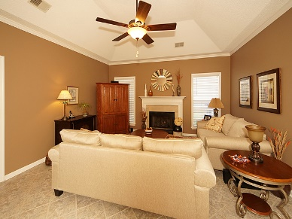
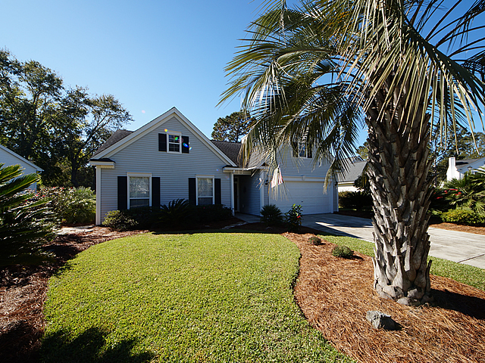
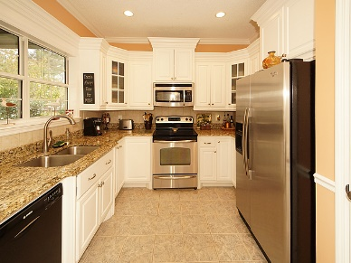
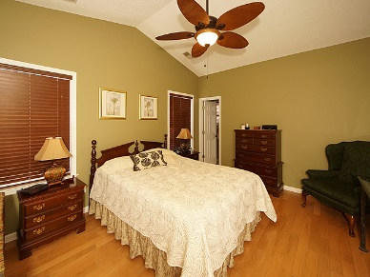
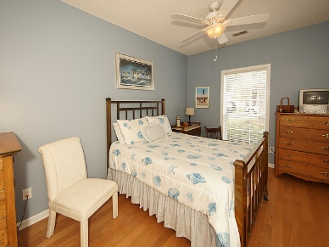
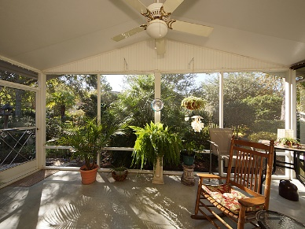
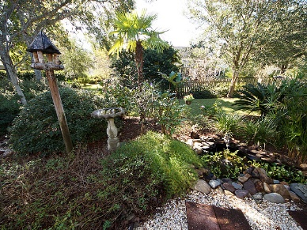
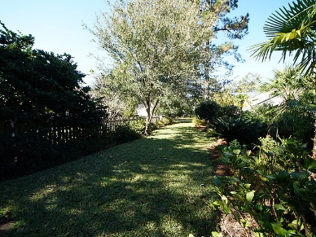
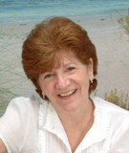

472 Old Carolina Court Belle Hall ~ Mount Pleasant, SC 29464 MLS# 17030376 ~ $369,000
Come View This Home Today!
Seller will pay up to $5,000 in Closing Costs - Just In Time for those January Christmas Bills.
With an acceptable Offer and must be able to close by the end of Jan 2018.
Welcome Home to this Move-In Ready, Well Maintained, One Story Home located on a quiet Cul-de-sac in Very Conveniently located Belle Hall. Open, Inviting family room with vaulted ceiling & cozy fireplace. Large eat-in Kitchen with newer Custom Cabinetry & Granite counter-tops looks out over the extra large screened-in porch and your private, professionally landscaped oasis of a back yard - perfect for enjoying that morning cup of coffee or your evening beverage of choice. Master suite has vaulted ceiling, large walk-in closet and bath with separate shower / tub. Secondary bedrooms are generously sized. Belle Hall is located very close to shopping and 526 and also has easy access to downtown, beaches, airport etc. and all that Mt Pleasant & downtown have to offer.
Maggie Curtis
REALTOR, EPRO, LMC, ABR
(843) 693-8207
maggiecurtis@comcast.net
Coldwell Banker Residential Brokerage
1127 Queensborough Blvd. 103
Mt Pleasant, SC 29464

