Slide 1
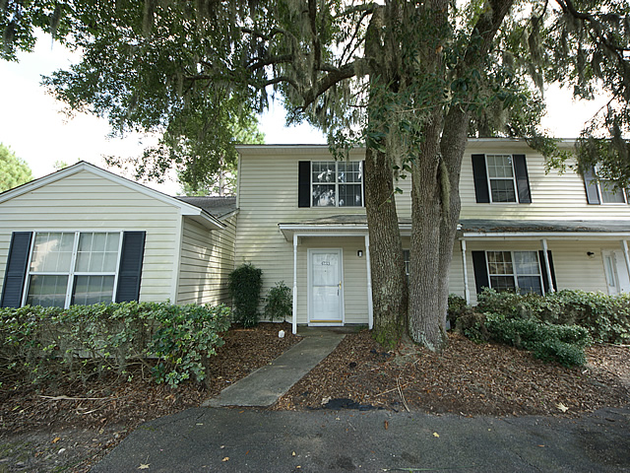
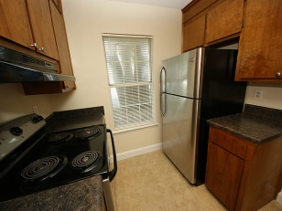
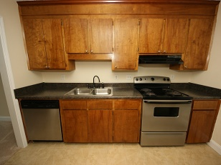
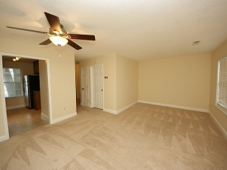
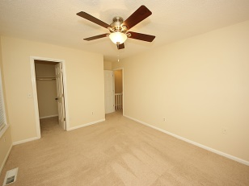
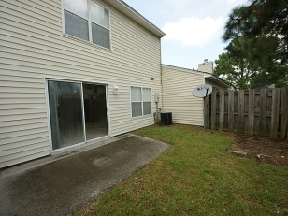
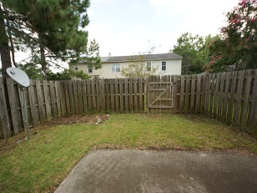


Investor’s Dream
4733 Bayfield Dr
Whitfield on the Ashley ~ North Charleston, SC
MLS# 1421718 ~ $74,900
2 Bedrooms | 1½ Baths | 1,000 Sq Ft
MOVE-IN READY!!! Great for owner occupied or investor. New ceramic tile in bathrooms and kitchen. Stainless steel appliances, including refrigerator. Large laundry room. Ceiling fans in living room and both bedrooms. Fenced in back yard. Great place to owner occupy at this price! Taxes are figured at 6%. Will be lower if owner occupied.
B C D Properties LLC
123 Piccadilly Loop
Summerville, SC 29483
Nancy Stewart
843-408-6251 M
knstewart81@gmail.com

