Slide 1
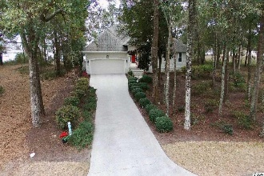
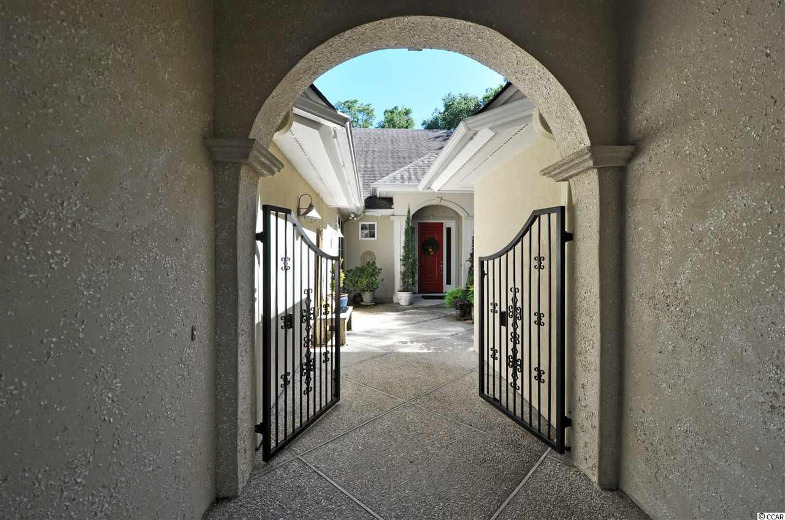
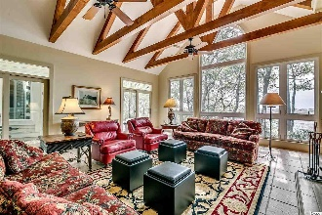
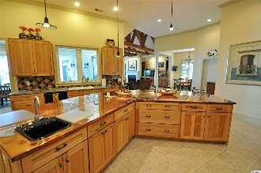
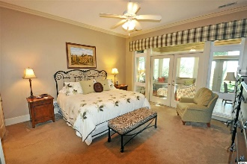
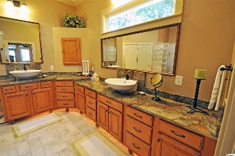
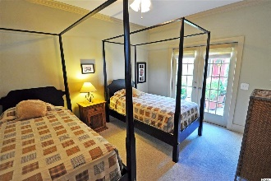
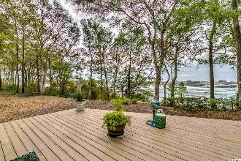
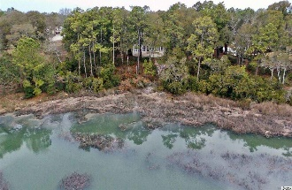
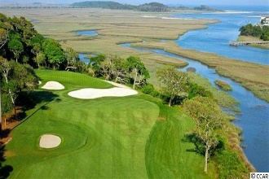
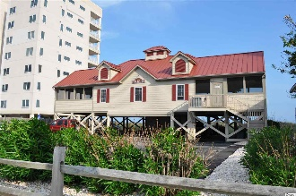


4734 Buck's Bluff Drive
N Myrtle Beach, SC 29582
MLS# 1819395
$689,000
Tidewater Plantation
Private Tuscan-inspired Cul-de-sac Enclave
Champagne Agent Tours:
Thu 9/27 10a-12p
Fri 9/28 1-3p
Sun 9/30 1-4p
The Bluffs of Tidewater borders the Cherry Grove Inlet where the Atlantic Ocean rolls into the marsh. The Bluffs is rapidly being built out.
Therefore, this expansive, 24-hour manned and gated private-retreat cul-de-sac enclave of almost 1/2 acre is highly sought after for the investor or primary- or vacation-home owner who desire to acquire an unforgettable property with one of the rarest and most stunning wildlife and marsh views in Tidewater -- yet at today's compelling market prices.
This wonderful home is a once-in-a-lifetime opportunity...IS IT TUSCANY OR TIDEWATER?
Deborah Collins
843-424-9013
dctidewater@yahoo.com
Connie Ross-Karl
702-306-2643
conniesross@aol.com
NEW WAY PROPERTIES MYRTLE BEACH

