Slide 1
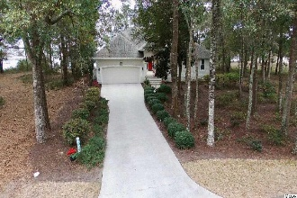
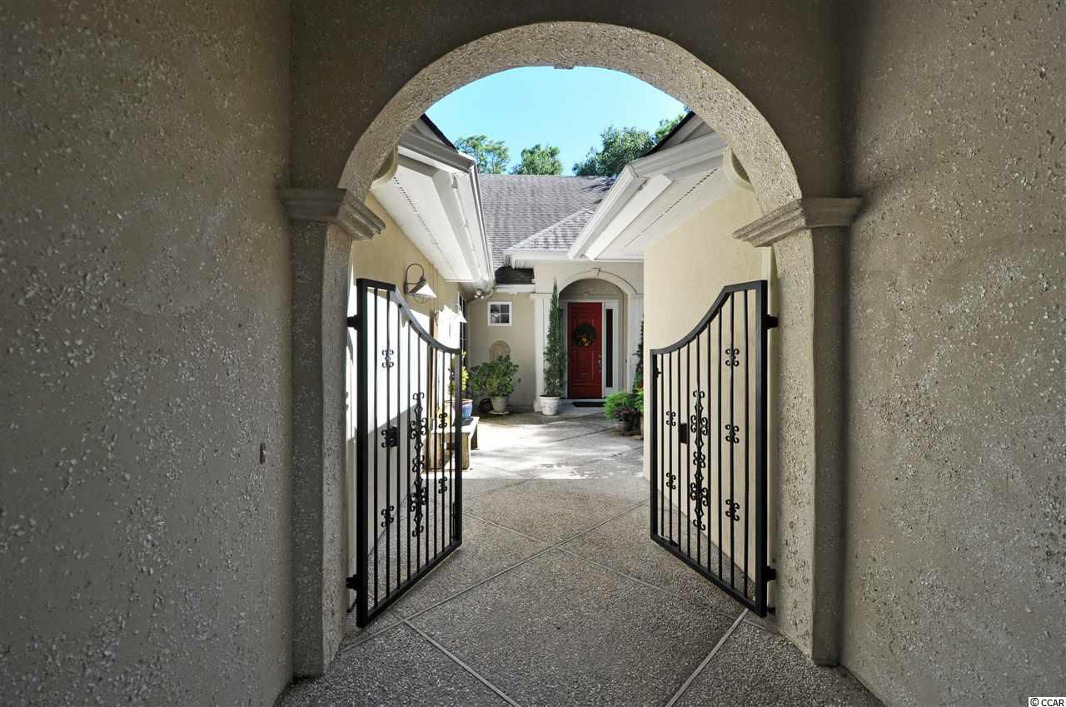
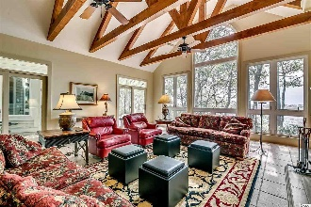
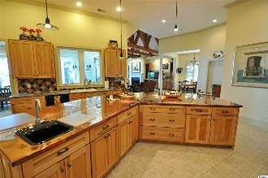
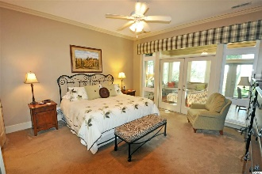
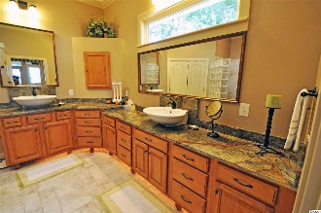
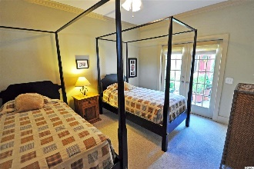
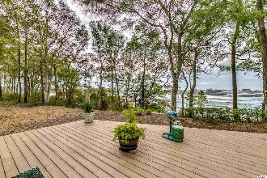
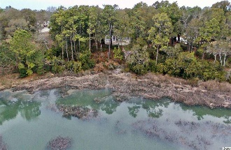
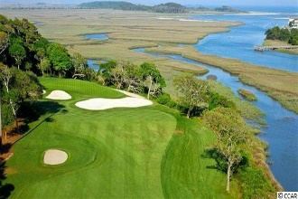
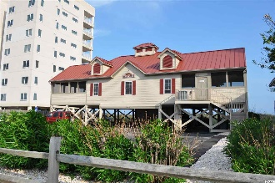


4734 Buck's Bluff Drive
N Myrtle Beach, SC 29582
MLS# 1819395
$689,000
Tidewater Plantation
Private Tuscan-inspired Cul-de-sac Enclave
The Bluffs of Tidewater borders the Cherry Grove Inlet where the Atlantic Ocean rolls into the marsh. The Bluffs is rapidly being built out. Therefore, this expansive, 24-hour manned and gated private-retreat cul-de-sac enclave of almost 1/2 acre is highly sought after for the investor or primary- or vacation-home owner who desire to acquire an unforgettable property with one of the rarest and most stunning wildlife and marsh views in Tidewater -- yet at today's compelling market prices. This wonderful home is a once-in-a-lifetime opportunity...IS IT TUSCANY OR TIDEWATER? Enter from a magnificent gated courtyard finished in tabby stucco. The lovely fountains in the atrium and courtyard and content convey. The interior boasts skip trowel Italian plaster on the main living space walls. Appreciate especially the terracotta tiles in the guest powder room off of the interior entry and the priceless hand-painted tiles at the exterior entryway and over the garage, commissioned and imported from Deruta, Italy. The spacious floor plan is elegant but casual. Walk to the right for impressive formal dining and huge open kitchen to the left. Counter tops are granite and the magnificent island is 12 feet of gleaming copper! Splendid solid-hickory shelving is plentiful. There is a coffee bar; 2 porcelain sinks, one looking out on the marsh; a desk; and a 6-burner professional-quality gas kitchen range with oven and range hood vented to the outside, plus another wall-mount electric oven and microwave. The Carolina room, as well as the breath-taking great room with 14-ft vaulted, beamed ceilings; ever-changing panoramic marsh and wildlife views; wood-burning/gas fireplace; and impressive built-in shelving, are contiguous to the kitchen and the cozy breakfast nook near an over-sized pantry. This very grand area affords both memorable family fun and fabulous entertaining! Nighttime views feature the twinkling lights of Cherry Grove. An appealing free-flowing design also leads to a study/fourth bedroom; two other guest rooms, each with its own sink and shared jack & jill bath; and wonderful French doors overlooking the courtyard, leaving guests to wonder if they are really visiting an Italian villa. The incredible master bedroom suite is tucked away in a separate wing. European-inspired sculpted tile, lots of natural light, open shower and big multi-functional closet compliment its overall unique design. The laundry/utility area occupies this wing too, and that hallway provides easy entry to the kitchen from the garage. Lots to see on your tour, both inside and out. So feel free to linger. Sold unfurnished but generous furnishings package conveys. The Bluffs pool is exclusive to residents of the Bluffs; however, they may use two other pools on the Plantation side. Tidewater is on a tree-lined road to oceanfront Anne Tilghman Boyce Coastal Reserve, a nature conservancy. Tidewater itself is on an elevated peninsula of live oaks and southern pines between the Intracoatal Waterway and the Cherry Grove Inlet to the Atlantic Ocean. The Plantation preserves the singular look of its own historic origins, only minutes from the beach, shopping, medical services, entertainment and access to major highways. Rich amenities at low HOAs include an oceanfront beach cabana for owners' use with open/screened porches, bathrooms, showers, and kitchen. Residents enjoy the use of several pools/hot tubs. Other amenities include a driving range, golf shop, clubhouse with bar/dining and event facilities overlooking the 18th hole, tennis courts, pickleball, fitness center, bocce, and amenity center for public/private events. Tidewater has gated storage for boats, jet skis, motorcycles, etc. Tidewater Plantation, with its full range of things to do and to enjoy, reflects a "way of life" in safe, popular North Myrtle Beach. This is an extraordinary home at an incomparable value of any such upscale custom-build along the Grand Strand...see it today!
Deborah Collins
843-424-9013
dctidewater@yahoo.com
Connie Ross-Karl
702-306-2643
conniesross@aol.com
NEW WAY PROPERTIES MYRTLE BEACH

