Slide 1
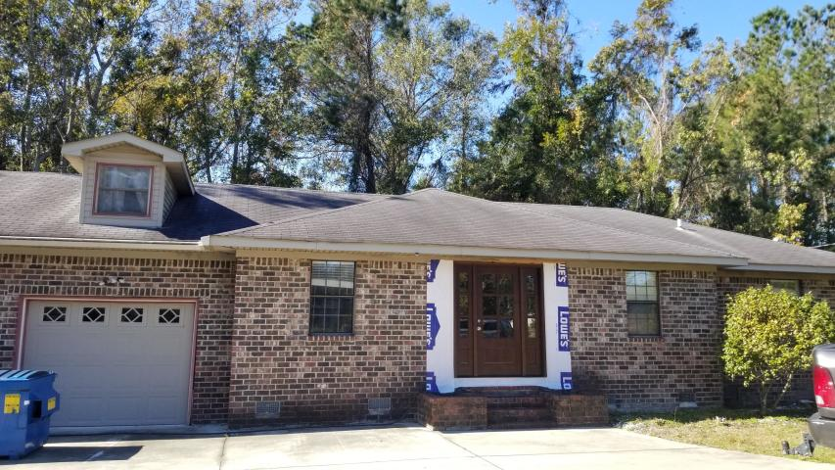
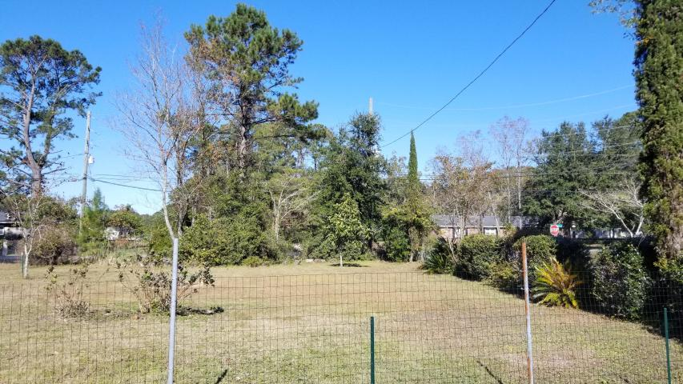
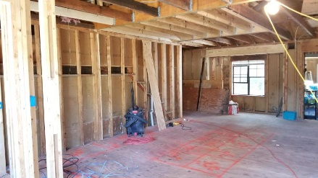
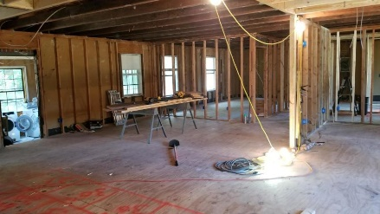
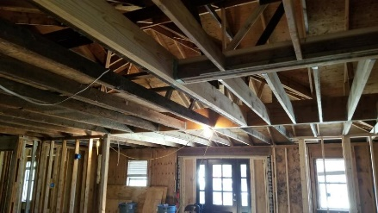
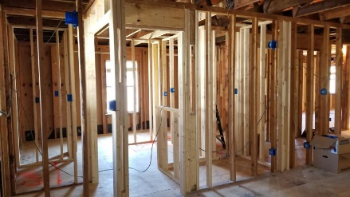
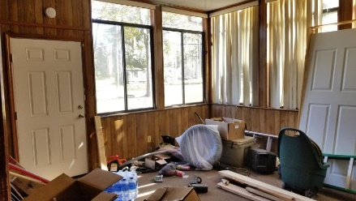
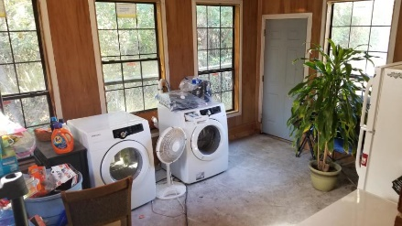
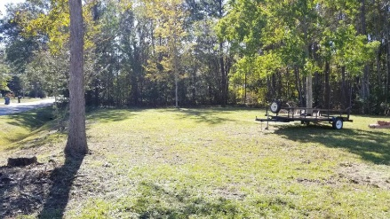
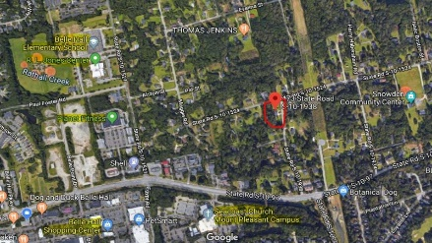



New Year, New Price!
$315k home on 2/3 acre lot in 29464
A $2100 Lender Credit is available and will be applied towards the buyer's closing costs and pre-paids if the buyer chooses to use the seller's preferred lender. This credit is in addition to any negotiated seller concessions.
473 Spann Street Snowden | Mount Pleasant | MLS# 19032301 | $315,000
Check out this unique opportunity to customize a brick home on 2/3 of an acre with no HOA in 29464! Zoned for the new Lucy Beckham HS for fall 2020. No flood insurance required! Already on city water and sewer. This home has been almost completely gutted and is ready for someone to add their personal style and design. The owners hoped to move in upon completion, however their plans have changed suddenly. The main level has been reconfigured with a desirable open concept layout, including a spacious master suite. Two 2x16x20 LVL beams have been added for structural support. All new wooden beams throughout living room, breakfast nook and mud room. New subflooring. Home is being sold as-is. Easy access to all parts of town via 526. Minutes from downtown or the beaches. Easy to show.
Whitley Boyd
(843) 324-4761
WBoyd@CarolinaOne.com
www.PropertiesofCHS.com
Carolina One Real Estate | 628 Long Point Rd. | Mt Pleasant, SC 29464-3032

