Slide 1
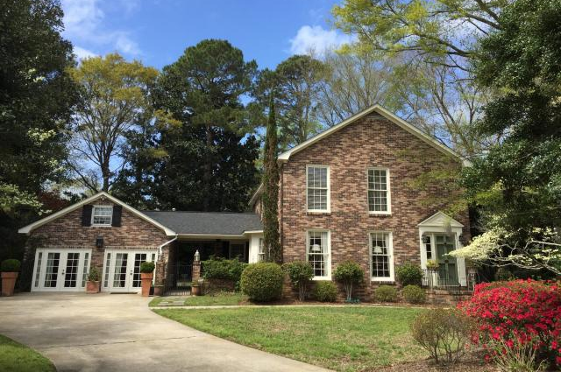
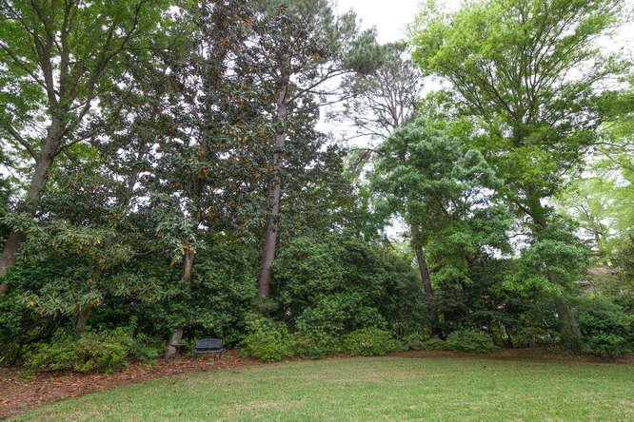
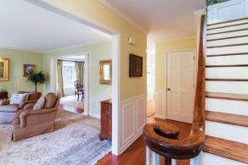
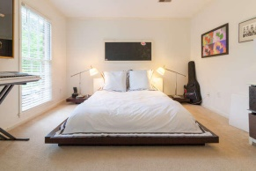
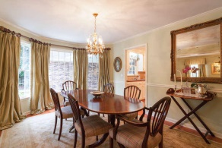
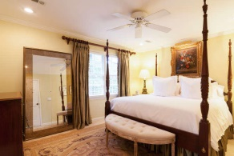
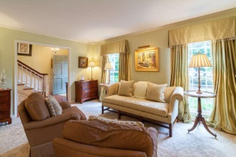
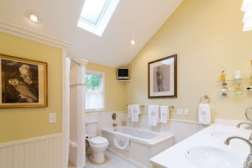
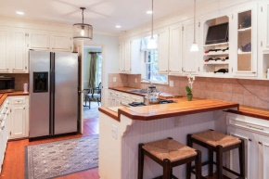
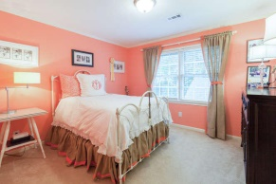
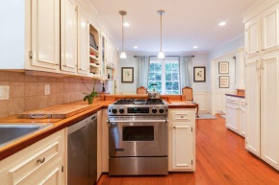
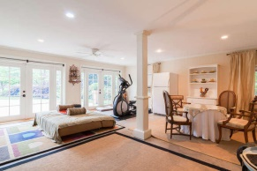
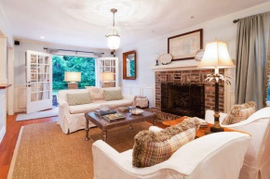
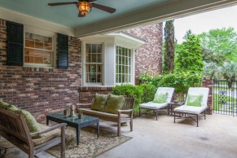


COMING BACK ON THE MARKET
This home went under contract in less than a week and I am sure it will do so again!
Open House Sunday 2-4, send your clients and text me their names, I'll welcome them for you!
473 Wimbledon Ct
Marlborough ~ Charleston
MLS# 15010044 ~ $495,900
Nestled in the center of the cul de sac, this 1974 home is the epitome of James Island's beauty and true Lowcountry elegance. The natural buffer of the beautifully landscaped lot allows for the feeling of seclusion while living within an active family neighborhood in the center of a thriving town. Fortunately, this home is within a block of Maybank Tennis Center, 1/4 mile from necessary shopping, and less than 4 miles from downtown. The traditional floor plan includes formal living and dining room adjacent to the fabulous kitchen boasting a gas stove, butcher block countertops, and eat in area which flows into the family room. Come see for yourself the ''surprises'' of this elegant home including it's detached/attached converted garage with upstairs office/craft room not included in sq ft
Robin Crump
(843) 813-5688
Robincrumprealestate@gmail.com
Brand Name Real Estate | 207 East Bay Street Ste 311 | Charleston, SC 29401

