Slide 1
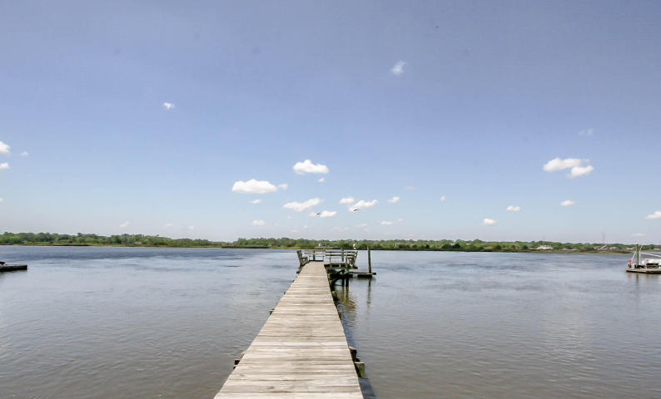
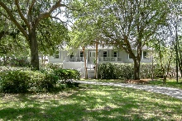
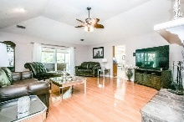
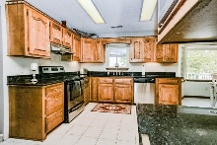
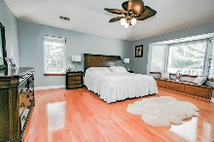
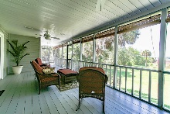
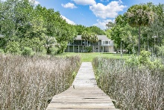
4751 Holbird Drive Wando Woods · North Charleston, SC 29405 · MLS# 17011795 · $749,000
Own a Piece of Deepwater Paradise!
Bring your boat and enjoy this amazing ''True Deep Water Low Country Dream Home'' located directly on the Ashley River. This beautiful, raised ranch home is situated perfectly with moss draped live oaks adorning the park-like front yard and fabulous breath-taking views of the Ashley River and your own private dock encompassing the back, making the setting almost appear as if a dream. Inside you will find continued fabulous Ashley River views from the Family Room, Kitchen and Dinette. Make your way to the Kitchen, boasting granite countertops and stainless steel appliances. Then step out on the expansive back porch and take it all in, the picture perfect setting for entertaining guests, enjoying family, reading a book or just relaxing in the sun.
Neil Schneider · 843-200-8902 · neil@charleston.info

