Slide 1

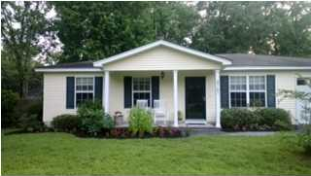
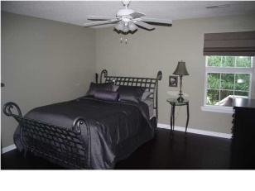
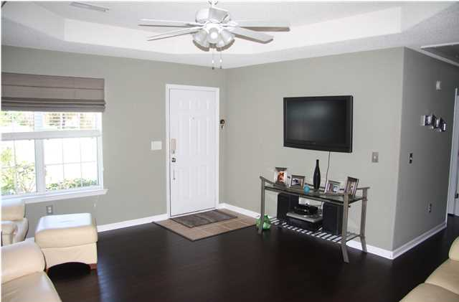
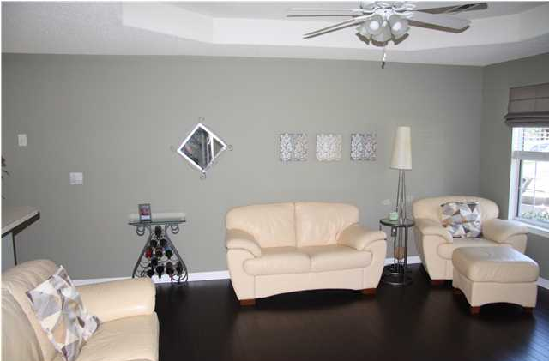
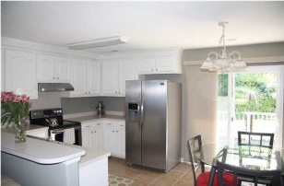
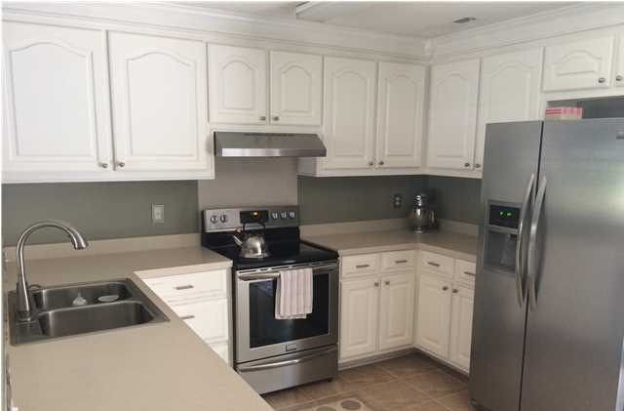
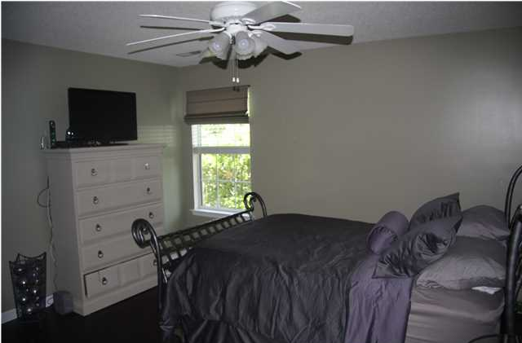
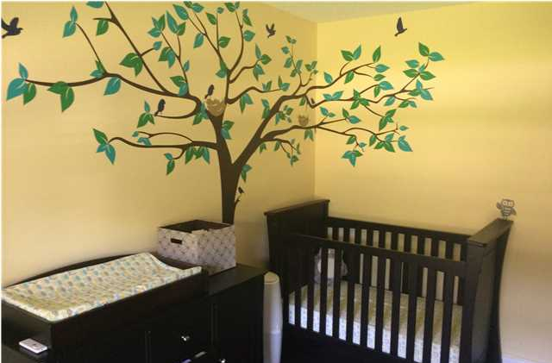
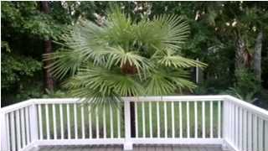
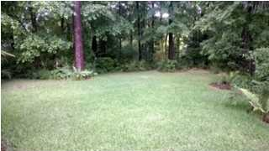
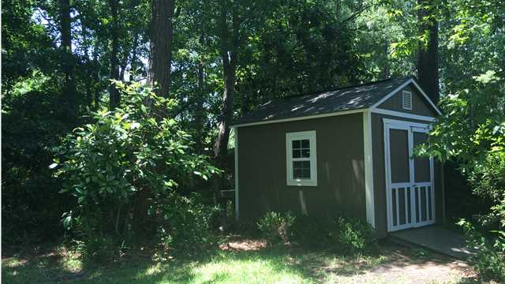
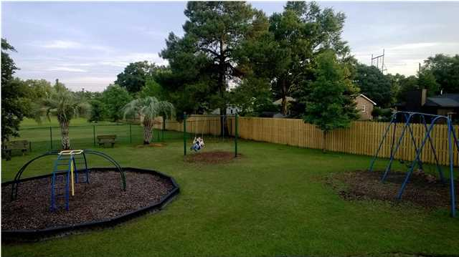
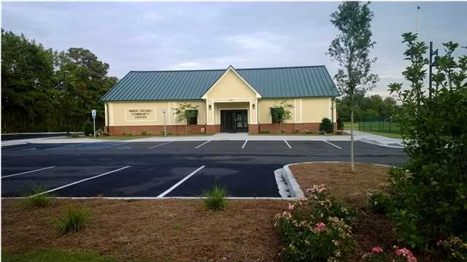
Price Adjustment!
CHARLESTON'S PREMIERE BOUTIQUE REAL ESTATE FIRM
4761 Langridge Drive
Listing Price: $184,000
MLS# 1414632
3 Bedroom / 2 Bath
1,150 Square Feet
This immaculate 3 bedroom, 2 bathroom home is conveniently located in a quiet neighborhood close to I-526/26, Boeing, airport, Tanger Outlets and less than 10 minutes from Downtown Charleston. Owners have taken pristine care of this home and invested approximately $11,000 in recent upgrades and renovations including bamboo hardwood floors, stainless steel appliances, window treatments, and built in laundry storage. Open concept floor plan. Surrounded by lush lawns, front and back. The spacious backyard is a private oasis with a deck, patio, large storage shed, and full privacy fence. A pond located behind the home insures privacy. Energy efficient thermal paned windows throughout. The home is nicely shaded by surrounding trees, keeping energy bills low. The home features an attached garage. Neighborhood amenities include a boat landing to the Ashley River, Community Center, and playground. Recycle, debris, and trash pick up provided. This home is one you don't want to miss!
Mandy Harrison
mandy@corealtysc.com
843-323-1521
www.corealtysc.com

