Slide 1
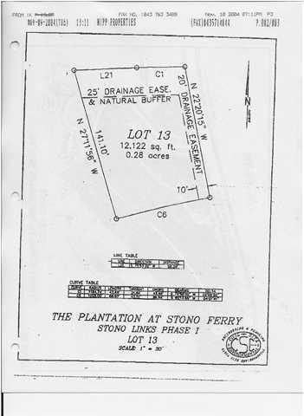
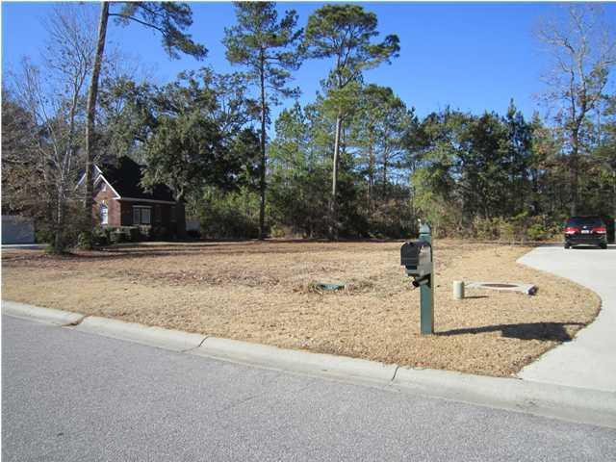
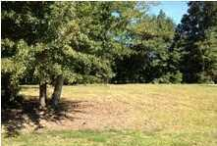
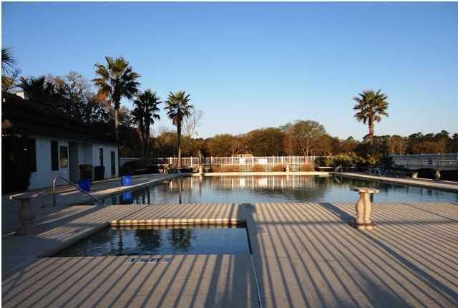
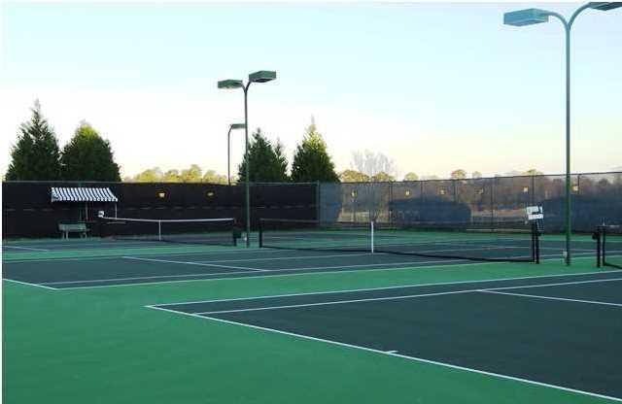
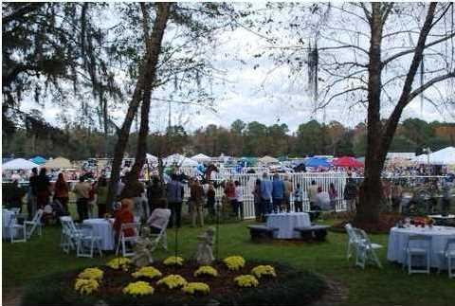
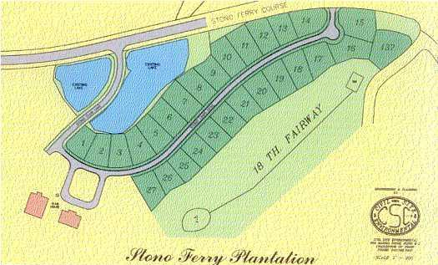
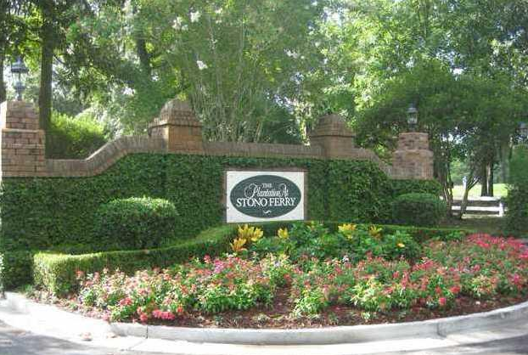


Ready to Build Lot in Golf Community
4769 Stono Links Dr
Stono Ferry - Rural West Ashley
MLS# 1315763 - $74,900
Just 20 minutes to Downtown Charleston, beautiful semi-private award winning Links at Stono Ferry is a golfers dream. This lovely cleared high lot is just a 5 minute walk from the golf clubhouse. It is situated in the very beautiful Stono Ferry community enjoying a junior Olympic pool, 3 tennis courts with lights, miles of walking and biking, 2 polo fields, and home to the Charleston Cup Steeple Chase each November. There are also private stables and horse field. Stono Ferry has an active community with the majority of residents living here year round. The grounds are very lush with grand oaks and trees in abundance. Stono Ferry Homeowners Association has enacted a 1/4% of 1% transfer fee to be paid by buyer at closing.
Daniel Amigone
Realtor
Complete Action Real Estate Services, Inc.
843-364-2888 - Mobile
daniel.amigone@comcast.net

