Slide 1
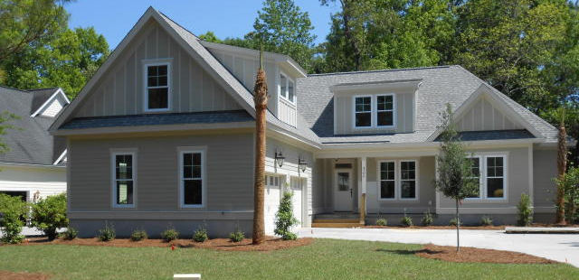
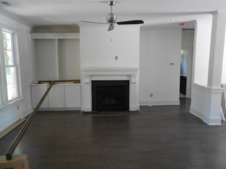
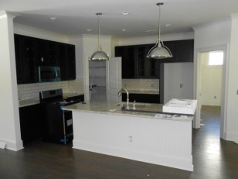
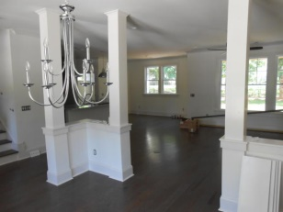
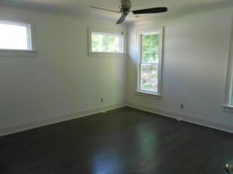
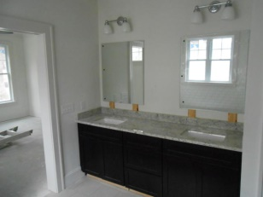
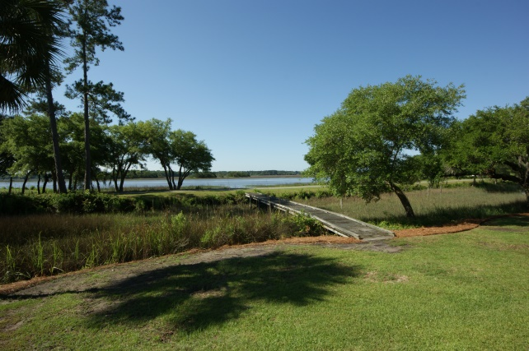
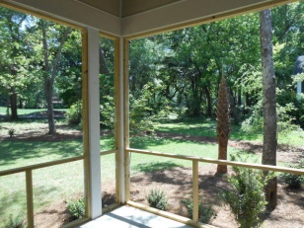
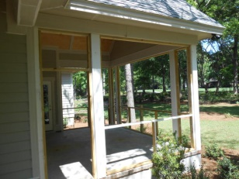
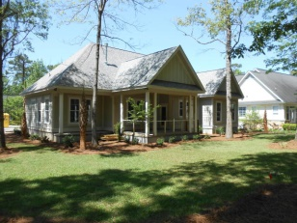
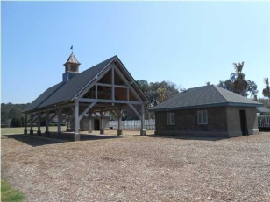
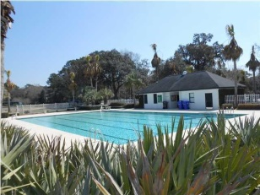

4786 Stono Links Dr – Hollywood - MLS# 1405126 - $495,000
New Construction in Stono Ferry... Finished in less than two weeks!
HOME IS NEARLY COMPLETE. BRING YOUR BUYERS AND LOCK IN A GREAT PER SQUARE FOOT COST. New construction built by award winning local builder New Leaf builders in beautiful Stono Ferry. Very functional floor plan which takes advantage of views of the 18th fairway and green of The Links at Stono Ferry Golf Course. This home has a very open floor plan which features 4 bedrooms, 3.5 baths and a downstairs master bedroom. 2 large bedrooms and a full bath plus a huge bonus room complete the upstairs. This is an upgraded home that will impress from the minute you walk in. Some features include hardwood floors throughout the downstairs including the master bedroom-Open kitchen with granite counter tops - 42'' cabinets - Stainless steele appliances - granite counter tops, dual vanities and custom tiled shower in master bath-Crown Molding all downstairs-Ceramic tile in all bathrooms-Tankless hot water heater-Low E Anderson windows-Large screened porch-Separate dining room-Laundry room with cabinets and sink-2 car garage-Plus many more. Stono Ferry is a gated community with an 18 hole championship golf course, lighted tennis courts, Jr. olympic sized swimming pool and is surrounded by the Intra-Coastal waterway and Log Bridge Creek. A very unique and private setting with an abundance of wildlife and many Grand Oak trees make Stono Ferry a great place to call home.
Rob Sturm
M 843-478-2404
rsturm@century21properties.com
Bud Poston
M 843-697-3786
bposton@century21properties.com
Century 21 Properties Plus | 3301 Salterbeck St Suite 100 | Mt. Pleasant, SC 29466

