Slide 1
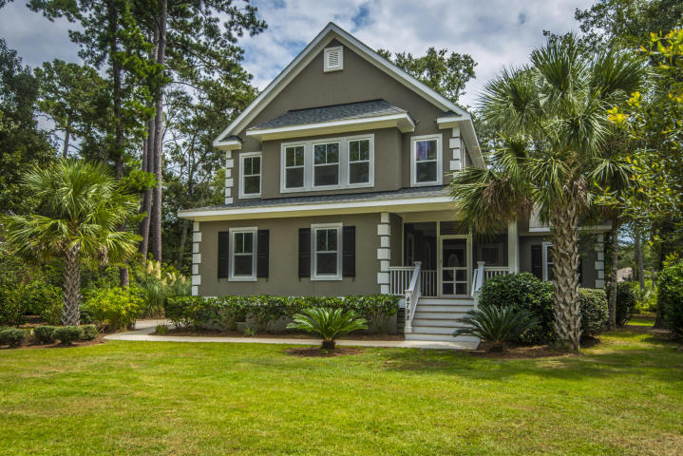
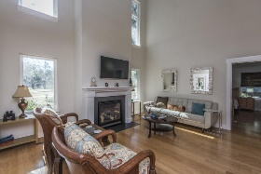
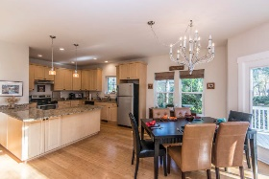
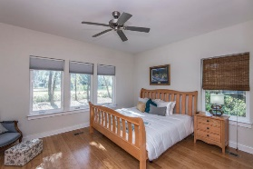
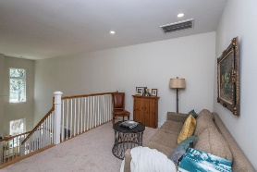
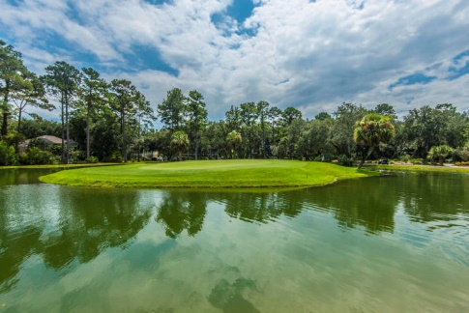
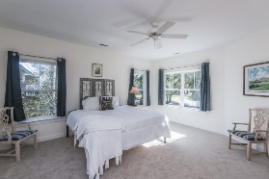
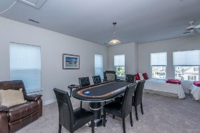
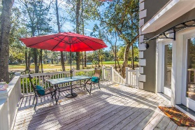
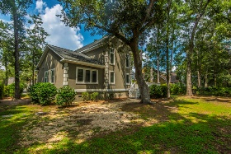
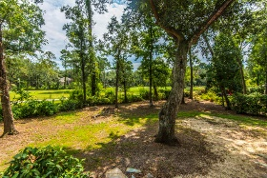

4798 Stono Links Drive
Stono Ferry ~ Hollywood, SC 29449
MLS# 18023567 ~ $400,000
$50K Price Reduction
Enter into a hidden treasure of a community just 20 minutes to downtown Charleston. This wonderful neighborhood has it all with a class "A" golf course, equestrian community, large pool, tennis and nestles along the Stono river. This one owner gem has a wonderful master suite and laundry on the first floor. The updated kitchen with plenty of 42'' cabinets opens to the living area for an open feel floor plan. The island has room for 3 or 4 stools for additional seating. The master features two walk in closets, en-suite with dual vanity, walk in tiled shower and a deep tub for relaxing at the end of the day, and direct access to the laundry. The master has views of the Island Green on hole number 18. A flex space greets you at the top of the stairs, perfect for an office or more.
There are two secondary bedrooms that feature walk in closets. They are both large, one was used as a "Man Cave" with a full size pool table. These rooms share a large bath with dual vanity and enclosed shower & water closet. The back yard has a welcoming raised deck to enjoy the view of the course and water fowl around the 18th green. It is a deck that can be converted to a screen porch with room left over for outdoor grilling. The treed lot in the back requires little maintenance while providing a shade area to relax. An added feature of the home is a side entry garage which enhances the look of the home. Please contact your agent for a personal showing, tour the neighborhood, find out why this is a special home in a great location.
George Arlet
(843) 452-7200
georgearlet@comcast.net
Joe Arlet
(843) 226-4141
joe.arlet@carolinaone.com
Carolina One Real Estate
2713 Highway 17 North
Mt. Pleasant, SC 29466

