Slide 1

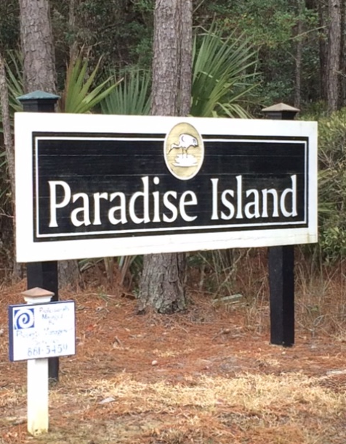
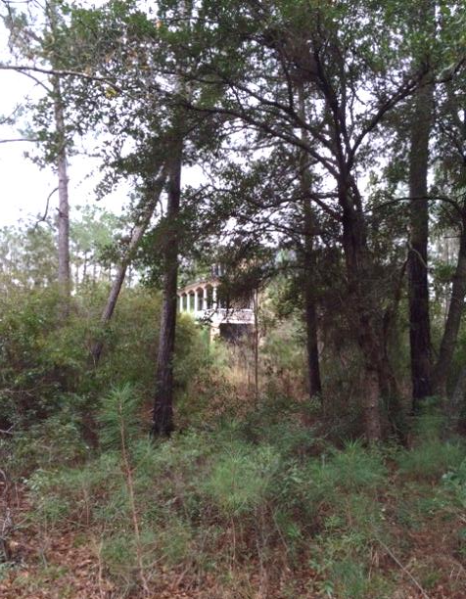
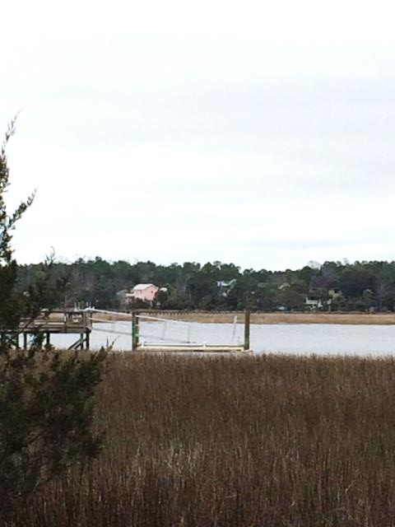
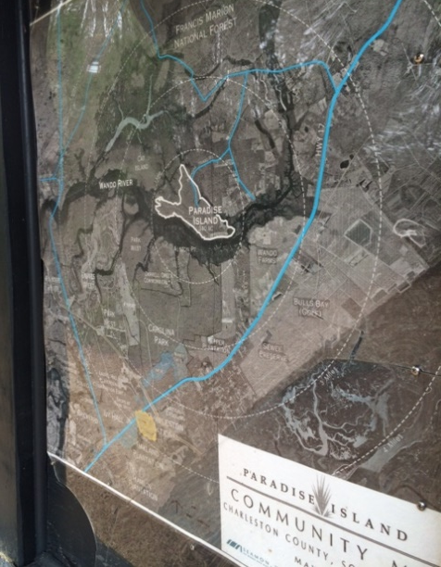
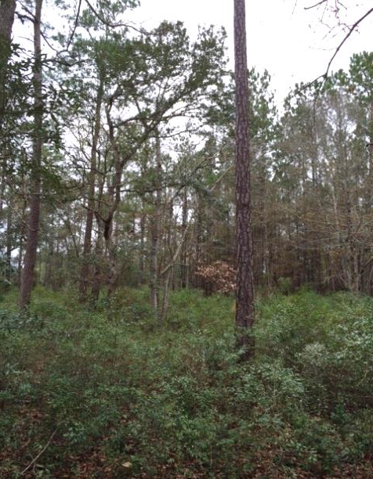


47 Cape Island Drive
Lot for Sale in Paradise Island
Welcome to Paradise… Paradise Island that is and if you have been looking for deep water on a deep lot, this may be just what you have been looking for. 0.68 Acres with a dock permit.
The Seller has a Geotechnical Investigation in hand and is motivated to sell this property. See the attachments on this listing to see many pictures and a video tour also exists to save you a trip.
This community offers a community boat ramp and dock facility as well.
Whether you want a custom home or just a private dock on the Wando, the choice is yours.
Address: 47 Cape Island Drive
City: Awendaw, SC 29429
Subdivision: Paradise Island
Tax Map #: 617-14-00-020
Lot Size: 0.68
Tax District: 13 - Bonneau
County: Charleston
Area: 41 - Mt Pleasant N of IOP Connector
Description: Big Paradise Island, Phase 1, Lot 47, Block C

