Slide 1
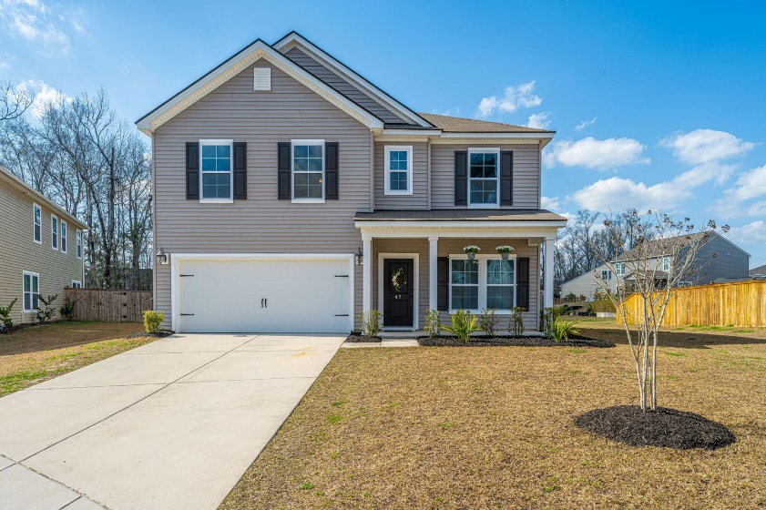
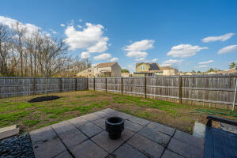
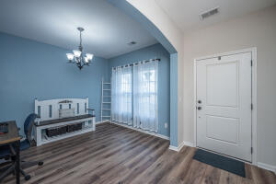
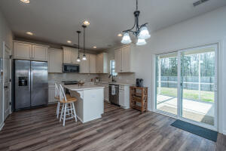
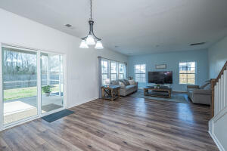
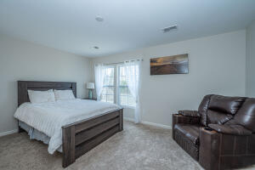
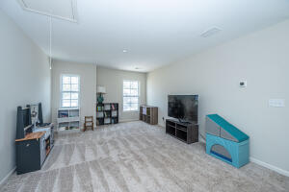
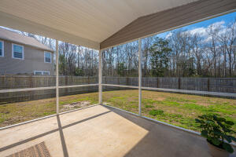



Why wait for new construction?
This Park Circle area home is LESS THAN 2 YEARS!
New Summerville Listing - $369,000
47 Pavilion Street
Reminisce · Summerville, SC 29483 · MLS# 22004631
Welcome to 47 Pavilion! This is a 3 bed, 2.5 bath house with 2,238 sq ft home that was built in 2018 and sits on a quiet cul-de-sac. There is a playroom or office space by the front door and a big loft space upstairs. They have beautiful laminate floors, premium cabinets, and granite countertops. House backs up to woods and dry pond.
Del Shaffer
843.408.6821
dshaffer@carolinaoneplus.com
2713 Highway 17 North
Mt. Pleasant, SC 29466

