Slide 1
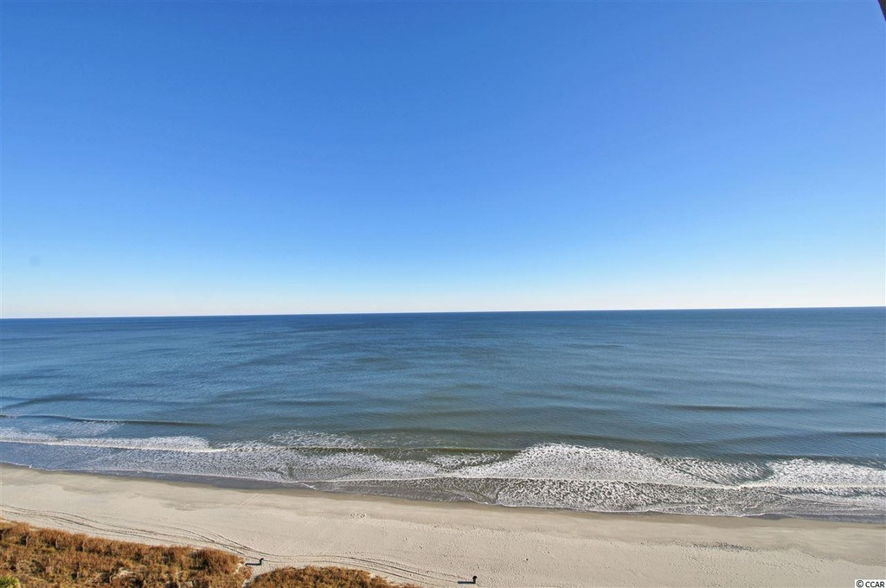
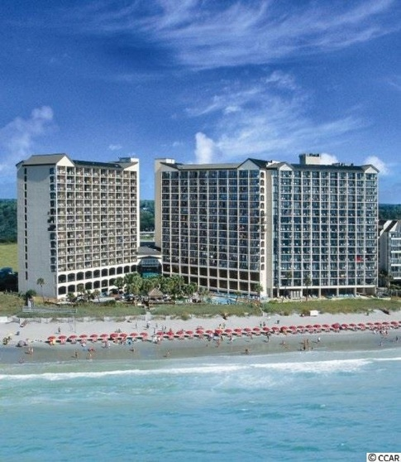
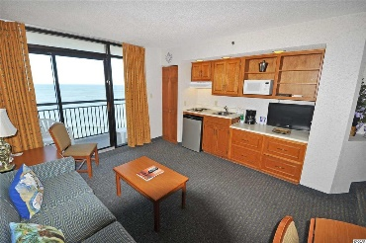
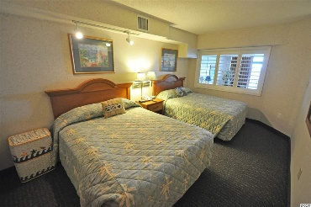
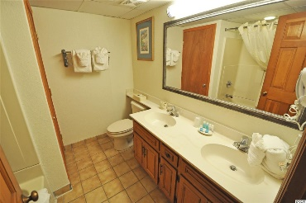
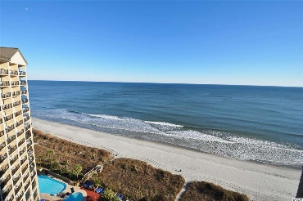
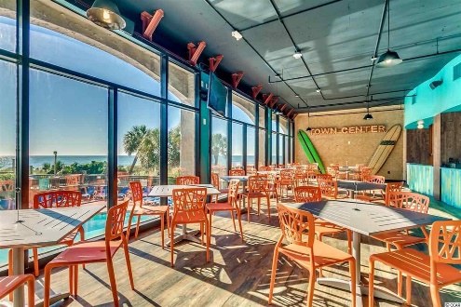
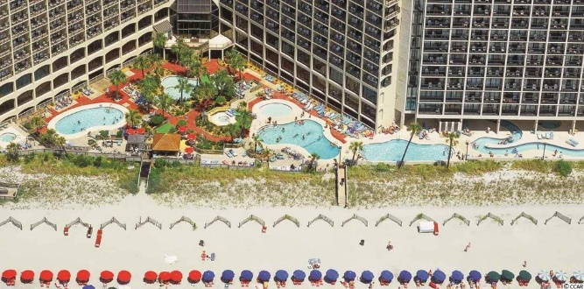
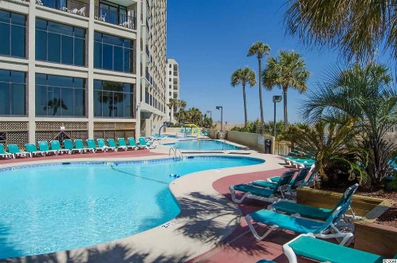


4800 N Ocean Blvd # 1518
North Myrtle Beach, SC 29582
MLS# 1601465
$99,500
Lowest priced Ocean Front 1 Bedroom
Beach Cove Resort -Great rental income
One of the lowest priced one bedroom units available in popular Beach Cove, across the street and in walking distance to Barefoot Landing and a variety of restaurants, entertainment, new winery and shopping. This condo is in nice condition and is a highly desirable rental too -- on a higher floor, one floor down from the top -- with panoramic views. Owner has paid 1/2 already towards upgrade of bathroom sinks, planned in February 2016; newer HVAC is very quiet; water heater is about 5 years old; and the sofa and the bedroom mattresses are new. This model is called the Oceanfront One Bedroom Executive Suite -- The One Bedroom Oceanfront Executive Suite is perfect for couples or small families visiting North Myrtle Beach. Featuring an efficiency kitchen/living room and bedroom, this suite can sleep up to 6 persons and sits at about 600 square feet. Rents well, therefore, year round. Beach Cove is a tropical oasis with spectacular views of the Atlantic from all sleeping rooms, convention center & meetings rooms, restaurants, lounges and game rooms. Owners allowed pets. Property is golf-cart- and motorcycle-friendly. The tropical oceanfront pool deck is a popular spot to soak in the sun or take a dip seasonally in any of the four indoor/outdoor pools, three whirlpools or giant lazy river. There is also a fitness center and racquet ball court. Beach Cove is a well managed and maintained up-scale resort in the highly desirable Windy Hill section of North Myrtle Beach -- perfect as a home, vacation home or investment property.
Deborah Collins
843-424-9013
dctidewater@yahoo.com
Connie Ross-Karl
702-306-2643
conniesross@aol.com
NEW WAY PROPERTIES MYRTLE BEACH

