Slide 1
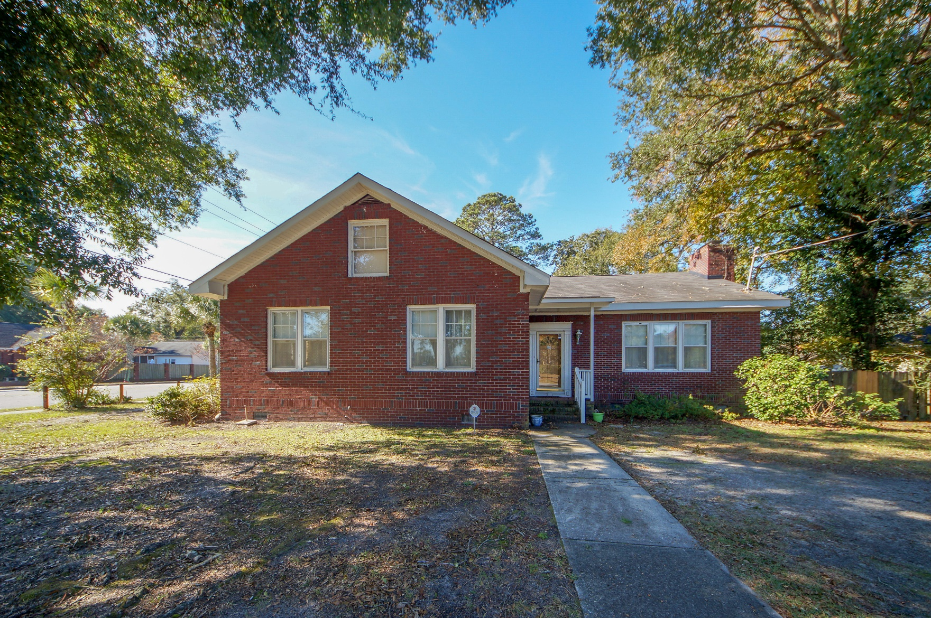
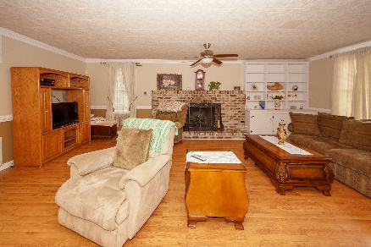
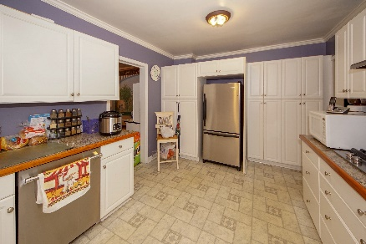
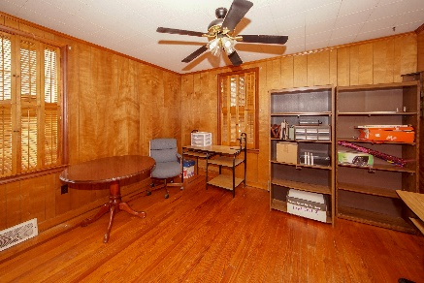


4801 W Park Place Park Circle ~ North Charleston, SC 29405 MLS# 19014044 ~ $369,900 3 Bed / 2 Bath
Location, Location!
Major Price
Reduction!
This Park Circle home rests on the corner of East Montague and W Park Place.
3 bedroom 2 bath brick home with hardwood flooring and detached garage. Staircase leading to attic could be converted to additional living space or office space.
We welcome residential and commercial investors. Great opportunity to live in Park Circle or own a business on the Circle.
Home faces Park Circle and detached garage faces E Montague.
Connie White, Broker
843-532-3356
connie@chrepros.com · conniewhiterealestate.com
Charleston Homes · 597 Old Mt. Holly Road · Suite 301 · Goose Creek, SC 29445

