Slide 1
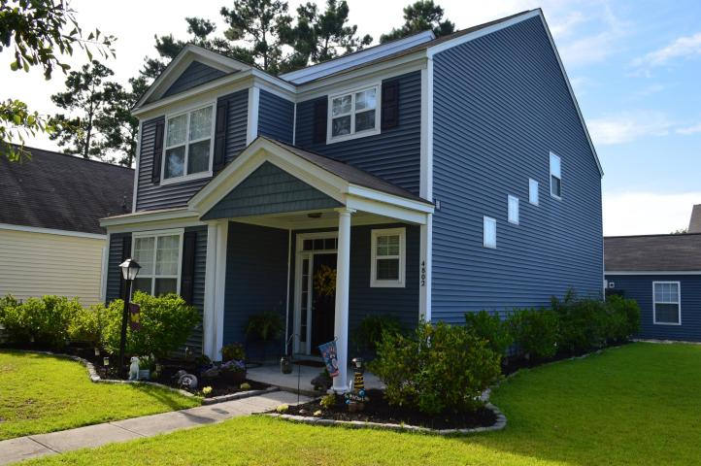
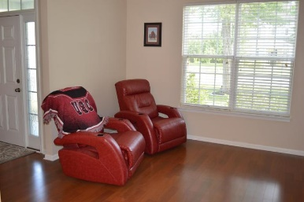
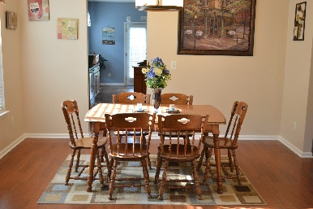
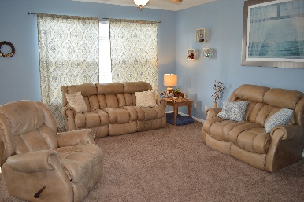
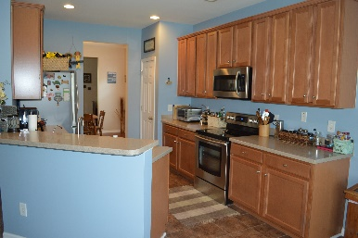
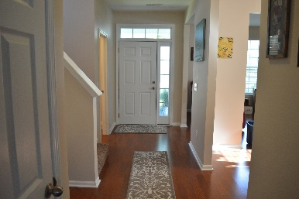
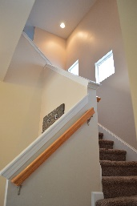
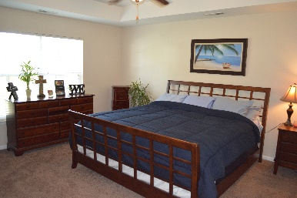
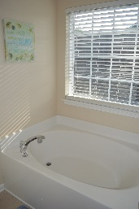
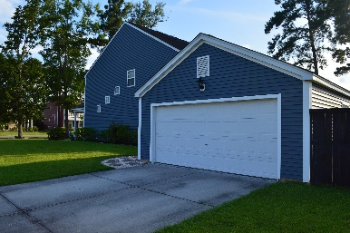


4802 E Red Maple Cir
Wescott Plantation
Summerville, SC 29485
MLS# 15016704
$210,000
UPGRADES! LARGE CORNER LOT!
SELLER OFFERING $2500 TOWARDS CLOSING COST
AND A ONE YEAR HOME WARRANTY!
Lovely Charleston single featuring 3 bedrooms, 2.5 baths, large yard, and a detached 2 car garage. The office, dining, and foyer area features hard wood floors. The Family and kitchen room features an open floor plan perfect for interaction when entertaining. The kitchen features 42' inch cabinets plenty of space for storage, corian counter tops, and tile floors. The upstairs master also has tray ceilings, garden tub in the bath, and a LARGE walk in closet. The 2 additional bedrooms are spacious as well. The back yard has a 6 foot privacy fence and a large patio area perfect for those summer BBQ's. The large side yard is also perfect for family gatherings.
Wescott Plantation is a great neighborhood with 27 holes of public golf, running trails and ponds for fishing. The Farms have a terrific amenity center with a barn-like clubhouse with a game area great for hosting parties. There is also a nice gym facility which is much nicer than most neighborhood gyms and the large pool area that has plenty of comfortable relaxing areas. The pool has a zero entry area perfect for the young one.
The pool has a zero entry area perfect for the young ones and a deeper end complete with marked lanes for laps. There is a grilling area, a hammock, and a great play gym which is like a play area at Chick-fil-a except about 5 times the size. Coosaw Creek Country Club is less than a mile away and features 18 holes of award winning golf, tennis and swimming facilities with memberships available. This home is in Dorchester 2 school district and is conveniently located close to historic Summerville, I-26 and 526, the airport, shopping and dining, Bosch, BOEING and Charleston Air force Base. DO NOT MISS OUT!
Brandon Ray
(843) 499-1928
brandon.ray@carolinaone.com
www.therightrayhome.com
Carolina One Real Estate
900 N Main St
Summerville, SC 29483

