Slide 1
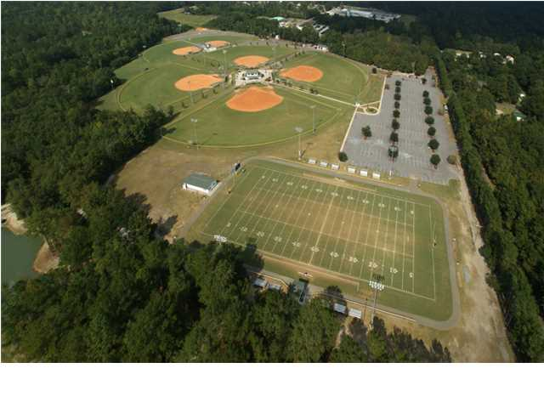
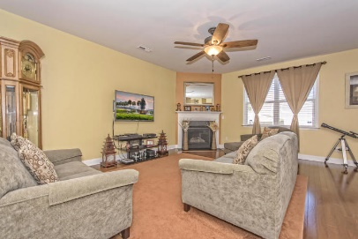
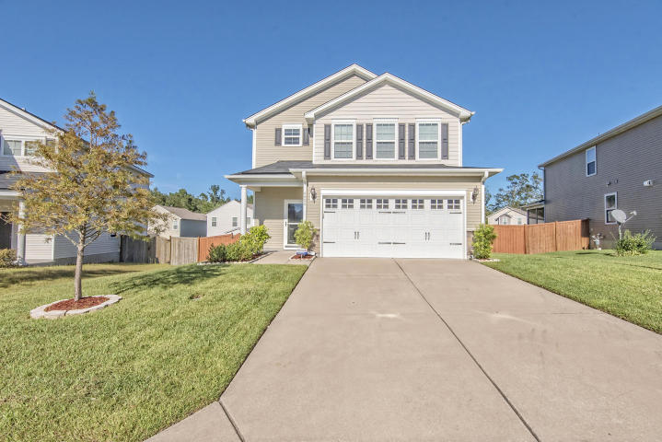
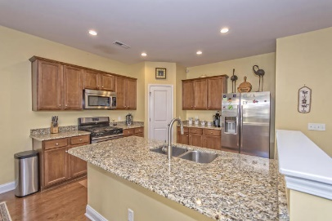
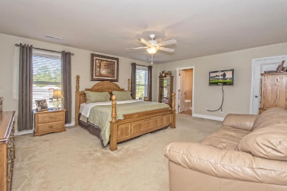
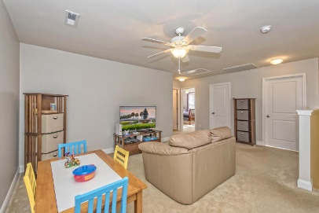
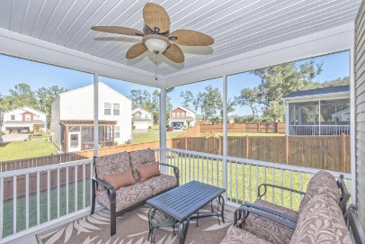
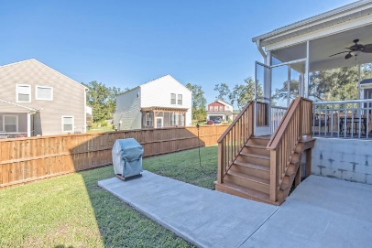
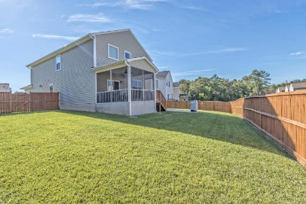


4802 Hawkins Drive
Mckewn | Ladson, SC 29456 | MLS# 16026489 | $235,000
Just Listed!
Open House 10/22 from 1-4
You will love all that this beautifully cared for home has to offer. From the hardwoods throughout the downstairs open floor plan to the separate dining room and spacious great room w/gas fireplace. The kitchen offers loads of cabinets and counter space, granite counters, SS appliances, a breakfast bar plus a large eat-in area. Huge office/den/xtra BR downstairs. Upstairs is a loft that can be used as an informal sitting area/playroom.
Large master suite with plenty of room for a king ensuite. Huge walk-in closet, Bathroom has separate garden tub and shower, Double vanities. Two add'l bedrooms, linen closet and huge laundry room w/room for a sink. Head outside to the elevated screen porch. Seller expanded the concrete patio to add a grilling space. Yard is fully fenced. Great DD2 schools.
Beth Mandell
M 843-900-1296 | O 843-871-2121
bmandell@century21properties.com
www.bestcarolinahomedeals.com
Century 21 Properties Plus of Summerville | 118 W Richardson Ave | Summerville, SC 29483

