Slide 1
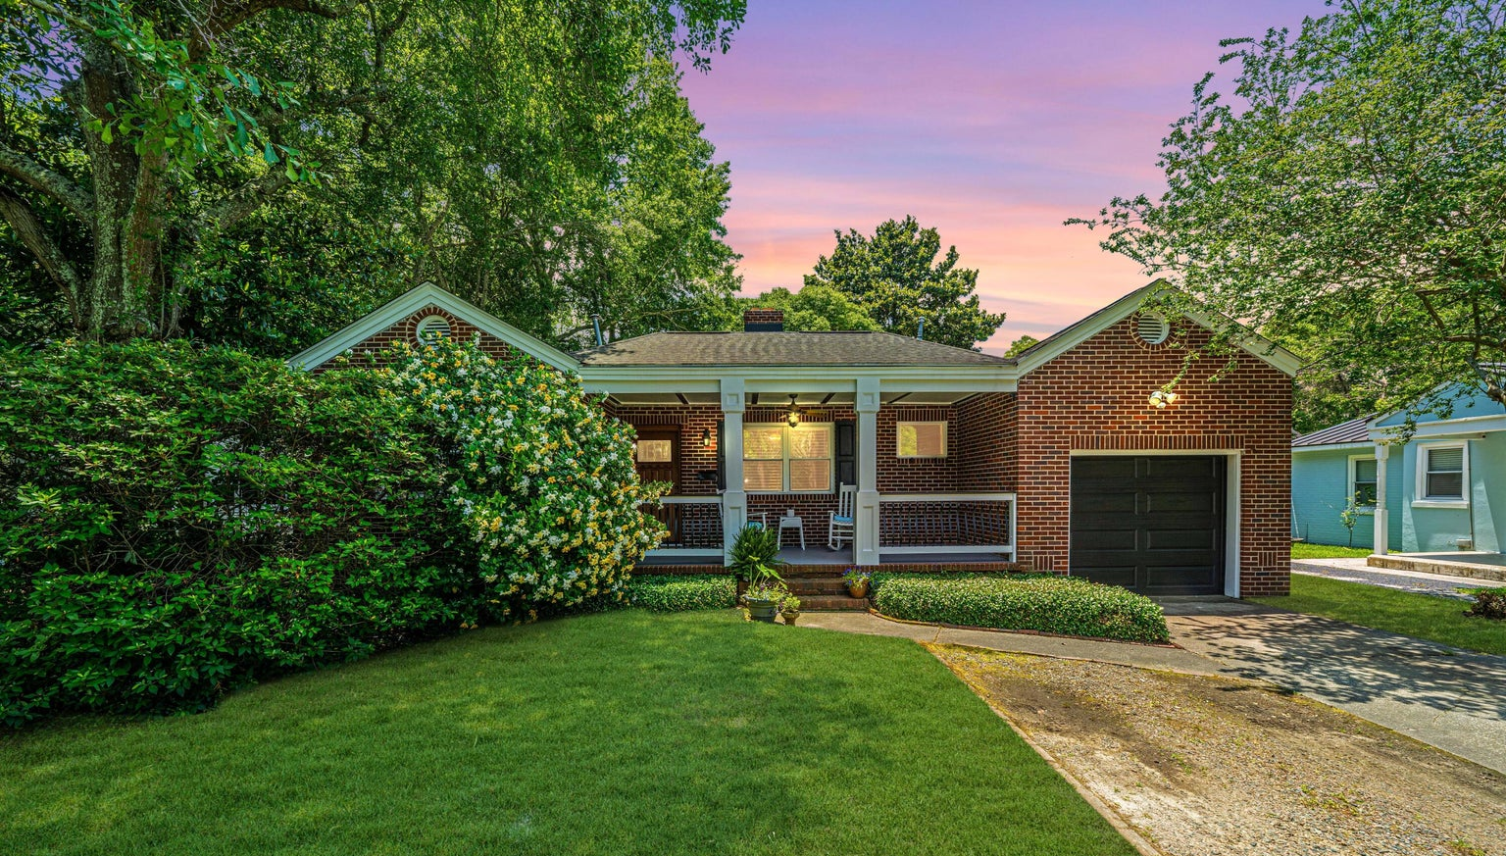
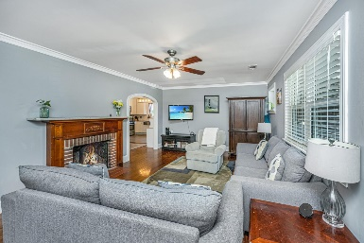
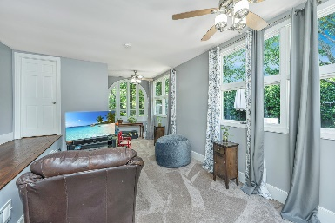
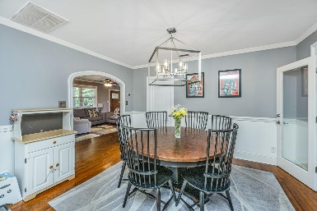
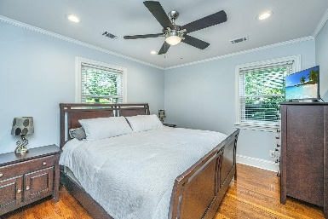
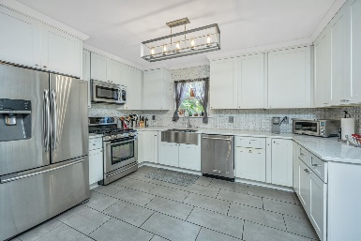
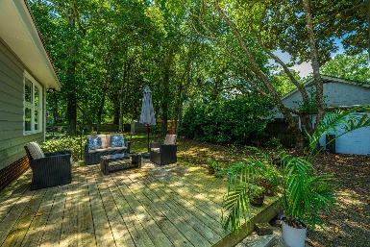


480 Magnolia Road
Carolina Terrace | Charleston, SC 29407
MLS# 24013535 | $675,000
Fantastic New Price!
Welcome to 480 Magnolia Rd, a charming one-story brick home nestled in the highly coveted neighborhood of Carolina Terrace in Charleston. This delightful property boasts 3 bedrooms, 2 full baths, and a convenient 1 car garage. Step inside to discover a cozy family room featuring a wood burning fireplace with a classic mantle, complemented by smooth ceilings and elegant crown molding throughout. The gleaming hardwood floors lead you to the open and renovated kitchen, complete with quartz countertops, a stylish tile backsplash, and a stainless steel gas stove. There is a nice sun room in back and deck in the large fenced in back yard. Home has a newer roof and brand new HVAC unit. Located within walking distance to the vibrant downtown Avondale Historic District, residents can enjoy easy access to an array of shops, restaurants, bars, breweries, and wine stores. Experience the best of Charleston living at 480 Magnolia Rd!!
Drake Herrin
843-729-4692
dherrin@carolinaone.com
www.DrakeHerrin.com
Carolina One Real Estate
873 Orleans Road, Ste 102
Charleston, SC 29407-5753

