Slide 1
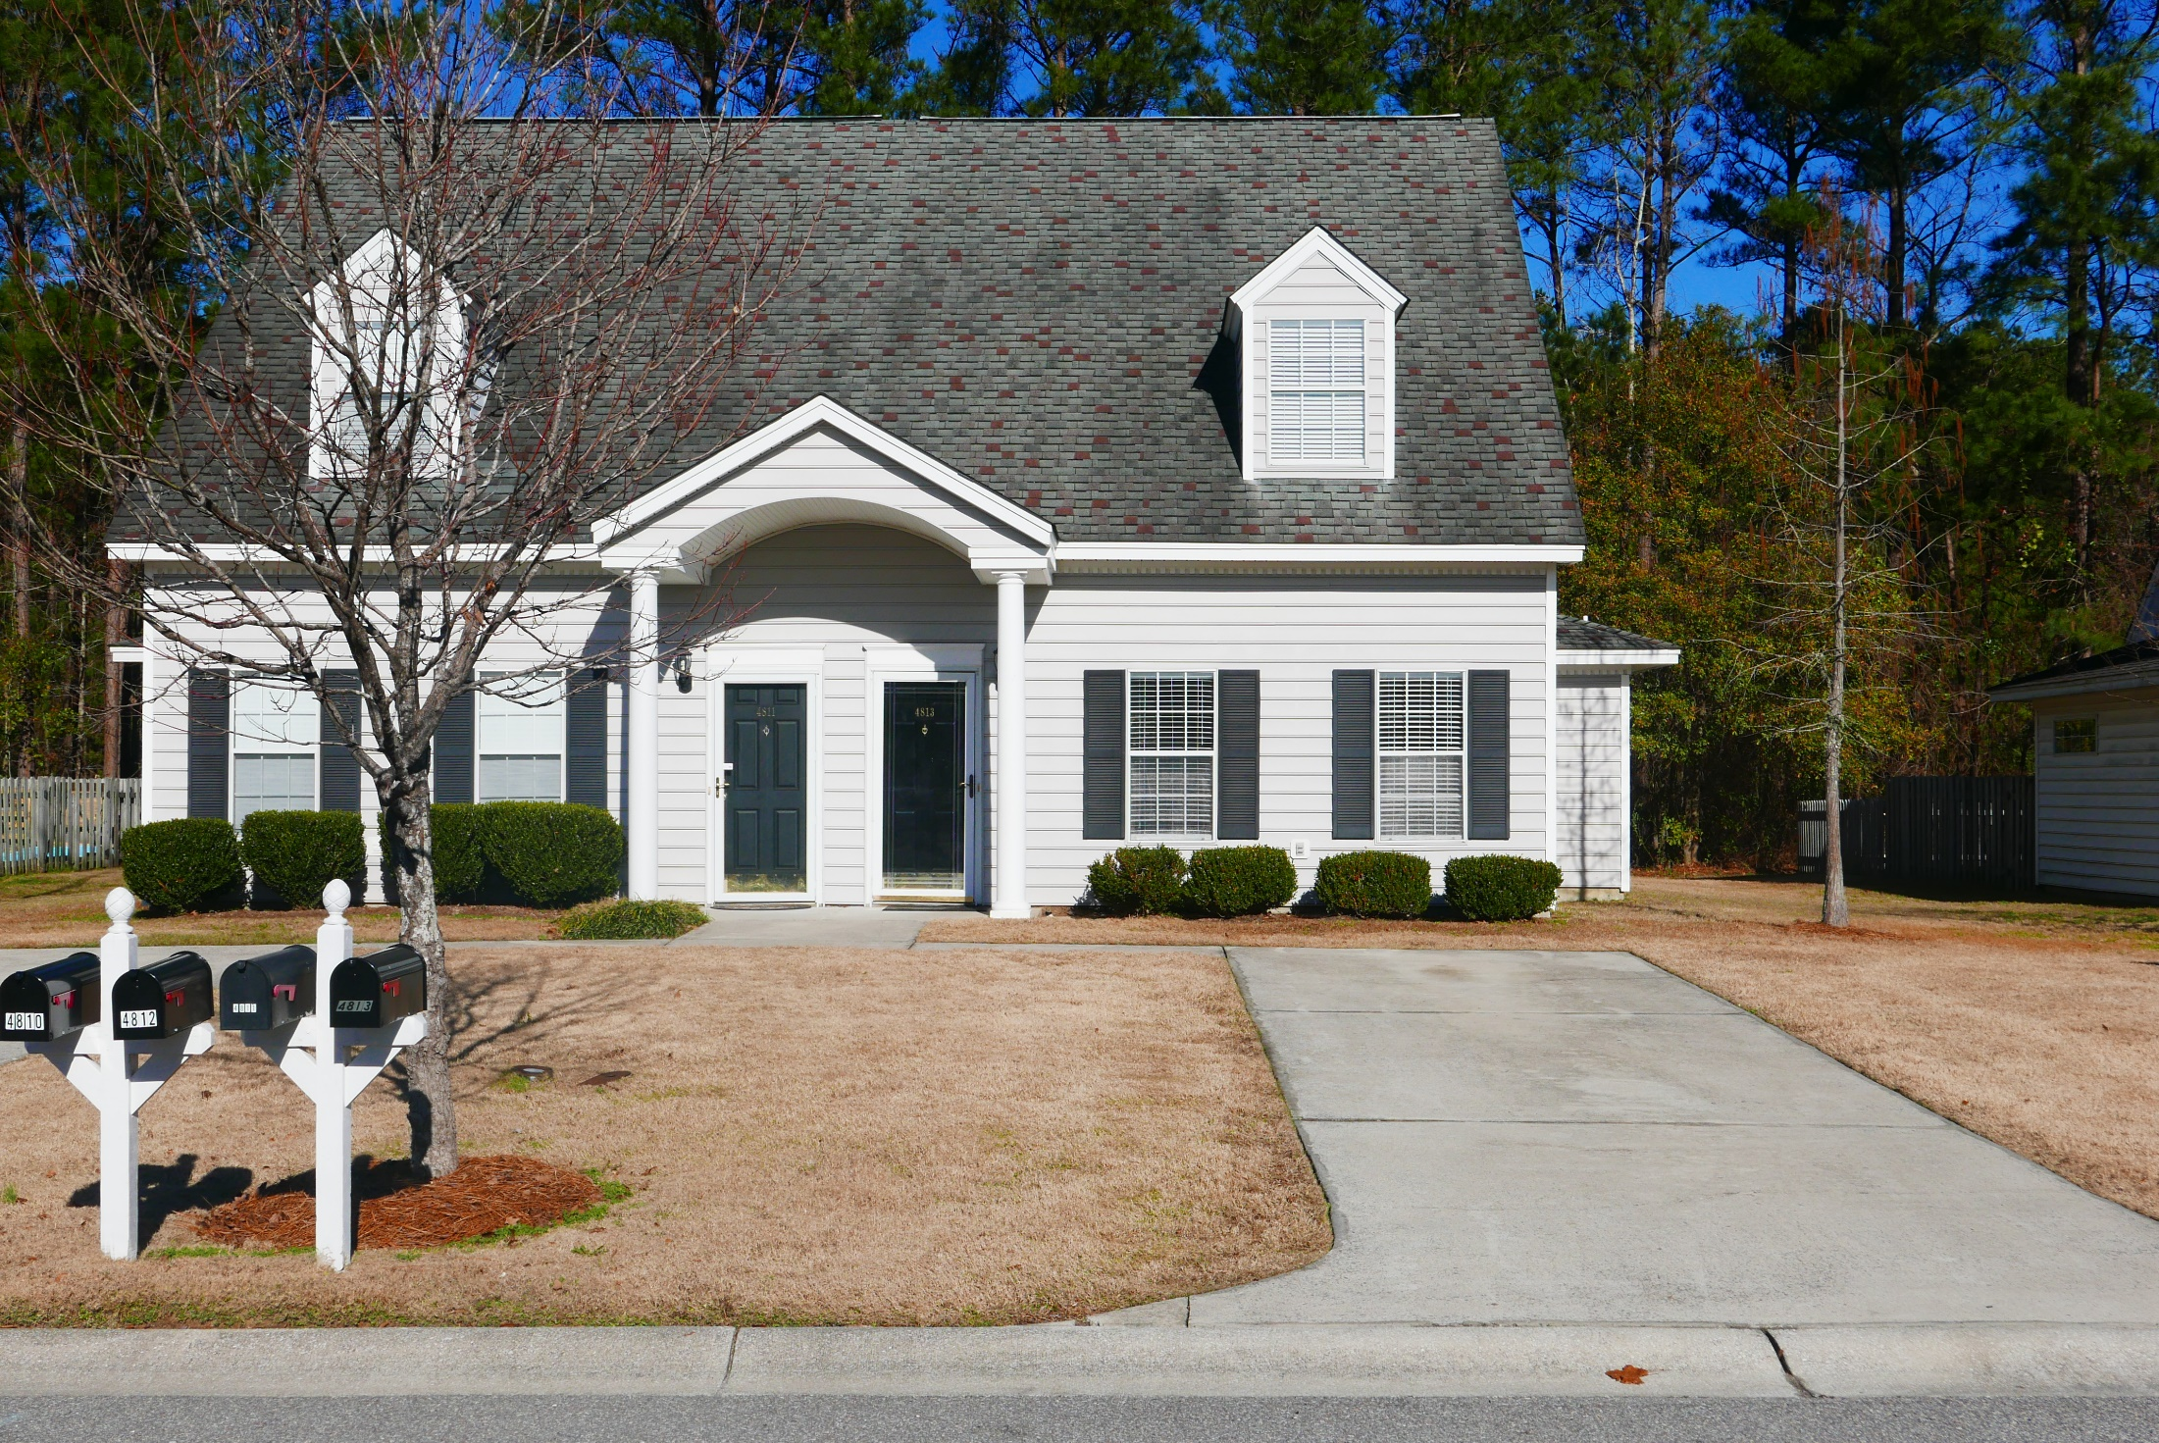
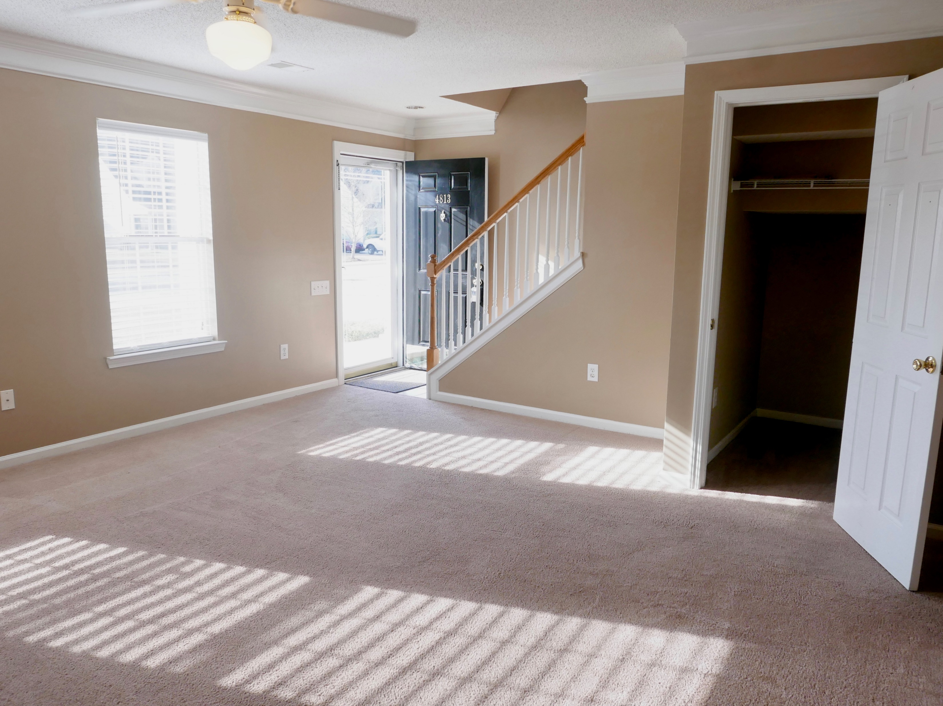
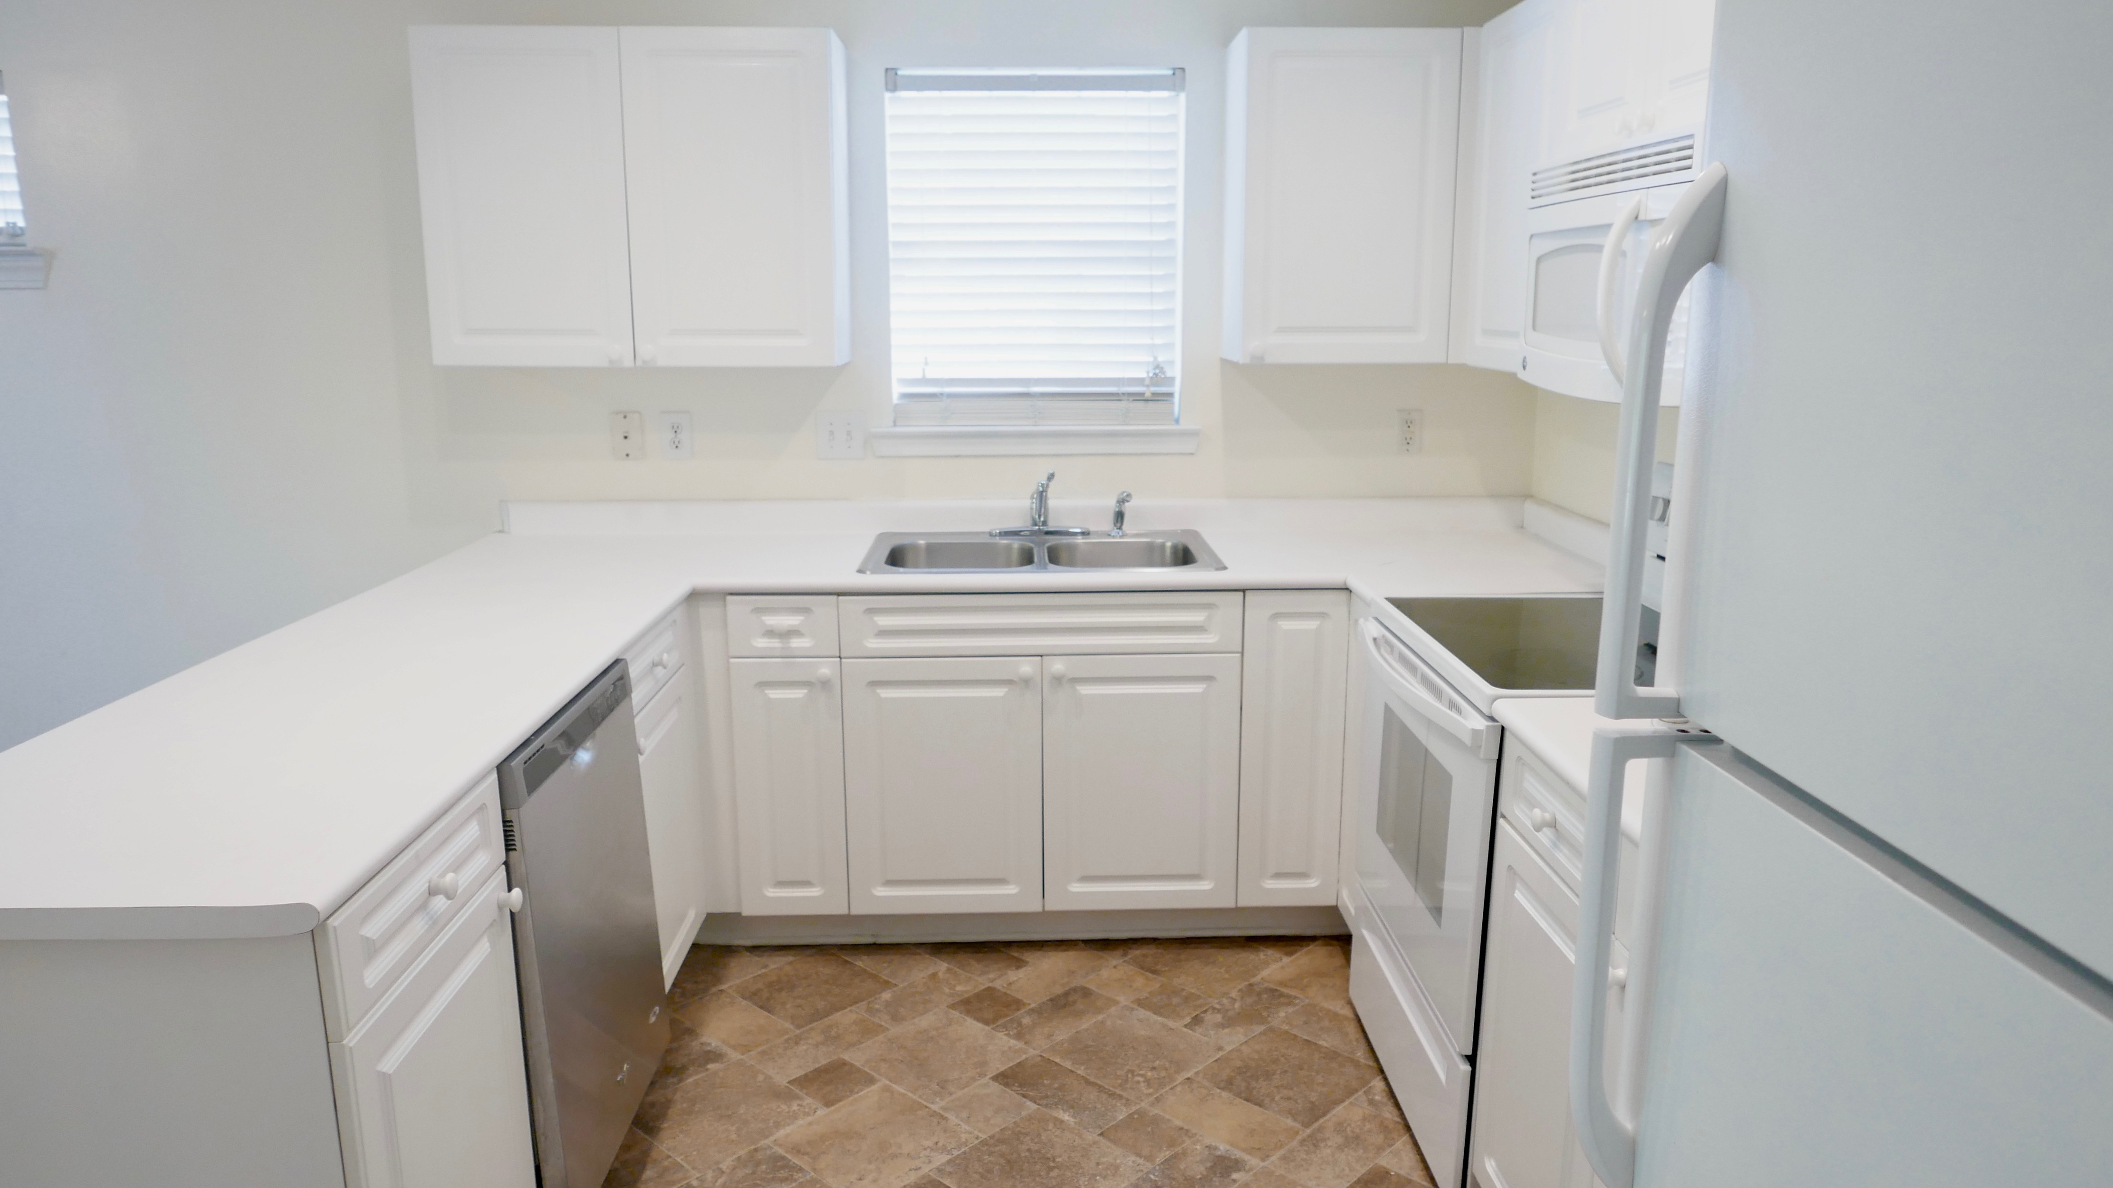
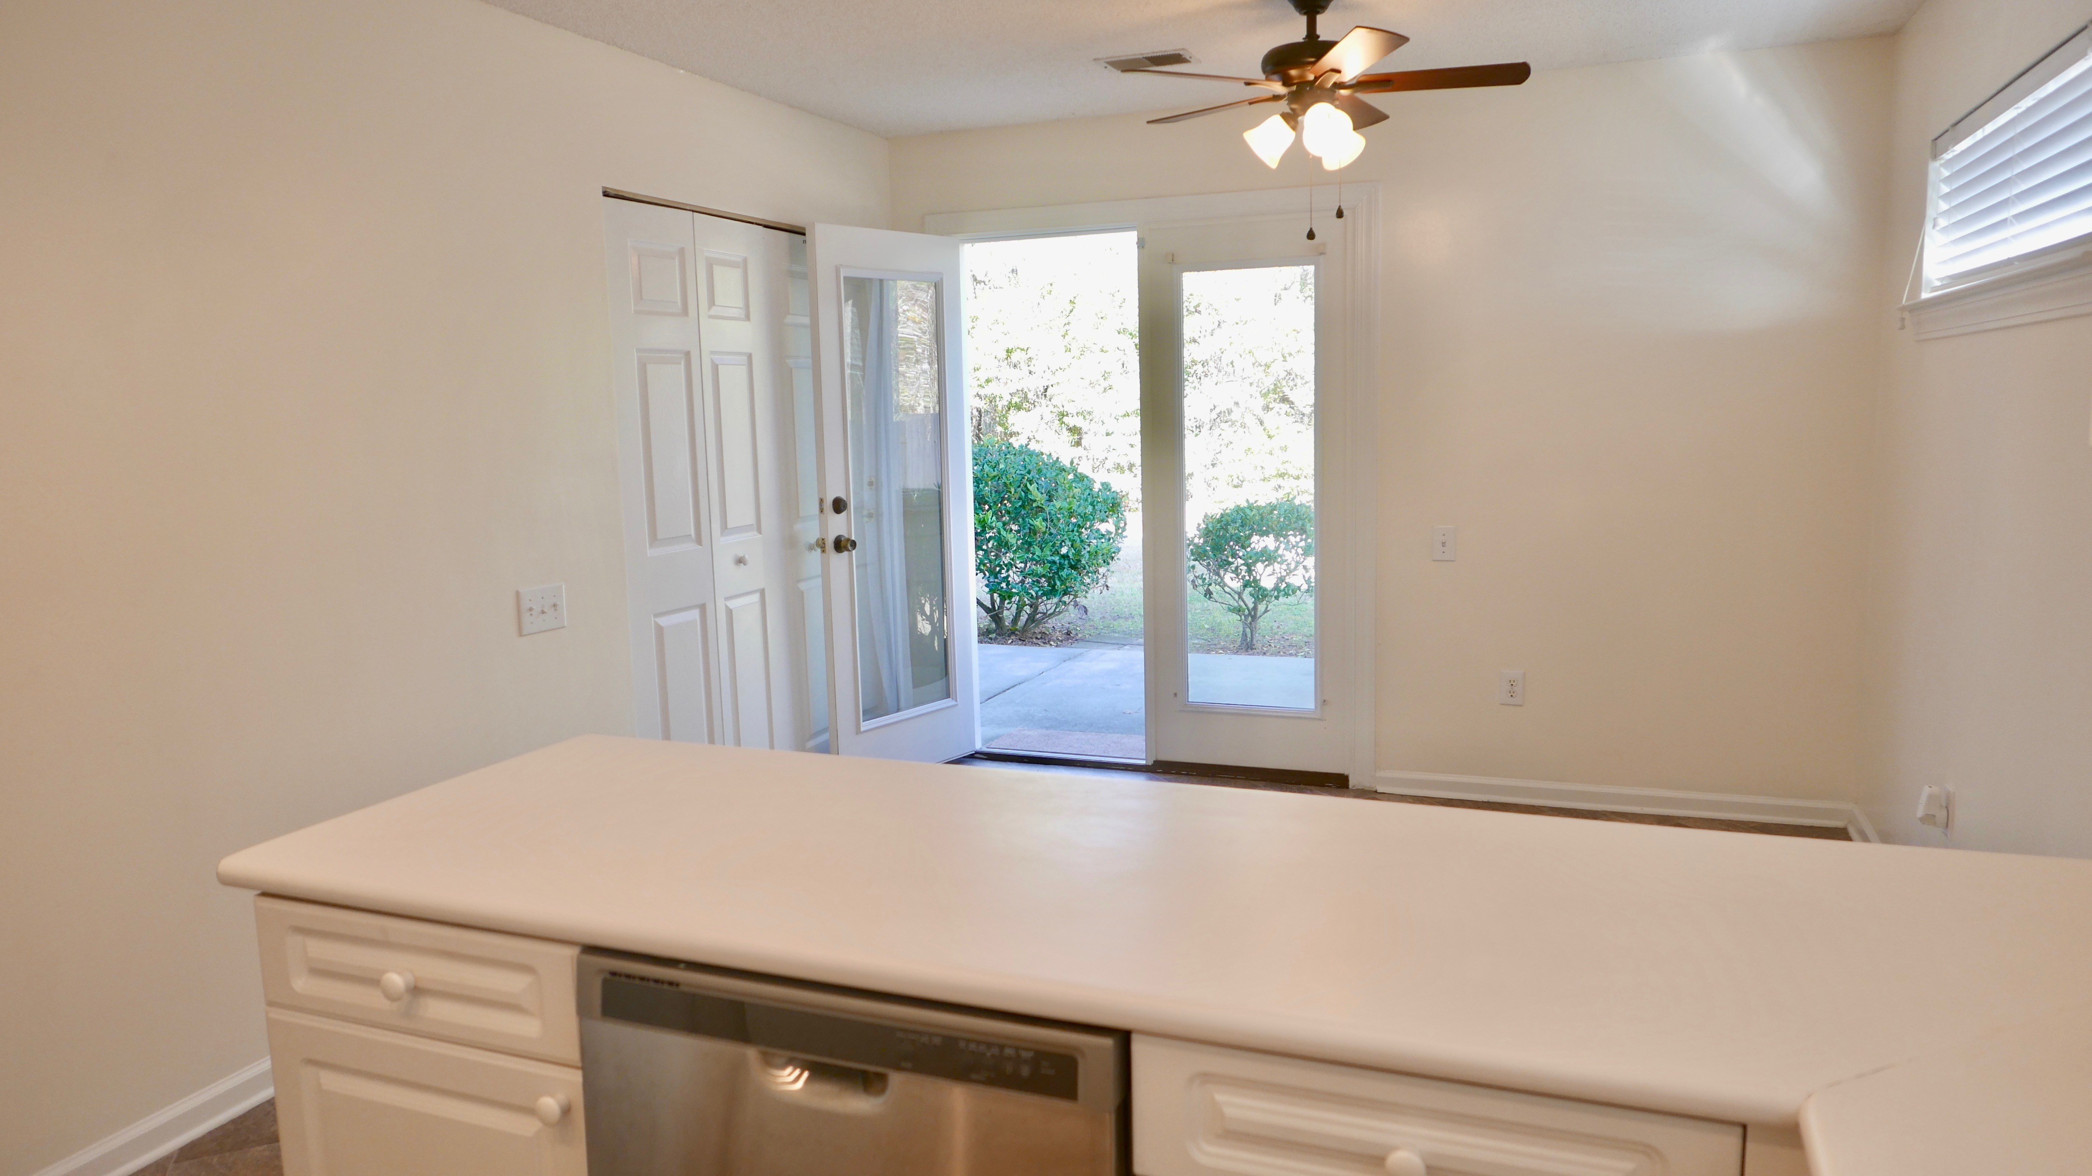
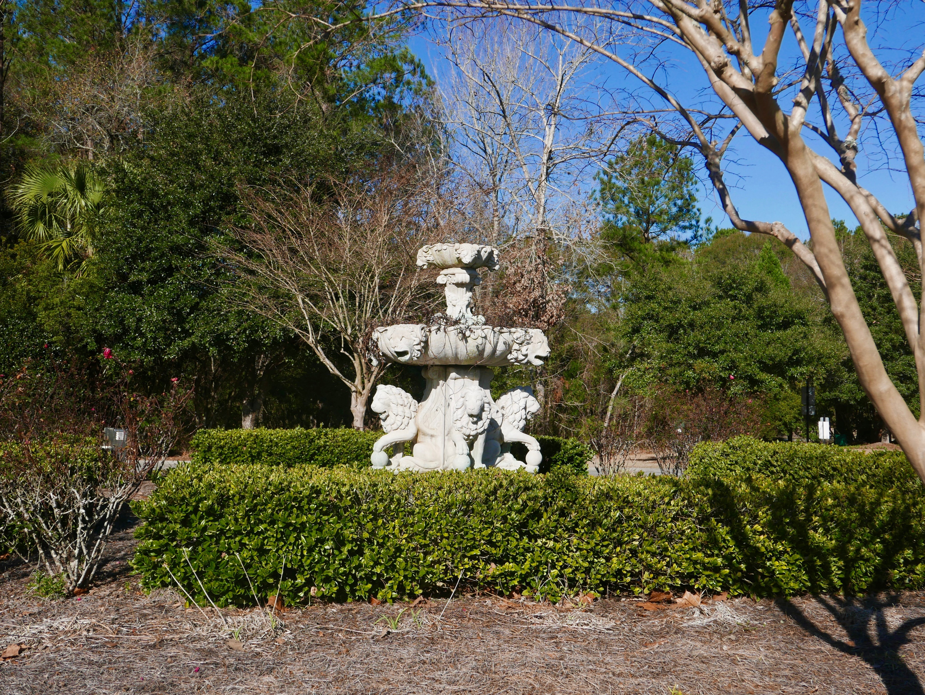


Move-in ready home in
an amazing location
4813 Habersham Lane
Wescott Plantation · Summerville
MLS# 17001041 · $132,000
David Andrews
(843) 452-0113
charlestonda@gmail.com
Close to Air Force Base, Bosch, Boeing, restaurants, shopping. Yard Maintenance is included in the regime as well as pool access!!! This low maintenance 3 BR/2 BA home has a great floor plan with a BR and full BA on 1st floor that could be 2nd master. Kitchen has lots of cabinets and all appliances are included! Off of the eat-in kitchen is a large patio that has a nice feel of privacy. Great storage with two pantries, linen closet, walk-in closets in the bed rooms, and a large closet in the living room. Plenty of attic storage too! HVAC & Smooth Top Range LESS THAN 1 YEAR OLD. Carpet and vinyl less than 2 years old. Super community with miles of great walking paths that are easily accessible. Flood ins available but may not be needed.
AgentOwned Charleston Group
902 Savannah Hwy
Charleston, SC 29407
Real Estate ● Mortgage
Insurance ● Business Brokerage

