Slide 1
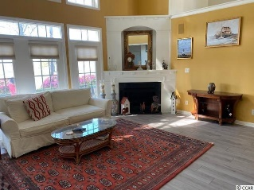
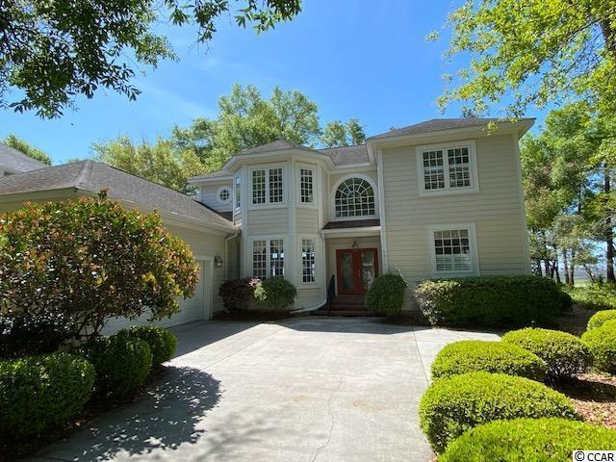
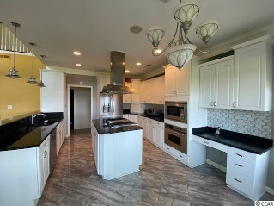
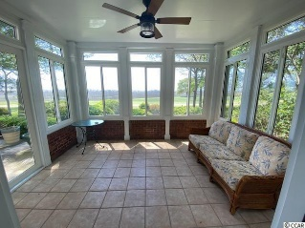
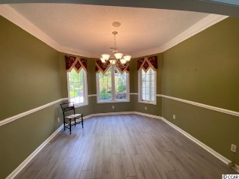
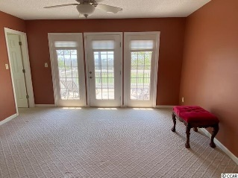
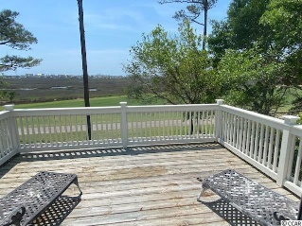
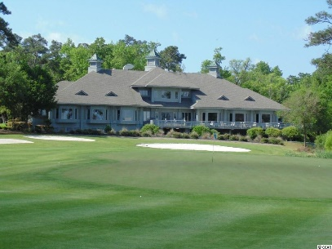
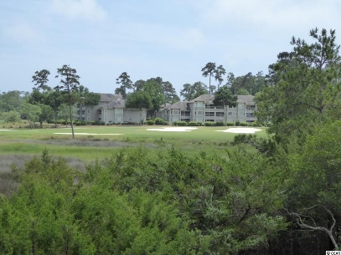
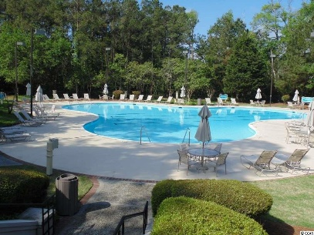
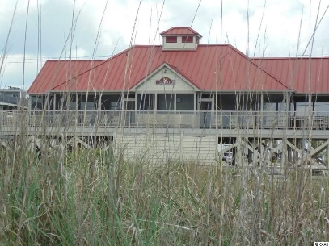
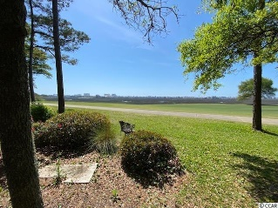
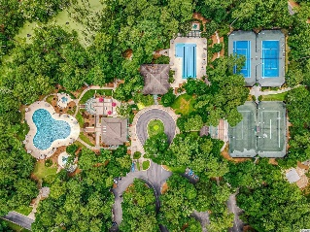
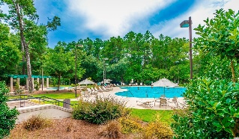
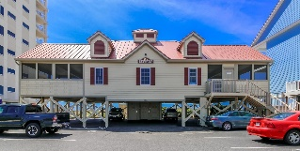


Location…Location…Location…
4814 Bucks Bluff Drive
Tidewater Plantation
North Myrtle Beach, SC 29582
MLS# 2210555 | $799,000
Tidewater Golf Plantation Location, Location, Location located on #4 fairway with views of the tee, fairway and green. Carolina Room off master bedroom is a great spot to relax and enjoy the view, or set on your porch and watch the sunrise and feel the ocean breeze. Located on marsh with glimpse of Atlantic Ocean from the upper deck. There are views from almost every room, kitchen, living room, Carolina room, office, library, upstairs bedroom deck, and patio. This home offers first floor master suite, fireplace and great room with soaring ceiling. Included are a spacious garage with 220 electric, a laundry room, a pantry, updated appliances, washer and drier, and dual heat pumps. For those not familiar with Tidewater, it is a fabulous sought after community. Included are multiple pools, four tennis courts/pickle, ball courts, bocci courts, horseshoes, a full workout center, amenity center, library, and an administration center. Tidewater has 24 hour security with manned guard house. Tidewater is an outstanding community in the great city of North Myrtle Beach. Tidewater has ocean front beach cabana which has screened porch, open decks and bathrooms, with ample parking for the use of homeowners only.
Donna Fortney 703-624-3517
dofortney@aol.com
Robert Jacoby 843-455-7075
rcjacoby@aol.com
NEW WAY PROPERTIES MYRTLE BEACH

