Slide 1
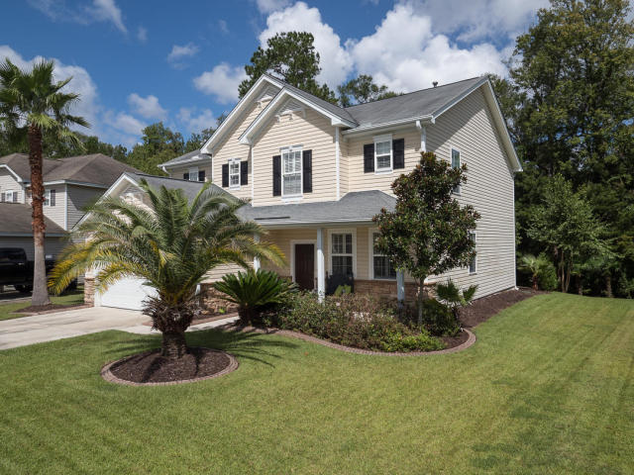
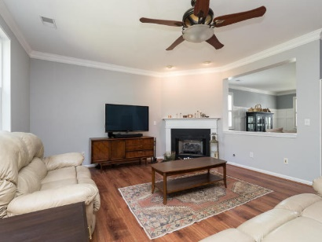
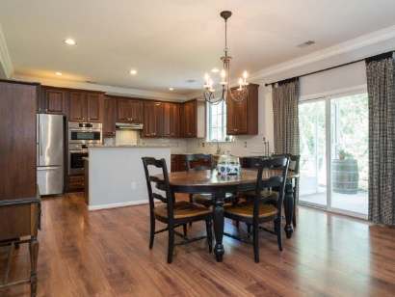
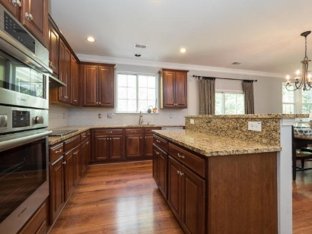
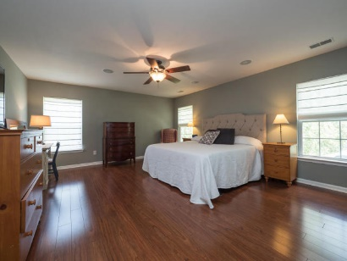
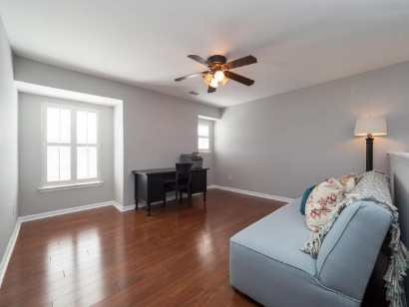
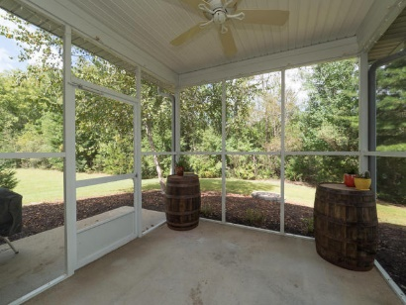
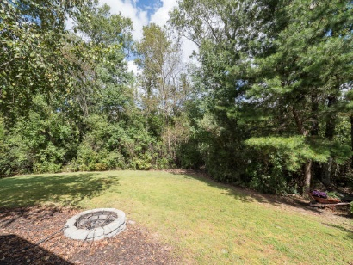
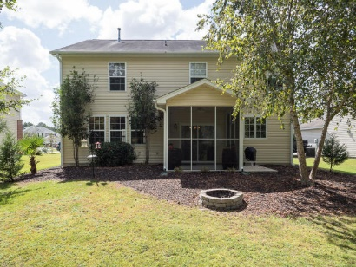

4817 Gilpen Court
Summerville ~ MLS# 17027813 ~ $285,000
3 Bed ~ 2½ Bath ~ 2,535sf
Wescott Plantation- Open House Sat & Sun
October 14th & 15th ~ 1-4pm Both Days
Open House Saturday & Sunday 1-4
Donna Landry
Mobile - (225) 921-2111
donna.landry@cbcarolinas.com
Betsy Sarsfield
Mobile - (843) 608-1048
betsysarsfield23@gmail.com
Coldwell Banker Residential Brokerage | 35 Broad St | Charleston, SC 29401 | www.thebestincharleston.com

