Slide 1
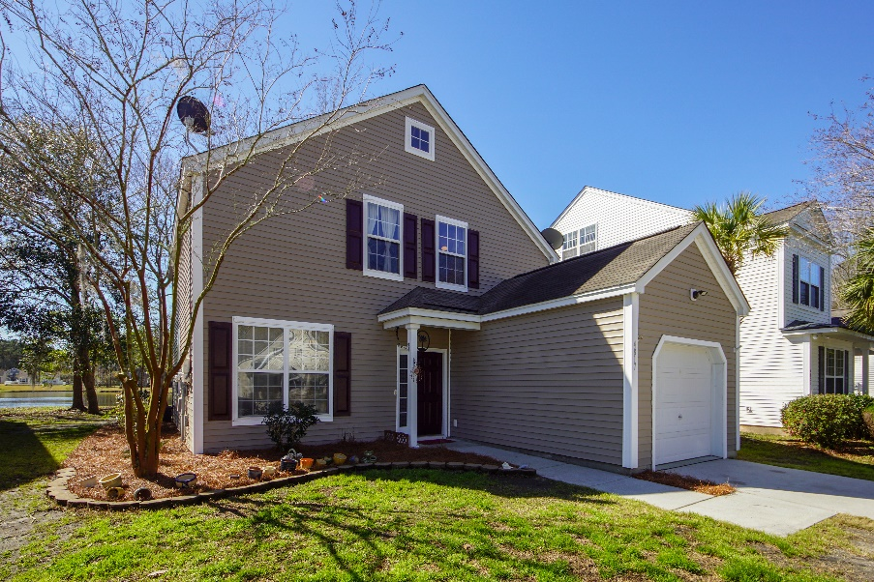
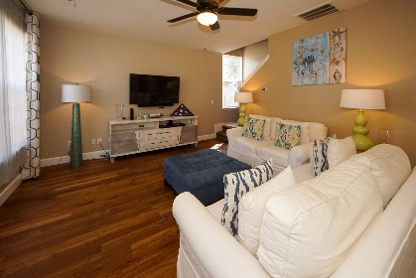
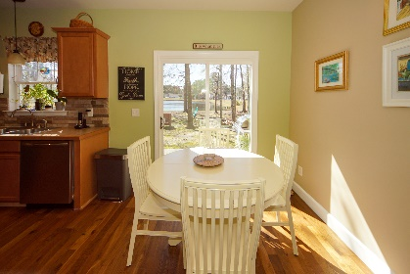
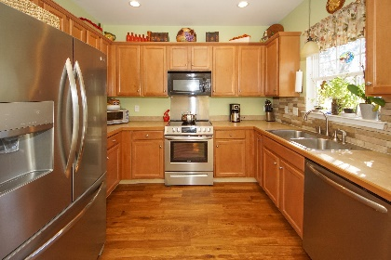
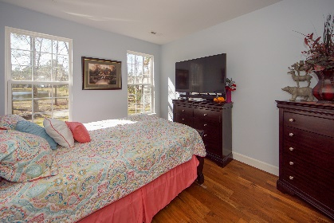
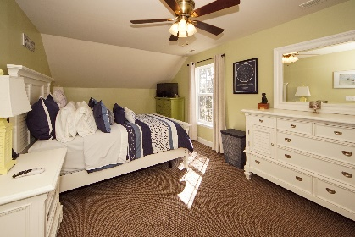
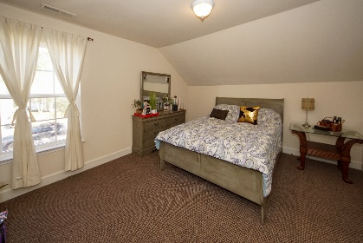
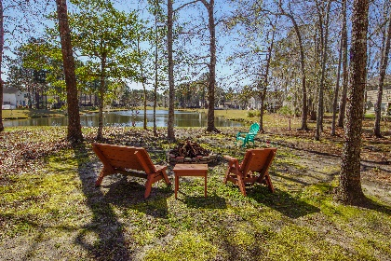
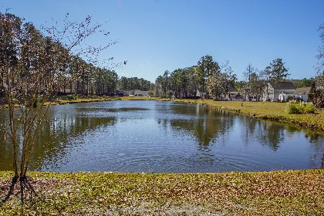




Open House Saturday From 11:30-2:00 Agents: Send Your Clients, They Will Be Protected!
4817 Oak Haven Place
Wescott Plantation
Summerville, SC 29485
MLS# 20005700
$247,000
4 Bedrooms :: 2½ Baths :: 1,752 sf
This move in ready home is in AWARD WINNING Dorchester 2 School District surrounded by shopping and dining! Energy Efficient Solar Panels! New free floating hardwood floors and a spacious bright living room. New 6'' craftsman baseboards have been installed in the home. There are smooth ceilings throughout the home, and new porcelain tile in all bathrooms! The eat in kitchen features stainless steel appliances, a window over the sink overlooking the pond, and plenty of storage, with a pantry. The first floor master boasts sunny windows, walk in closet and bathroom! Upstairs you have a 2nd master and 2 more large bedrooms! The stairway, upstairs landing, and all bedrooms have brand new berber carpet. Out back you have a stunning backyard with a patio, fire pit, and wide views of the lake.
Enjoy energy efficiency with a new solar panel array! Seller has also recently installed a brand new Pella sliding glass door at the back of the house and an "Insinkerator" garbage disposal at kitchen sink. Wescott Plantation is a beautiful community with many amenities. The Farm at Wescott Plantation has on site boat storage and a beautiful community pool!
Eric Draper
(843) 442-7118
eric.draper@gmail.com
Jon Moore
(843) 732-3365
jon@charlestonrealestategroup.com
www.charlestonrealestategroup.com
Charleston Real Estate Group | 443 Folly Road | Charleston, SC 29412

